Slide 1
COD Urban Agriculture Division
Comprehensive Urban Agriculture Plan
July 2023
Rabekha Siebert, UA Coordinator
Yaritza Torres, UA Coordinator
Office of Environmental Quality & Sustainability
City of Dallas

Slide 2
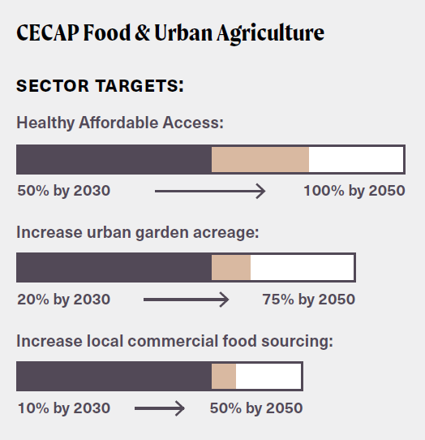
Dallas Comprehensive Urban Agriculture Plan
The Comprehensive Urban Agriculture Plan (CUAP) is housed in Office of Environmental Quality.
Purpose: Set path towards CECAP Goals
Goal 7: All Dallas Communities have access to healthy, local food
Urban agriculture generally refers to the cultivation, processing and distribution of agricultural products in urban and suburban settings, including things like:
Vertical, Warehouse, or rooftop farms
Community gardens and urban farms
Hydro, aero, aquaponic facilities
Notes:
Hello & Self introduction
so glad to be here with y’all tonight, thank you for setting aside part of your evening for me to share the comprehensive urban agriculture plan with you. So I’m just going to do a brief overview and let you know where we are at with the plan.
So this plan comes from Dallas comp environ Climate Action Plan, during climate planning in 2020 access to “healthy Local Foods” was identified as a critical issue. So through that process All Dallas Communities having access to healthly, local food, became goal 7 of the City’s climate action plan.
& The Purpose of the Urban Agriculture plan, that I am talking to you about tonight, is to set path towards achieving that goal, and it’s sector target listed here on the right.
So what are we talking about when we say urban agriculture, really that just means food grown in the city, which includes processing and distribution of food grown here in Dallas, and that can be grown in many different ways including vertical, warehouse, or rooftop farms, community gardens, hydro, aero, or aquaponic facilities.
Next slide.

Slide 3
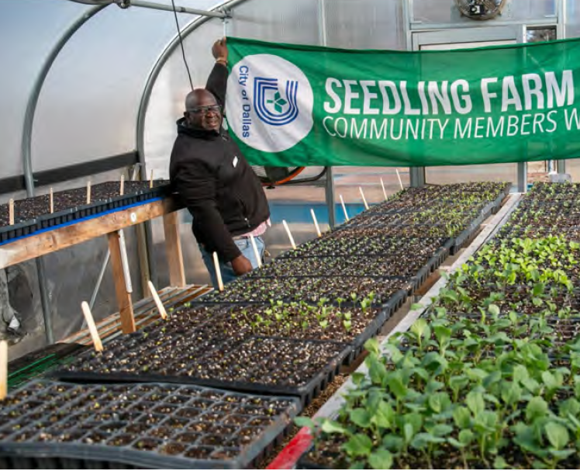
Dallas Comprehensive Urban Agriculture Plan
A long-term framework to build organizational capacity and partnerships around the urban agriculture ecosystem
Helps lay the groundwork for the next 5-10 years of UA development in Dallas by recommending:
a range of ordinance updates,
program development activities
equitable resource distribution
to ensure COD reaches and exceeds CECAP targets listed in Goal 7
Notes:
So what is the Comprehensive Urban Agriculture Plan?
It’s a framework to build capacity and partnerships around Dallas’ Food system, it helps lay the groundwork over the next 5-10 year for UA development in dallas by recommending:
A range of ordinance updates,
Program development a
And equitable resource distribution

Slide 4
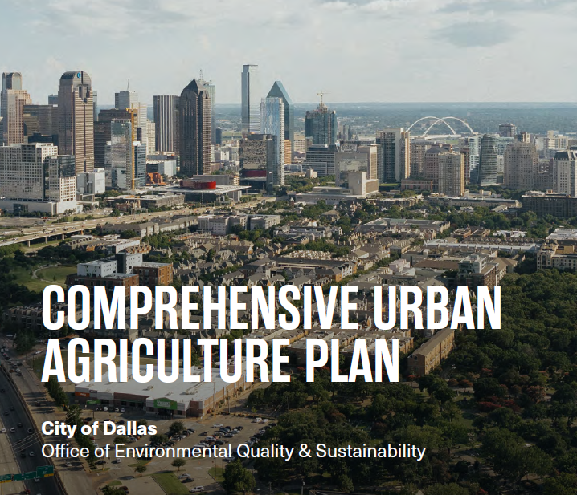
Dallas Comprehensive Urban Agriculture Plan
The Comprehensive Urban Agriculture Plan focuses on five key recommendations, each encompassing several solutions and action items:
Reduce Regulatory Barriers
Support Land Access
Provide Urban Agriculture Education, Resources, and Support to Dallas Residents
Facilitate Collaboration and Partnerships Among UA Stakeholders
Build Market Opportunities
Notes:
The Comprehensive Urban Agriculture Plan focuses on five key recommendations, each includes several solutions and action items, the 5 recommendation are listed here,
The first is to reduce urban agriculture regulatory barriers
Support land access
Provide urban agriculture education and resources to support dallas residents
And the last 2 are to facilitate collaboration and partnerships among urban agriculture stakerholders
And the 5th is to build market opportunities
Next Slide

Slide 5
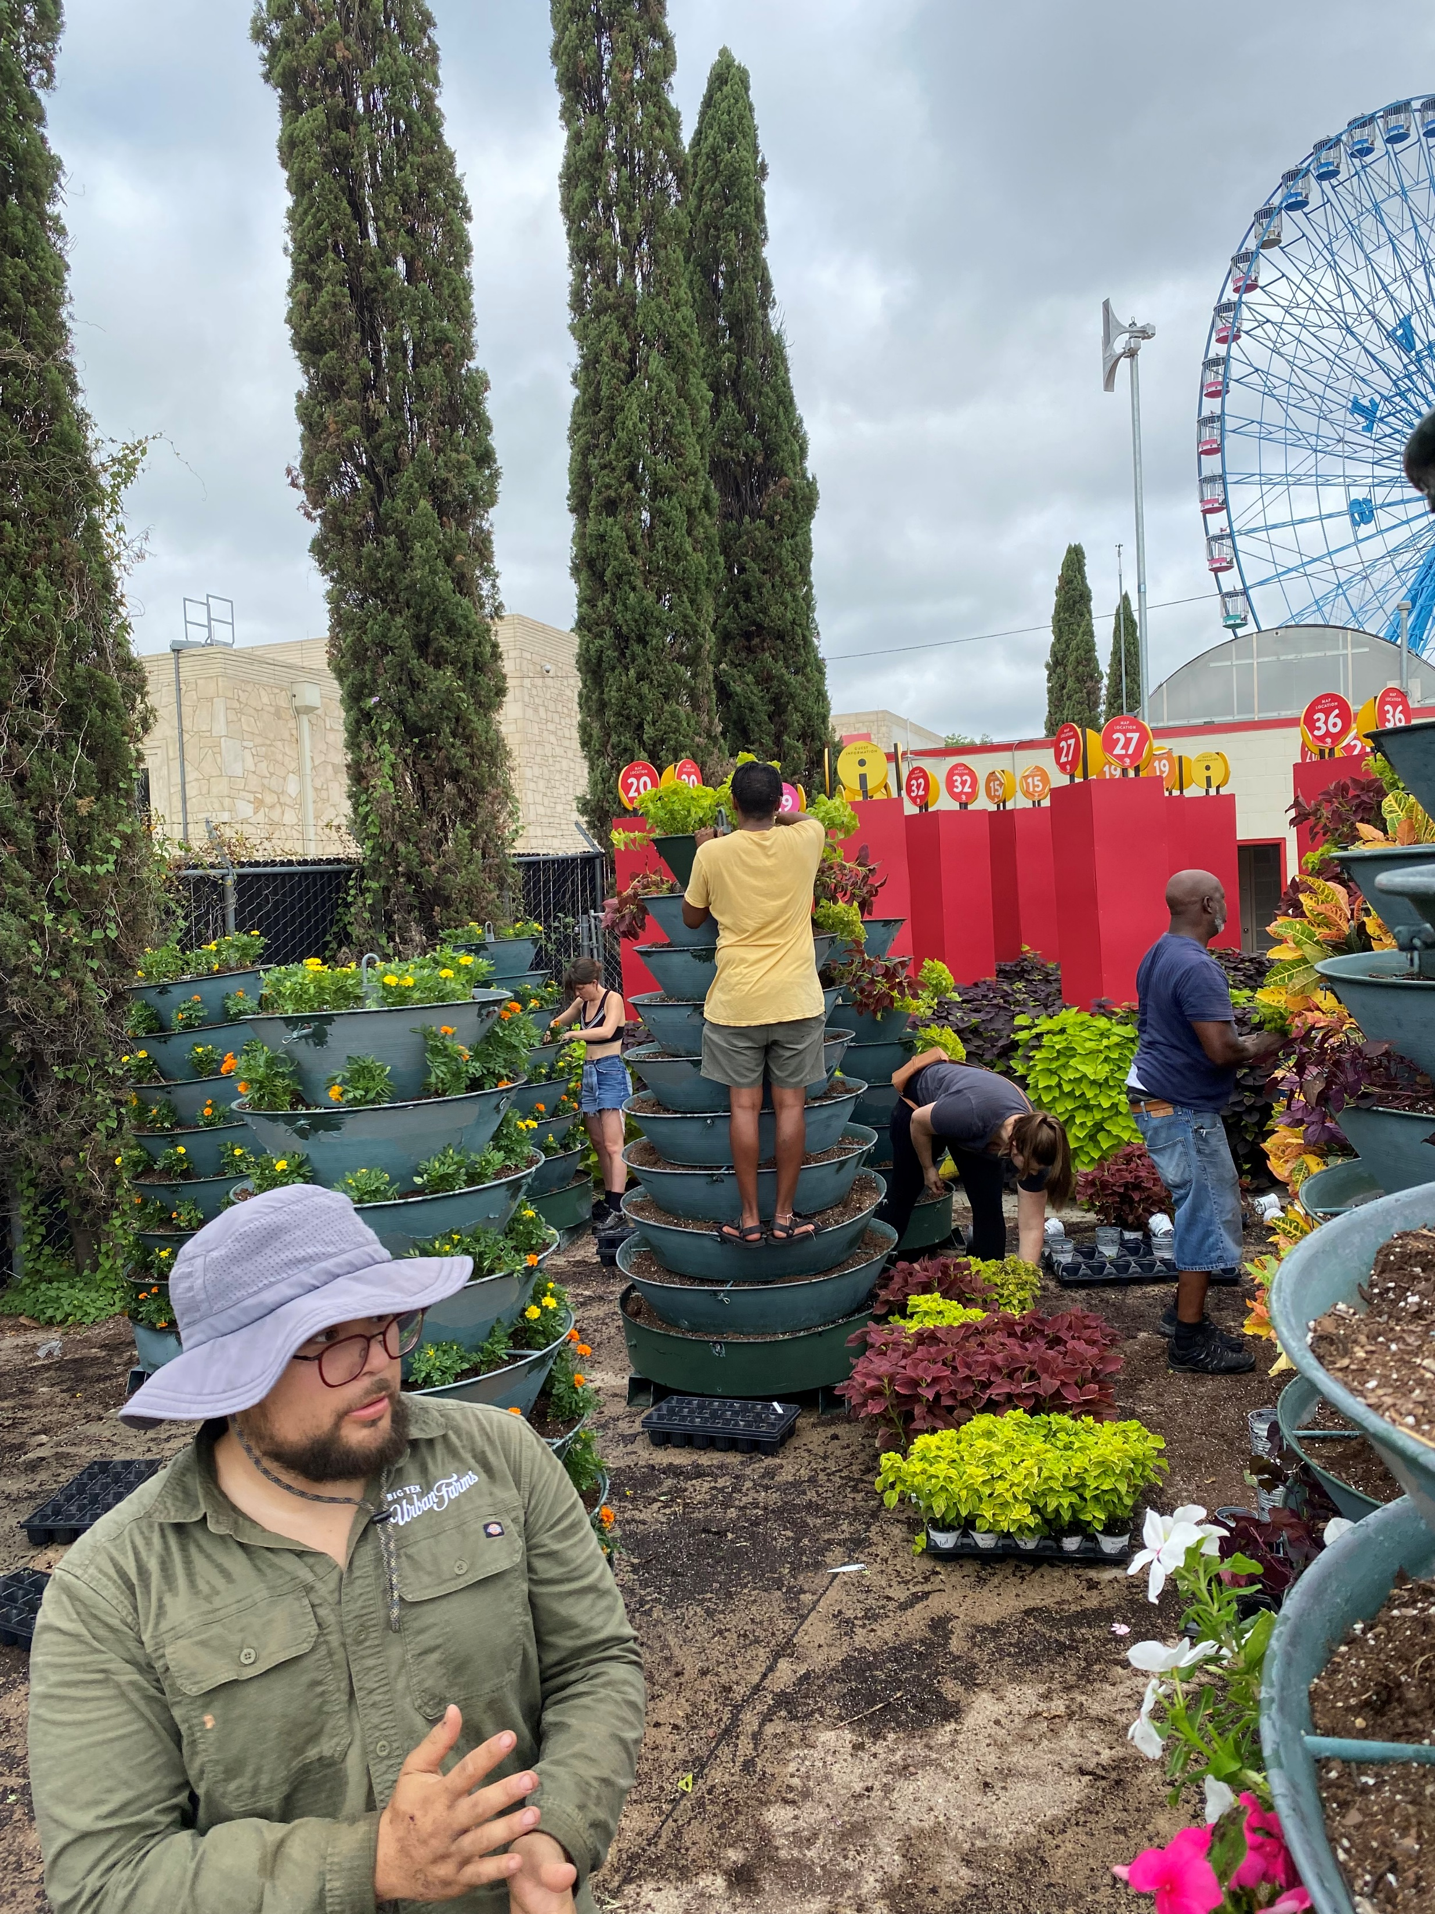
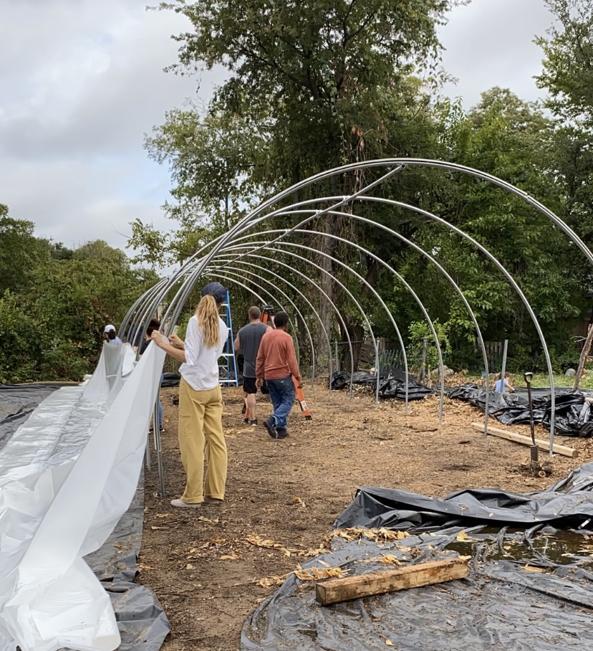
Urban Agriculture Program
Comprehensive Urban Agriculture Plan (CUAP)
Supports CECAP Goal #7: All Dallas’s Communities Have Access to Healthy, Local Food
Prioritizes access through urban agriculture production
Includes a GIS Web App that shows Urban Ag priority areas based on the Social Vulnerability Index, vacant land, and activity generators
Grow With Us Programs
Virtual Speaker Series
Monthly Field Days: Onsite volunteer opportunities to support urban farmers in feeding and educating the public
DIGS (Dallas Inner-City Growers’ Summit): Building Resilient Food Systems - Spring 2023
Urban Agriculture Engagement Network

Slide 6
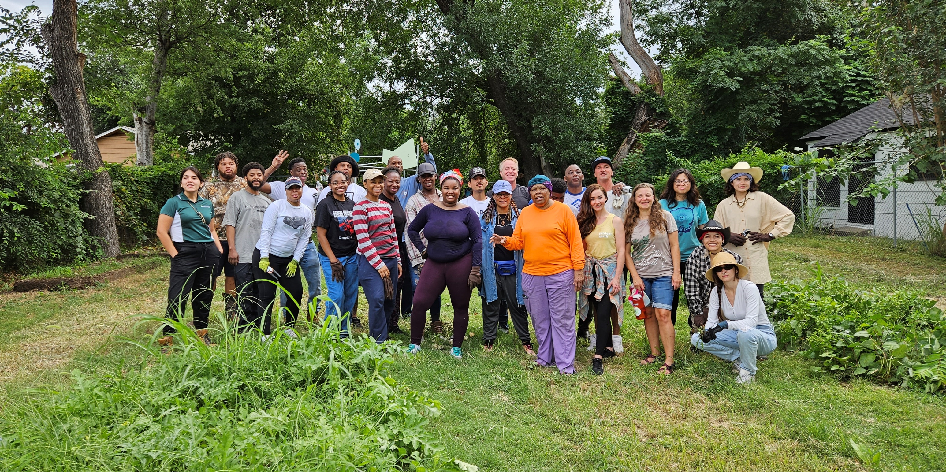
Revitalization Project: Sunny South

Slide 7
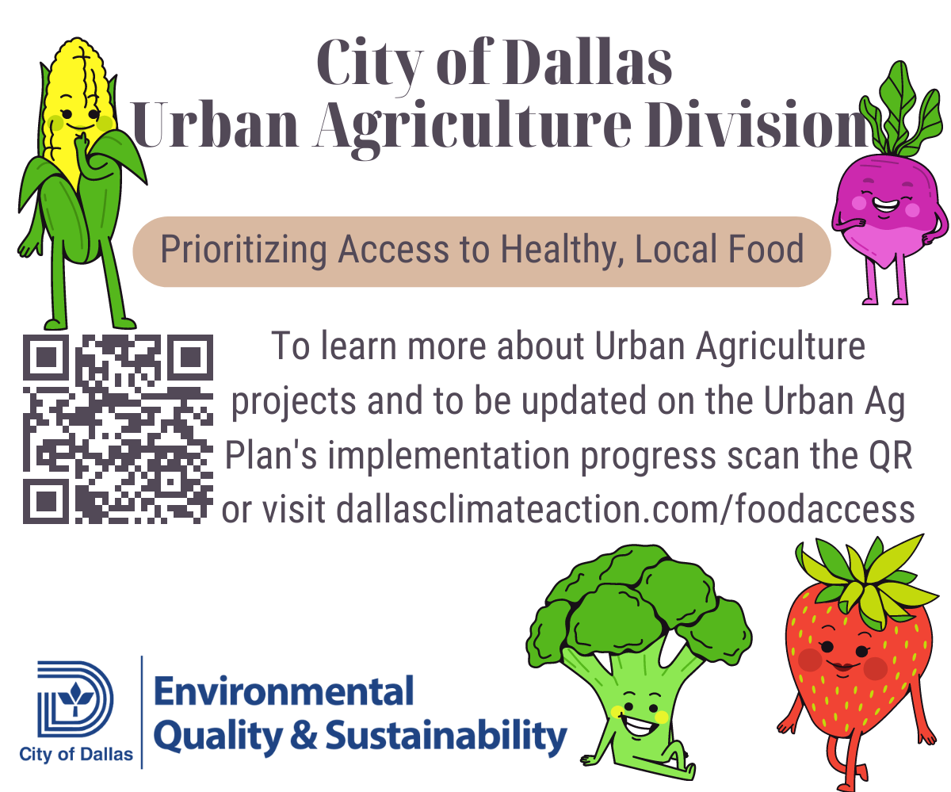
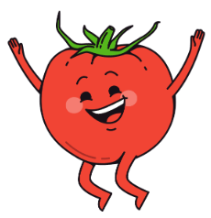
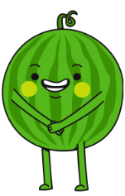
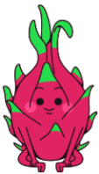
Connect With Us
Rabekha.Siebert@dallas.gov
Yartiza.torres@dallas.gov
Notes:
So the primary directives of this plan are to increase local food production, food access and local commercial food sourcing through increased UA production.
In closing, I encourage you to scan the QR code or visit Dallasclimateaction.com/foodaccess, the full plan can be viewed here, as well as you can sign up for the Dallas Urban Agriculture newsletter to stay up to date. & lastly the plan will be going to City Council for adoption on February 22, so stay tuned for more to come.
And with that we can go to our next presenter with the Whole Home Dallas Program.

