Slide 1
Urban Agriculture & Communities of Faith
Claire Howell

Slide 2
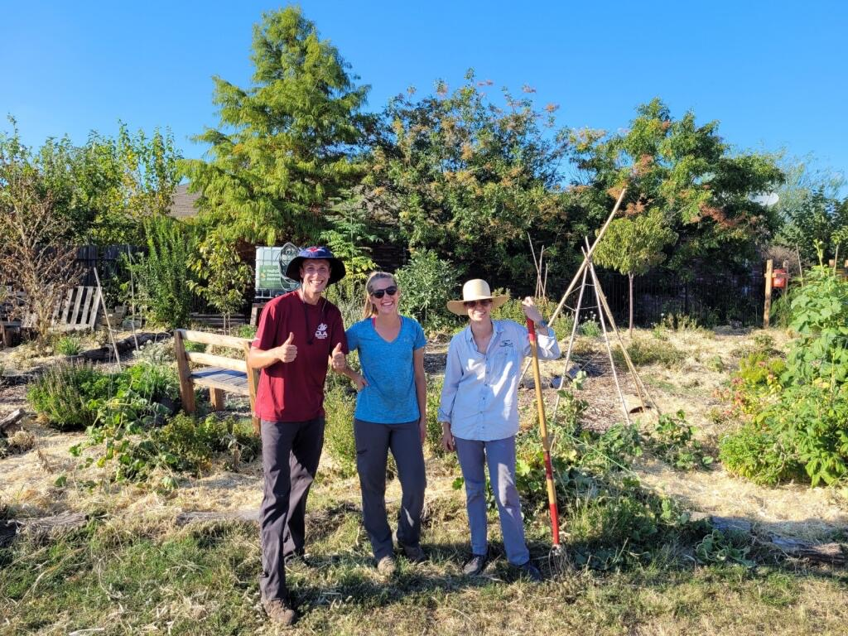
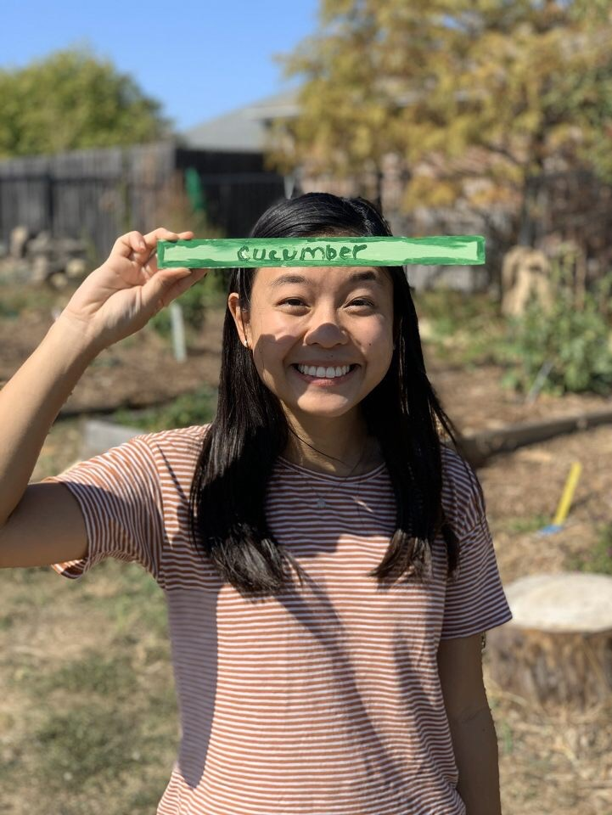
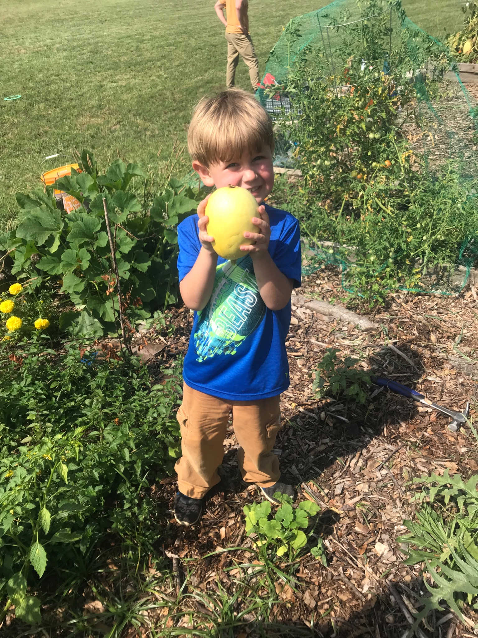
My Work
Director of Creation Care Ministry at Disciple City Church
Co-Founder of Eagle Ford Community Garden
Owner of Balcony Box, LLC

Slide 3
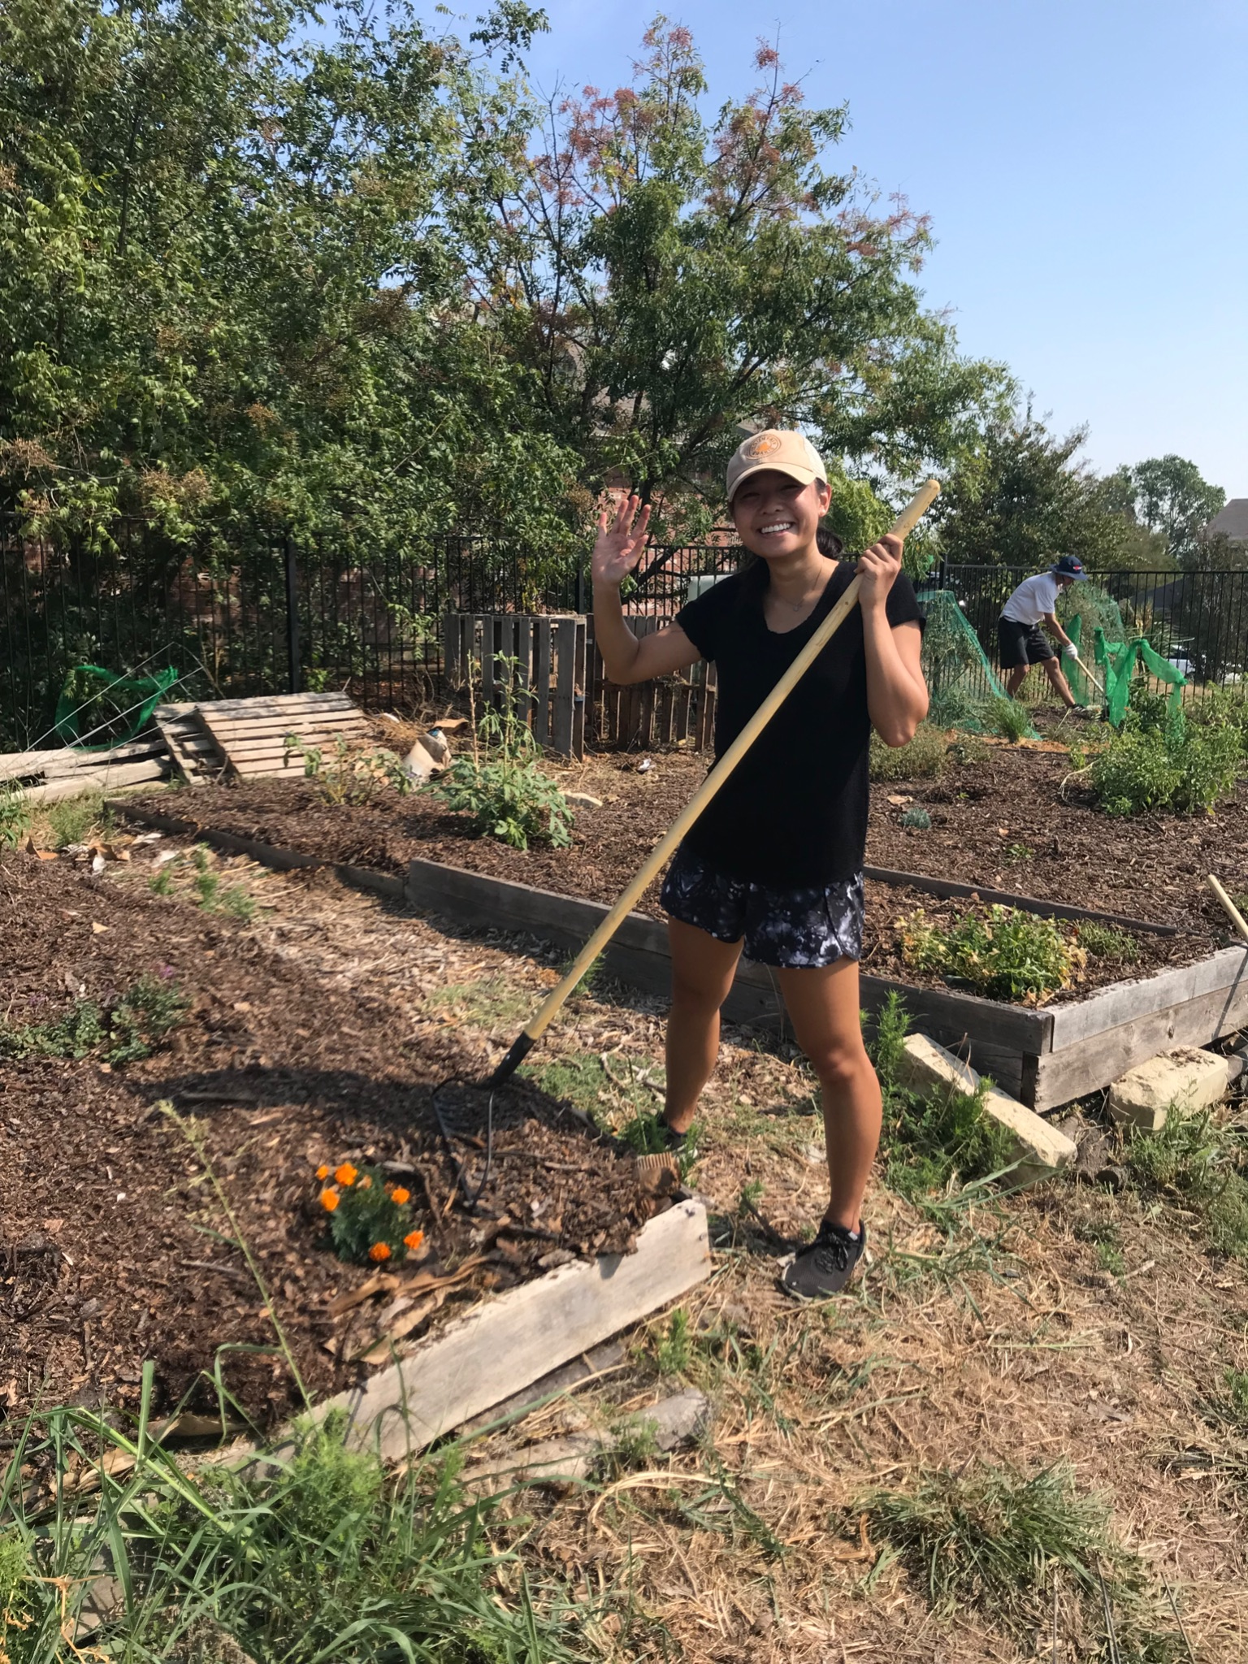
Why Urban Agriculture?
Urban Agriculture gives your congregation an opportunity to build up your community by creating:
A safe & vibrant green space.
A community gathering spot for people of all backgrounds.
Access to nutritious food.
Skills & education for people to grow & cook their own food.

Slide 4
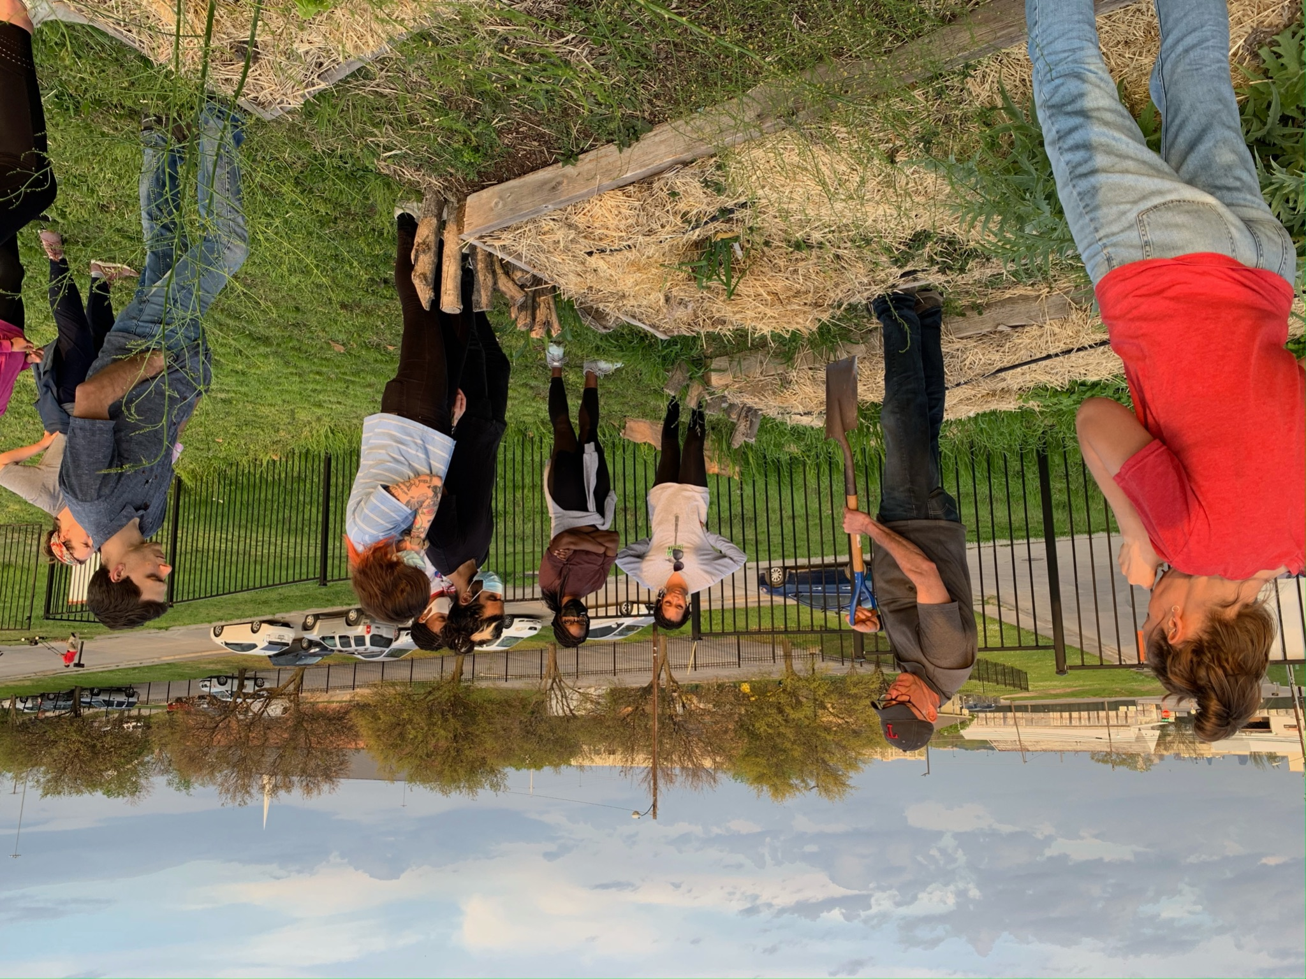
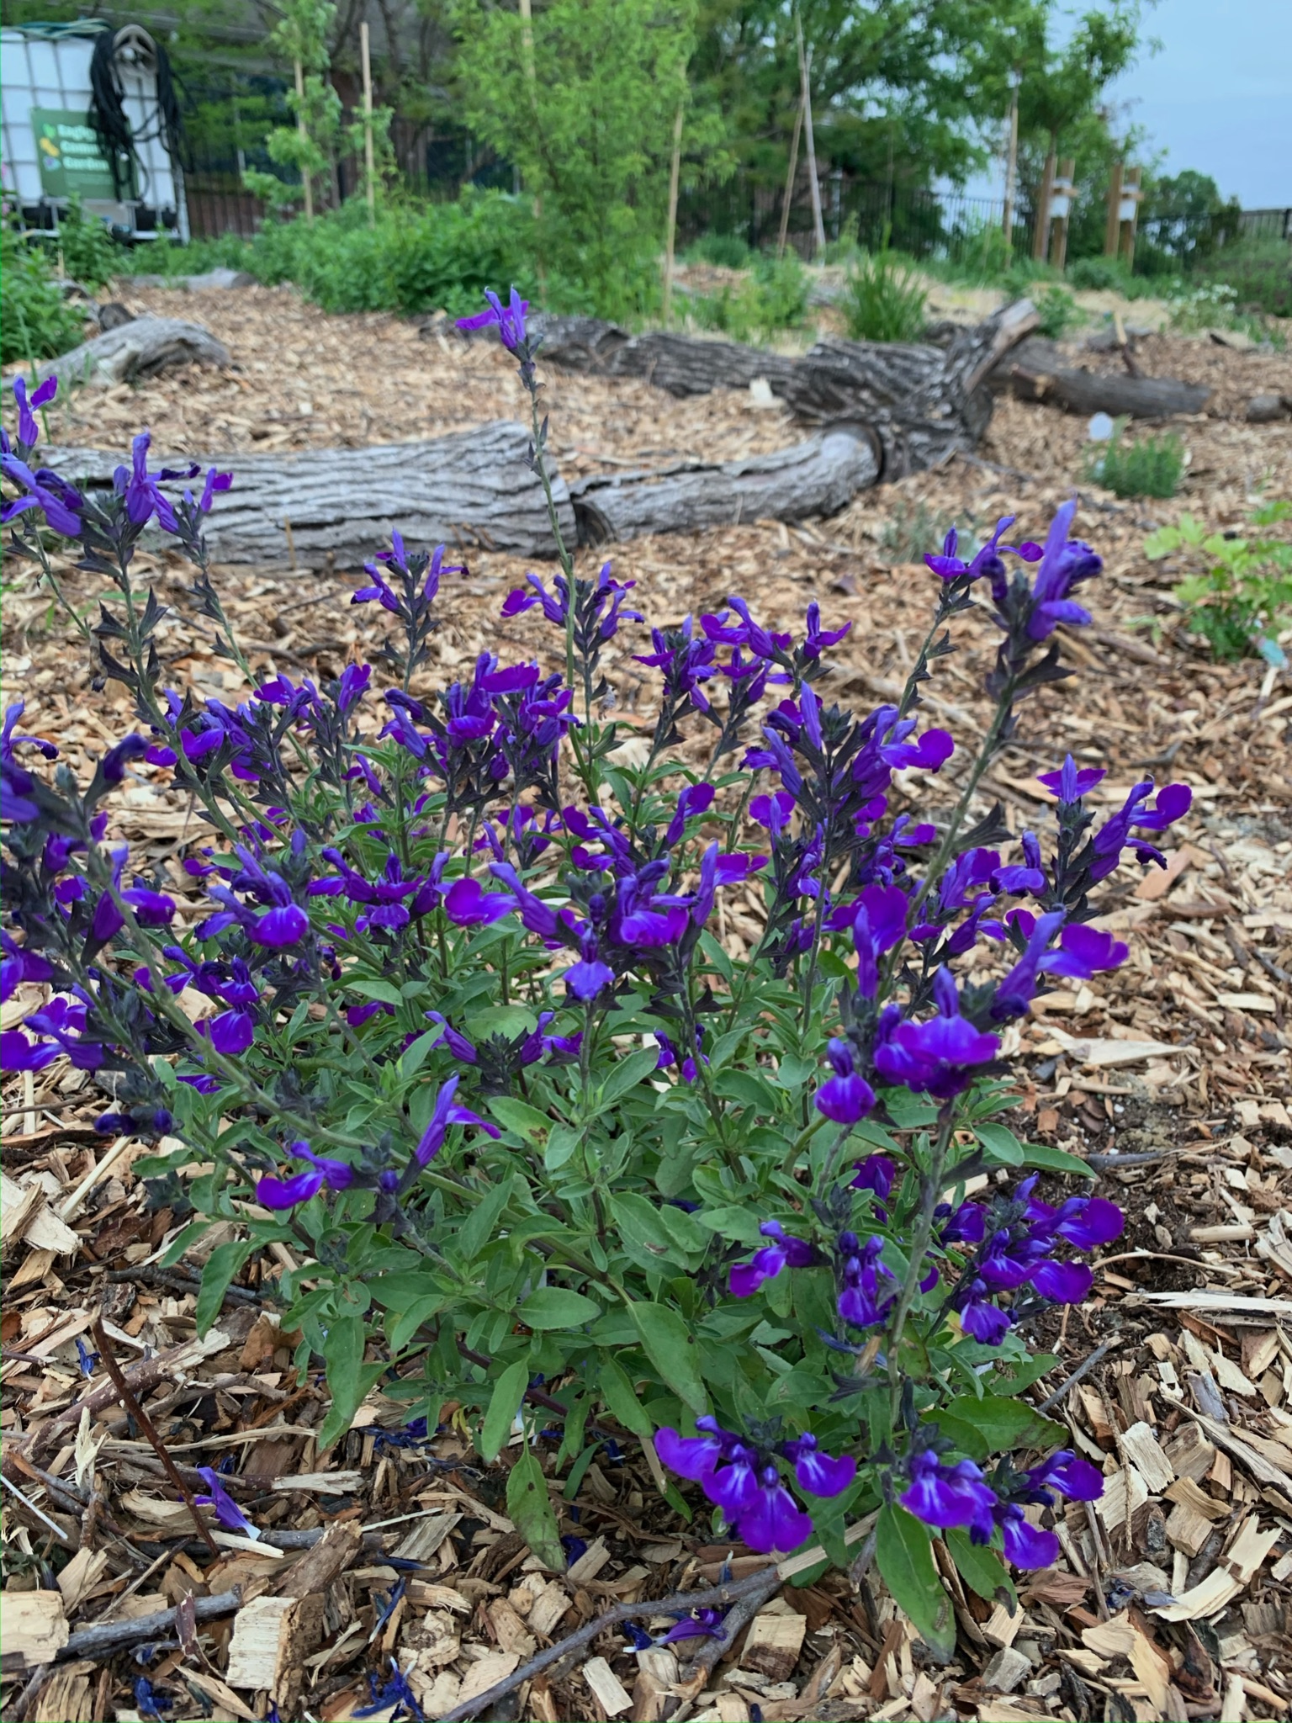
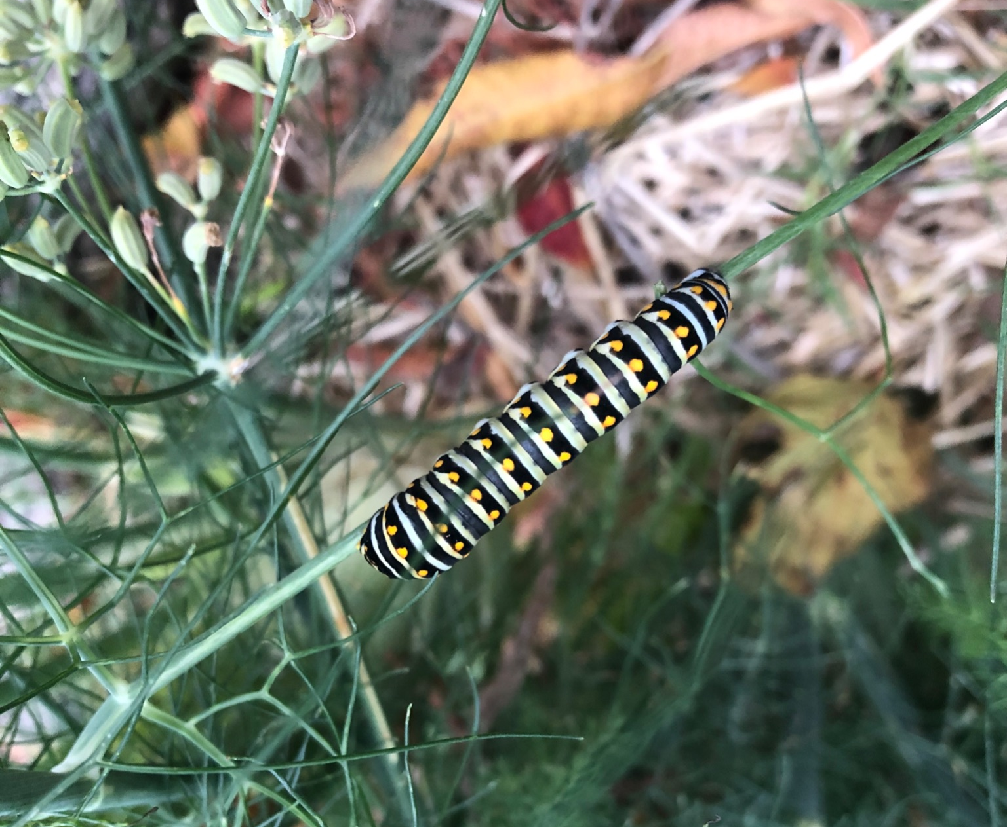
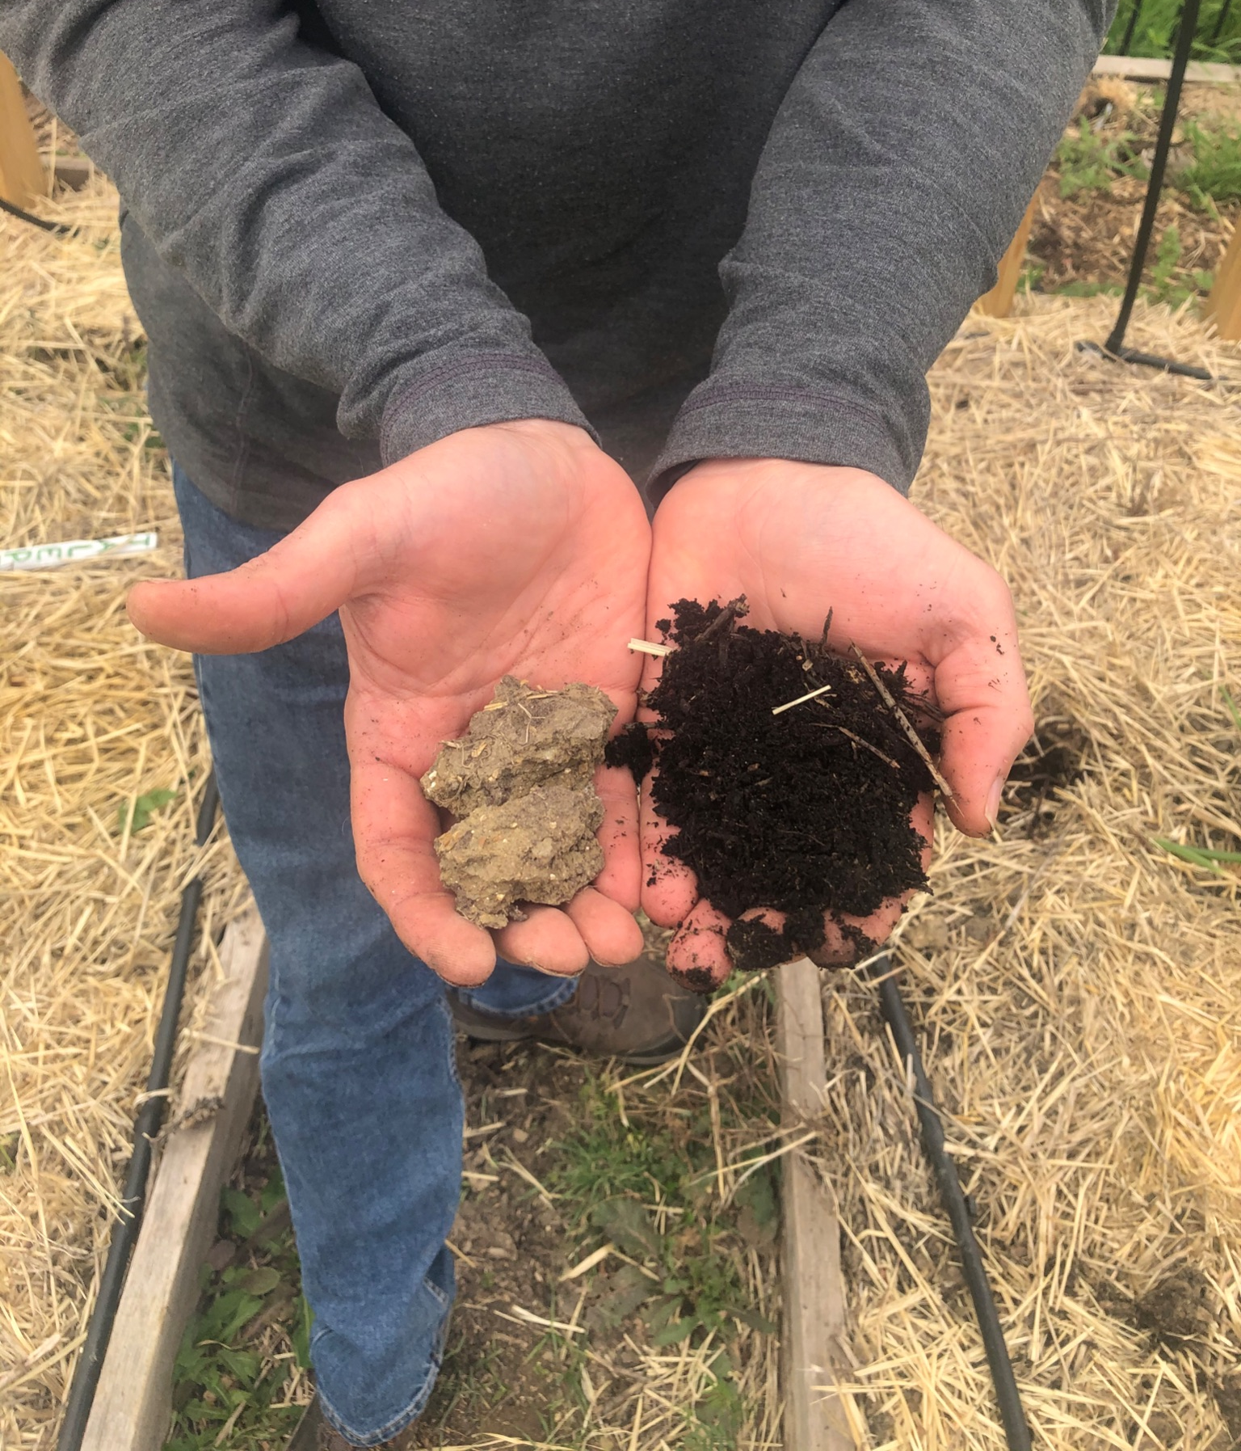
A Safe & Vibrant Green Space
Why?
Earth stewardship
Caring for marginalized people
Reconnection with self & spirituality
How do we do this?
Using organic & regenerative gardening methods
Focus on restoring the soil
Plant native and wildlife-supporting plants
Manage any hazards

Slide 5
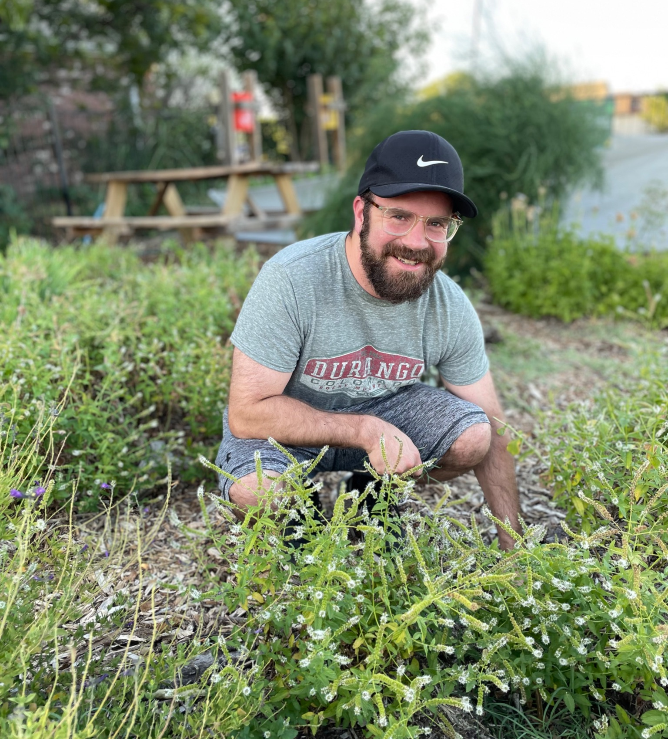
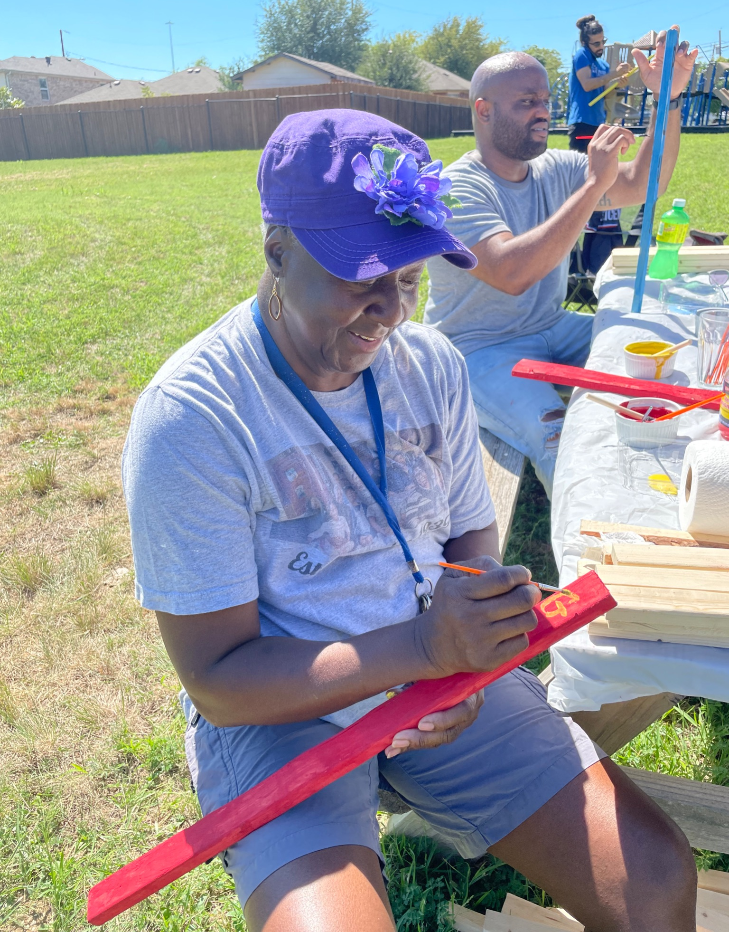
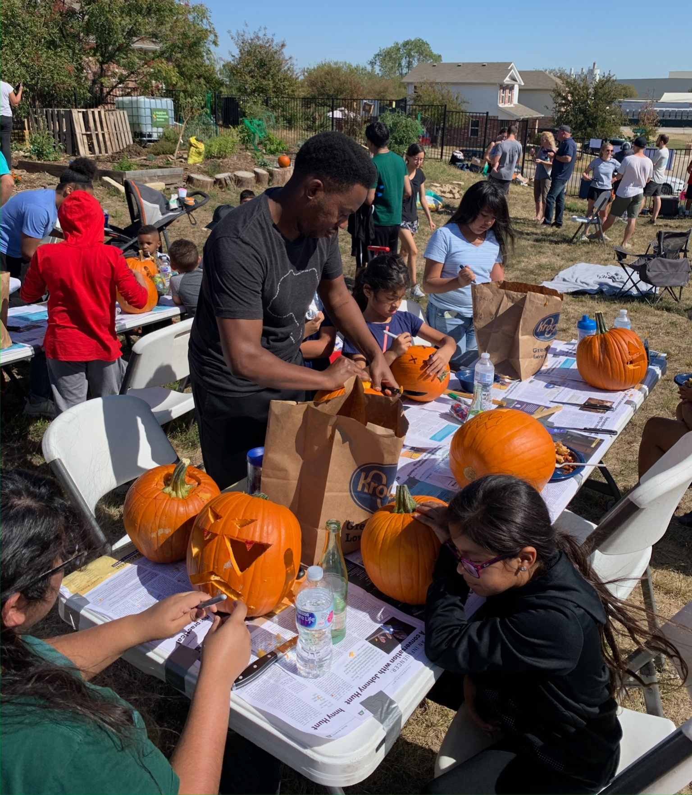
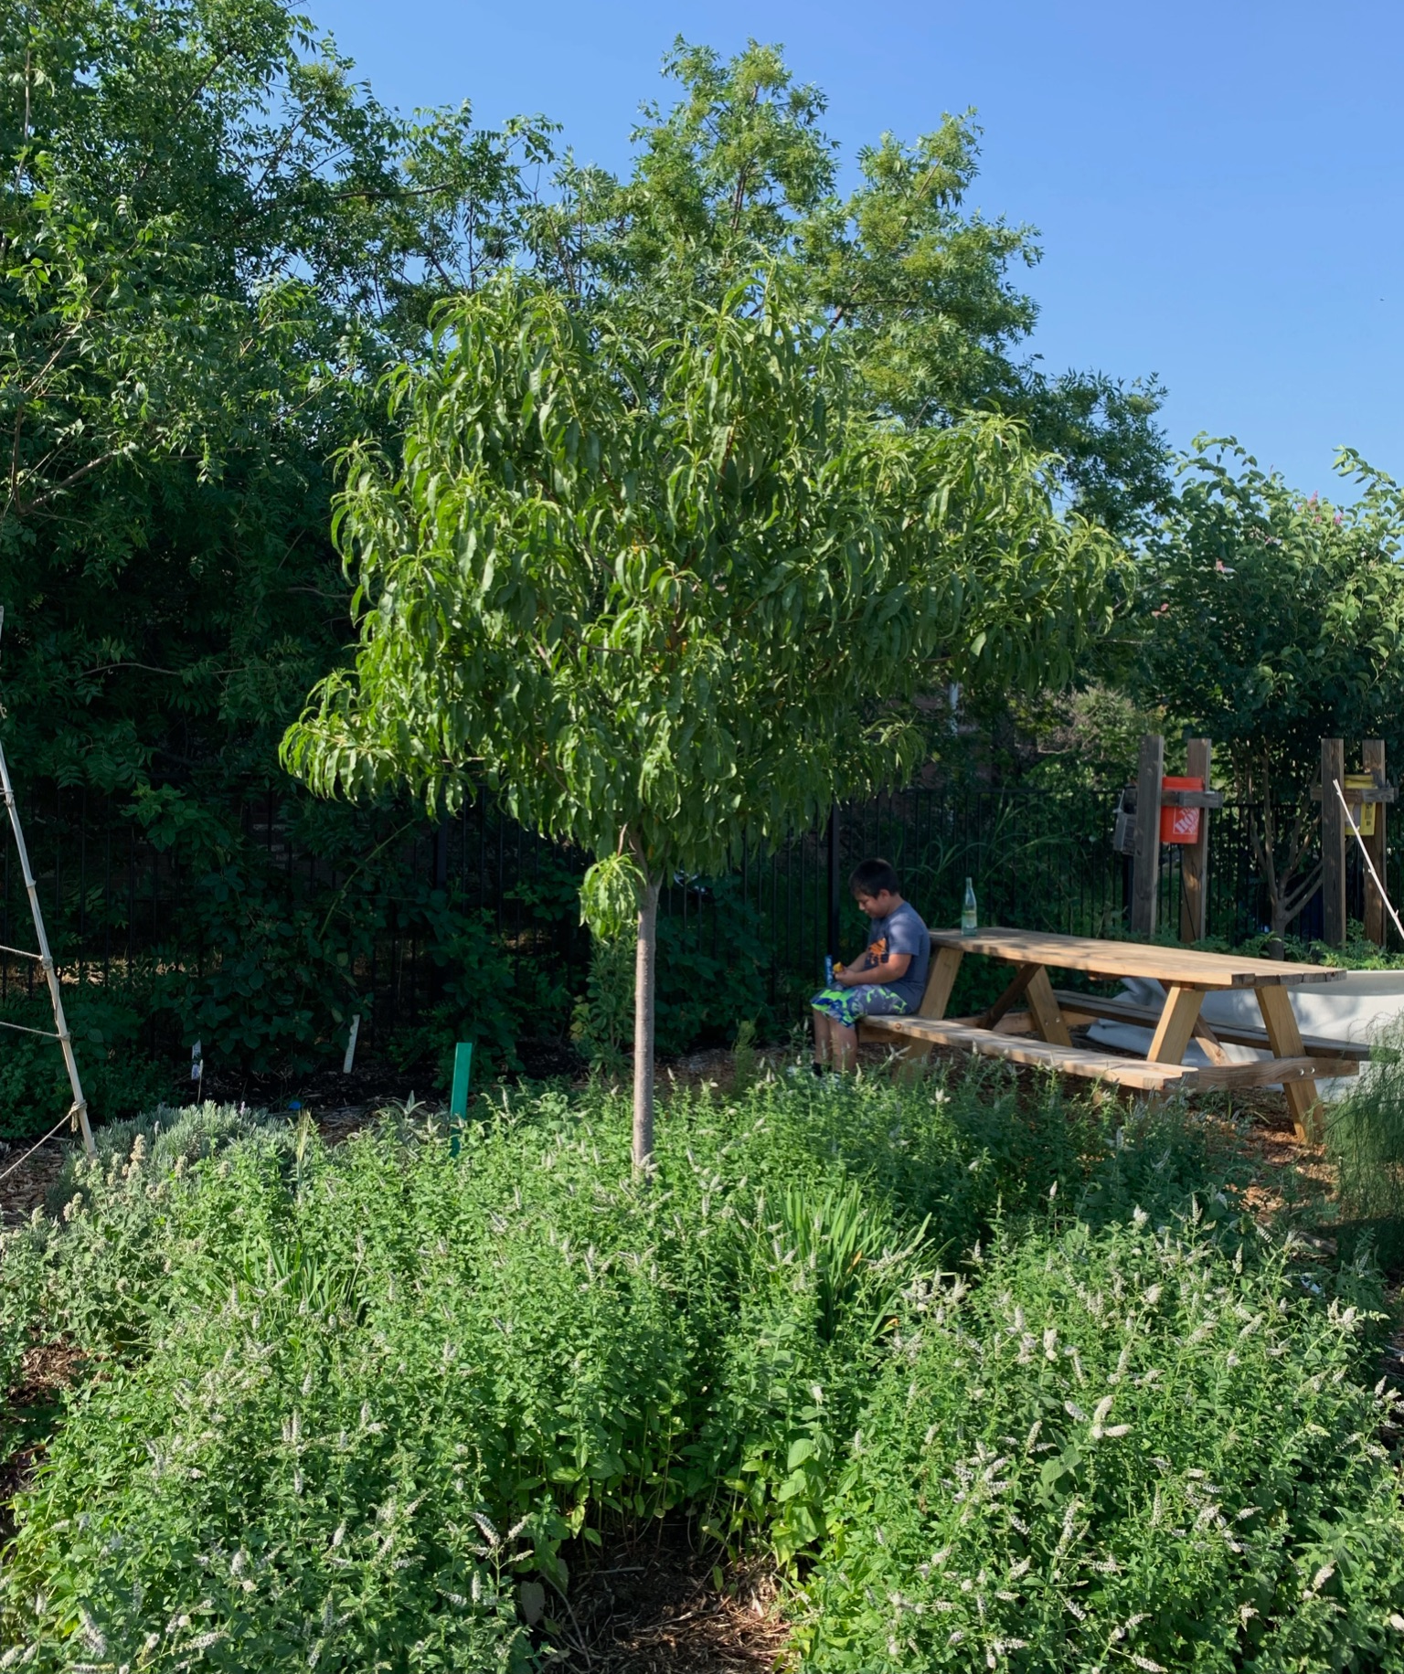
A Community Gathering Spot
Why?
Welcoming the outsider
Bridges social barriers of income, language, culture, race, etc.
How do we do this?
Host regular community meals and gatherings
Providing shelter and gathering space
Put up welcoming signage
Provide opportunities for people to engage with nature

Slide 6
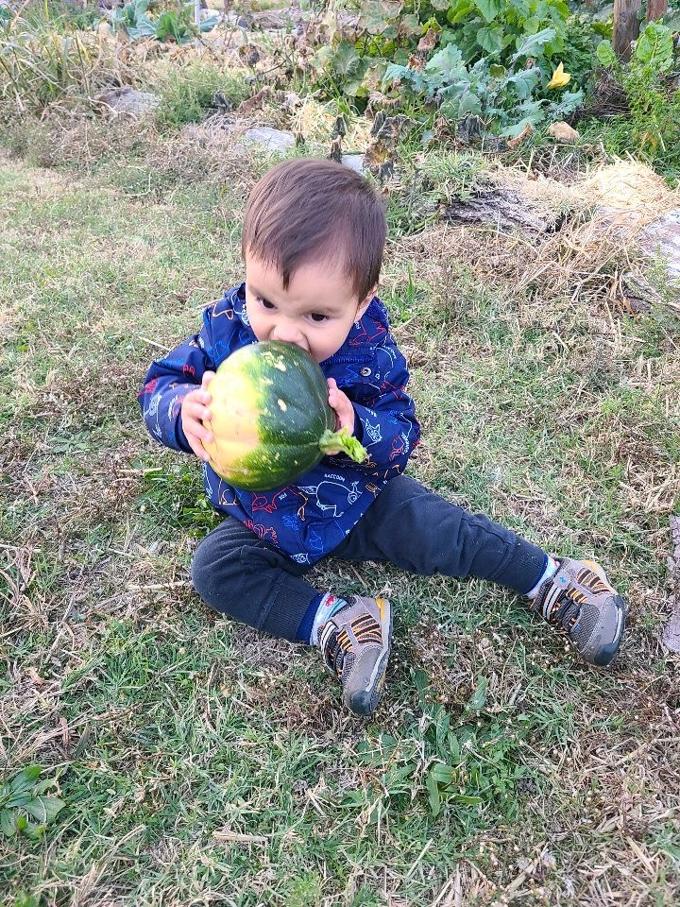
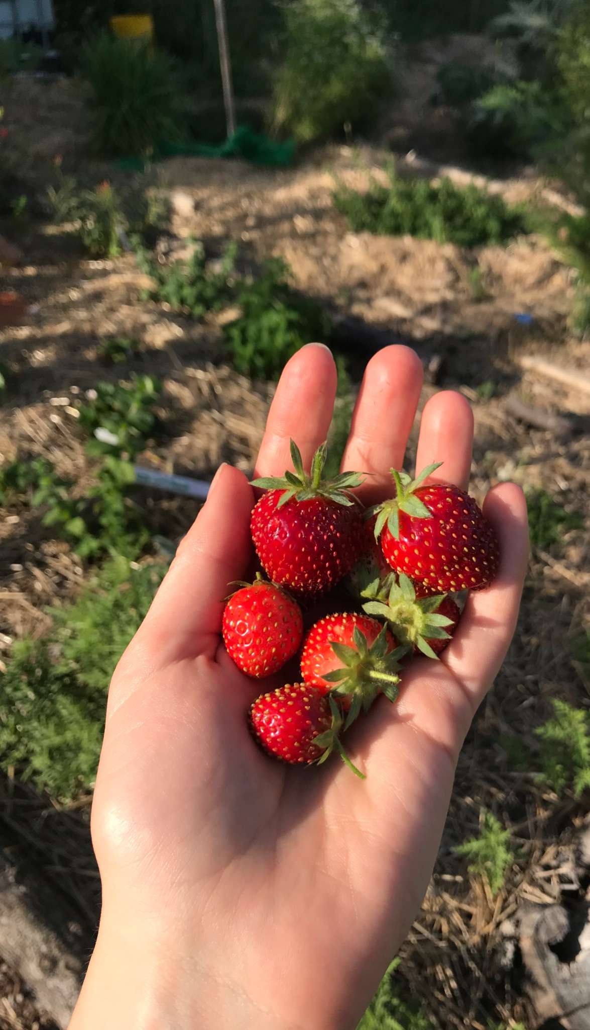
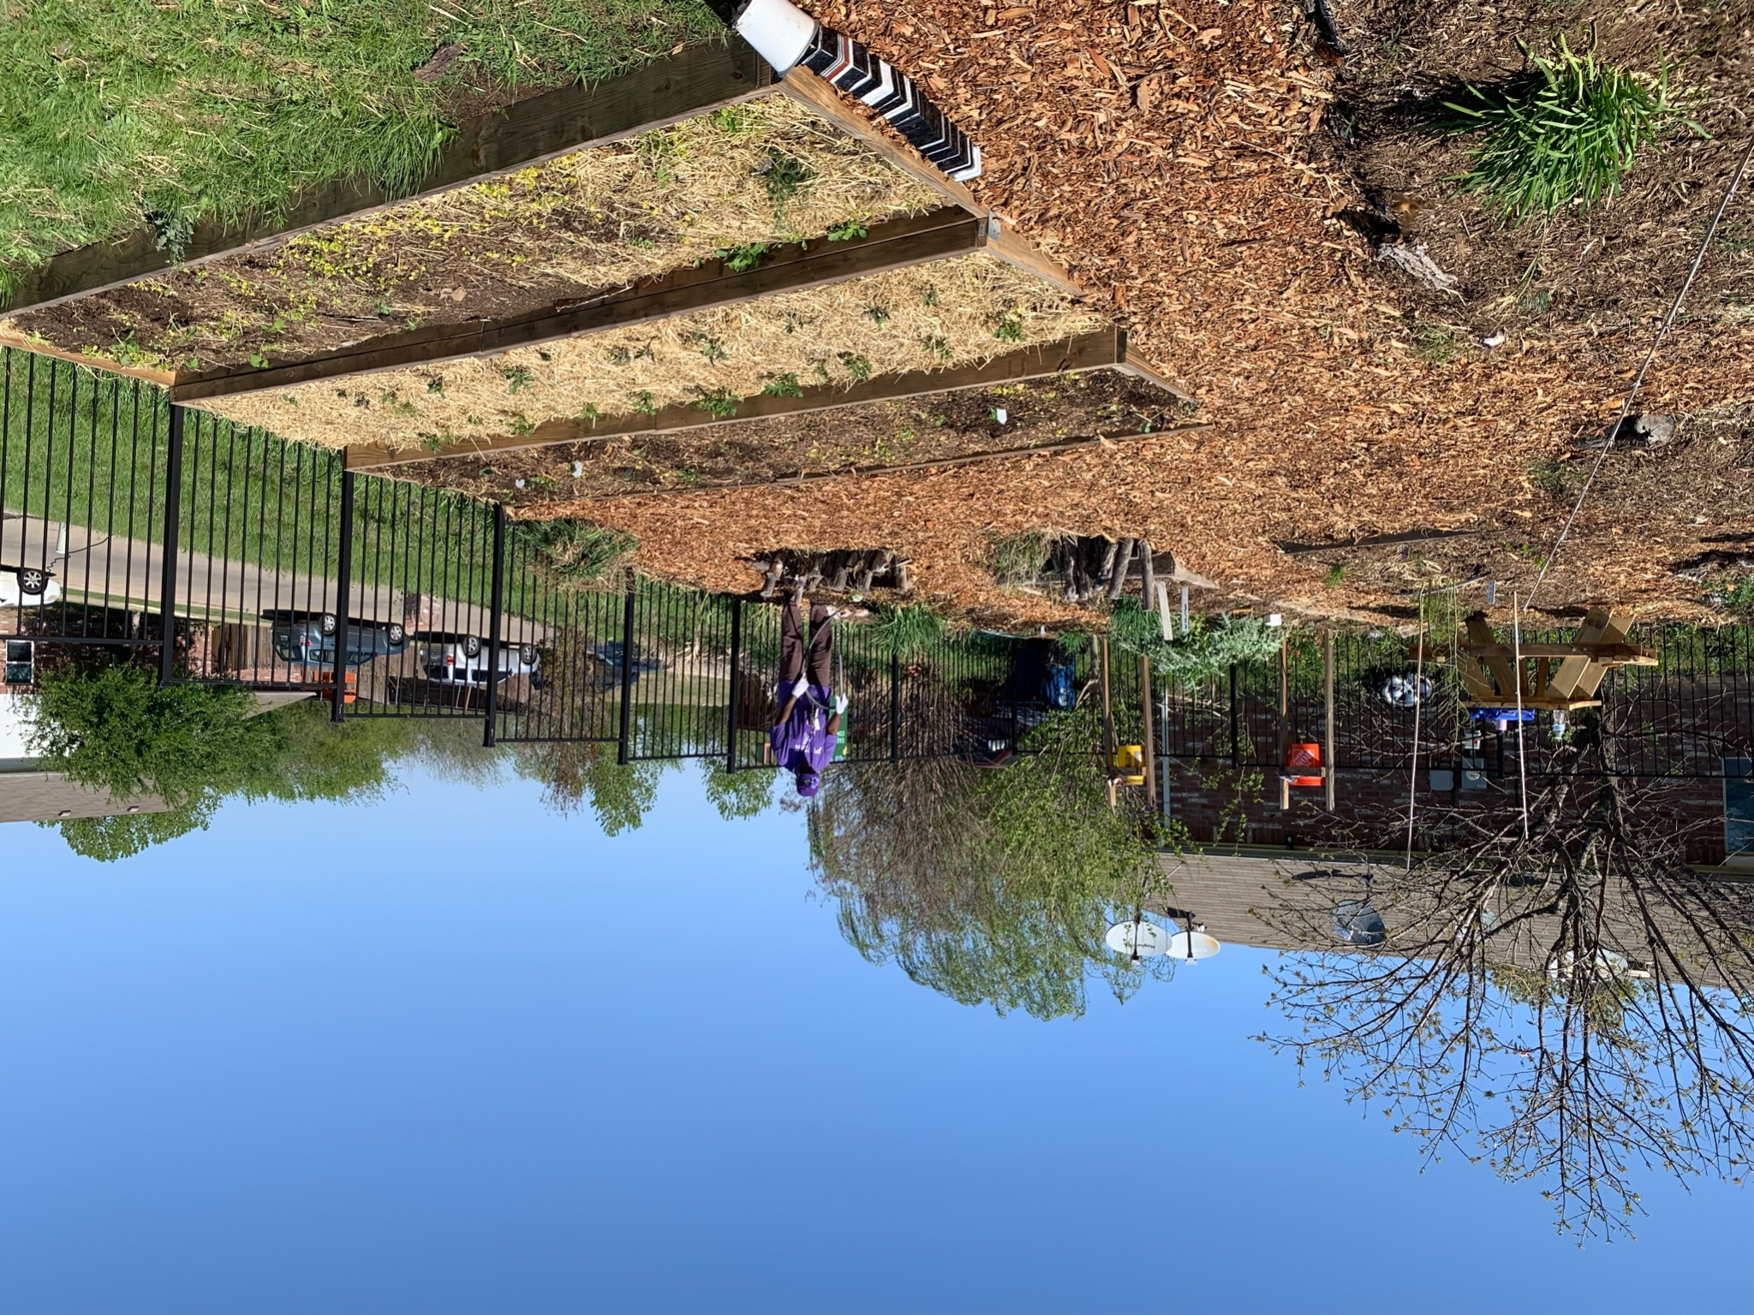
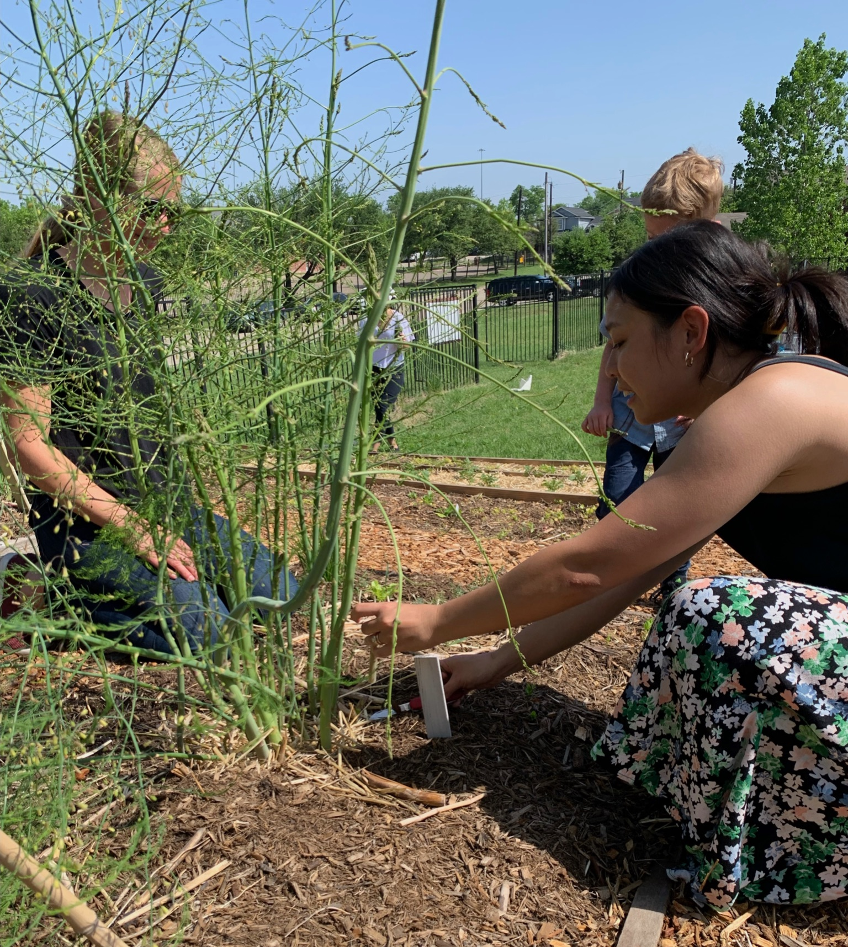
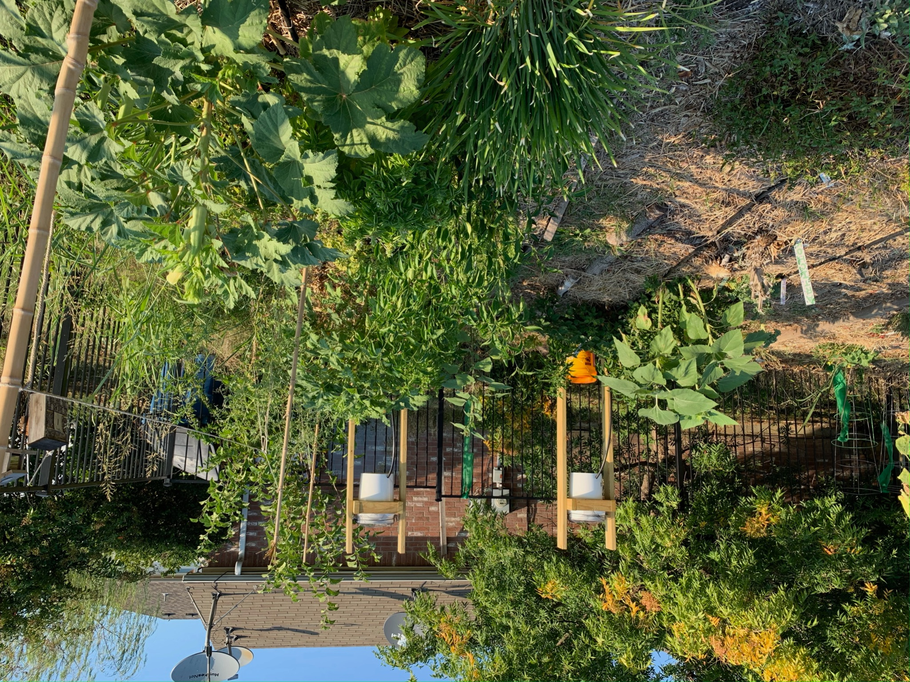
Access to Fresh Food
Why?
Lack of access to fresh food is one of the primary issues facing our city!
How do we do this?
Grow organic food
Distribute food to your community (farm shares program, food bank, neighborhood farm stand, etc.)

Slide 7
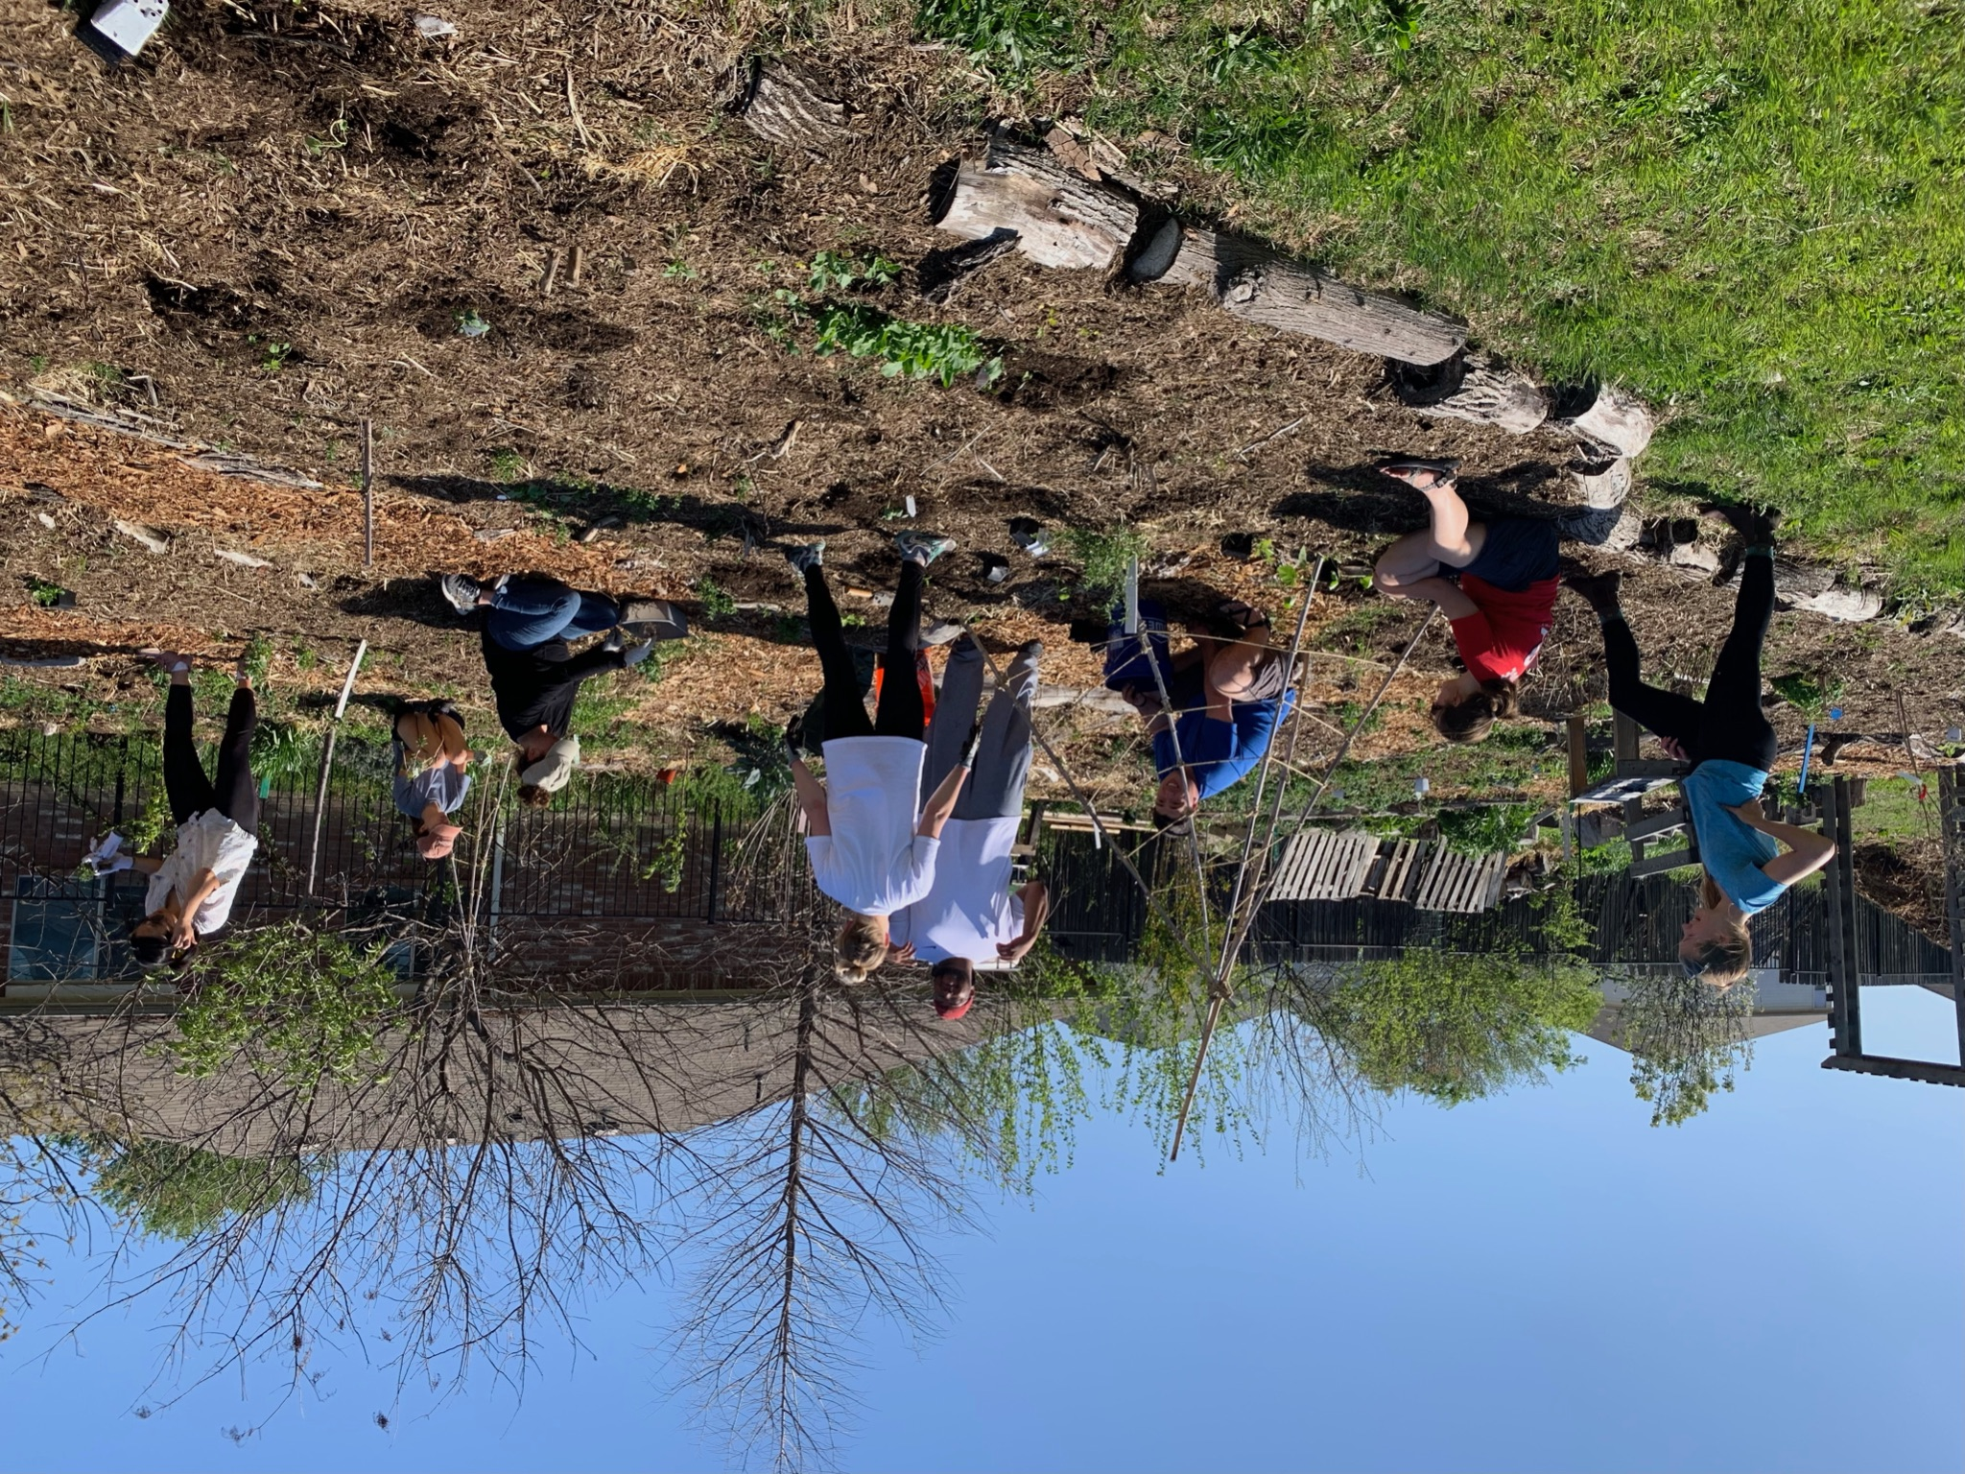
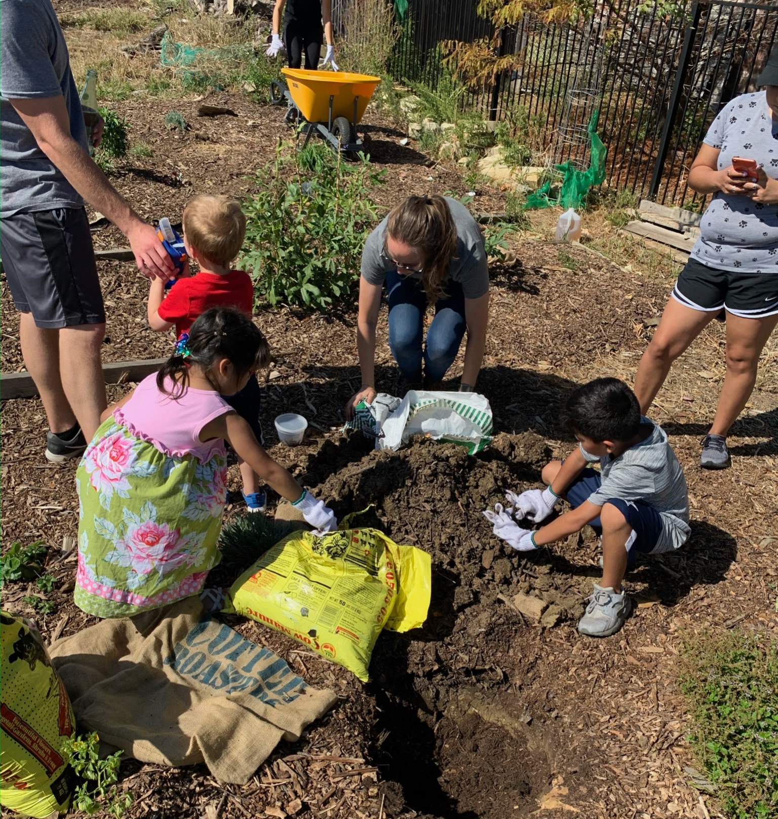
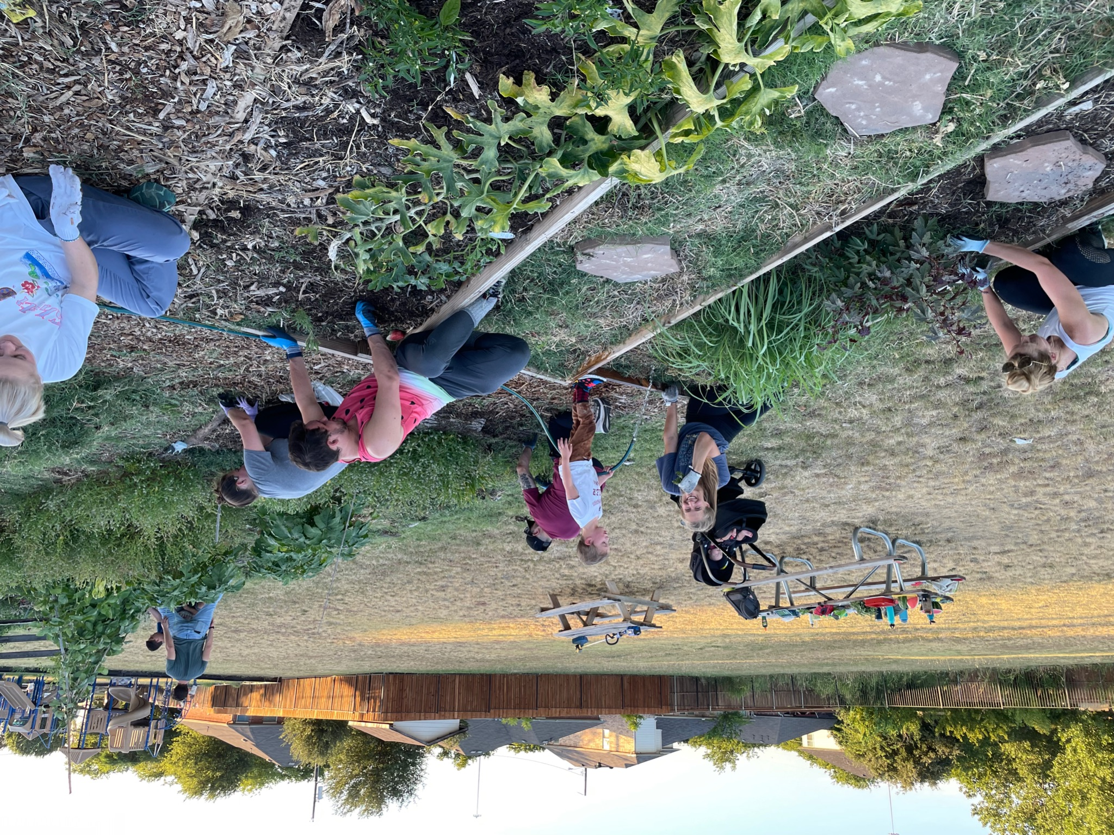
Skills & Education to Grow & Cook Food
Why?
Build sustainability by teaching people how to care for themselves
How do we do this?
Host regular garden work days and pop-up education opportunities to teach gardening skills hands-on
Demonstrate different food-growing methods in our garden to help people think creatively about their own space
Provide resources to teach people how to use the produce

Slide 8
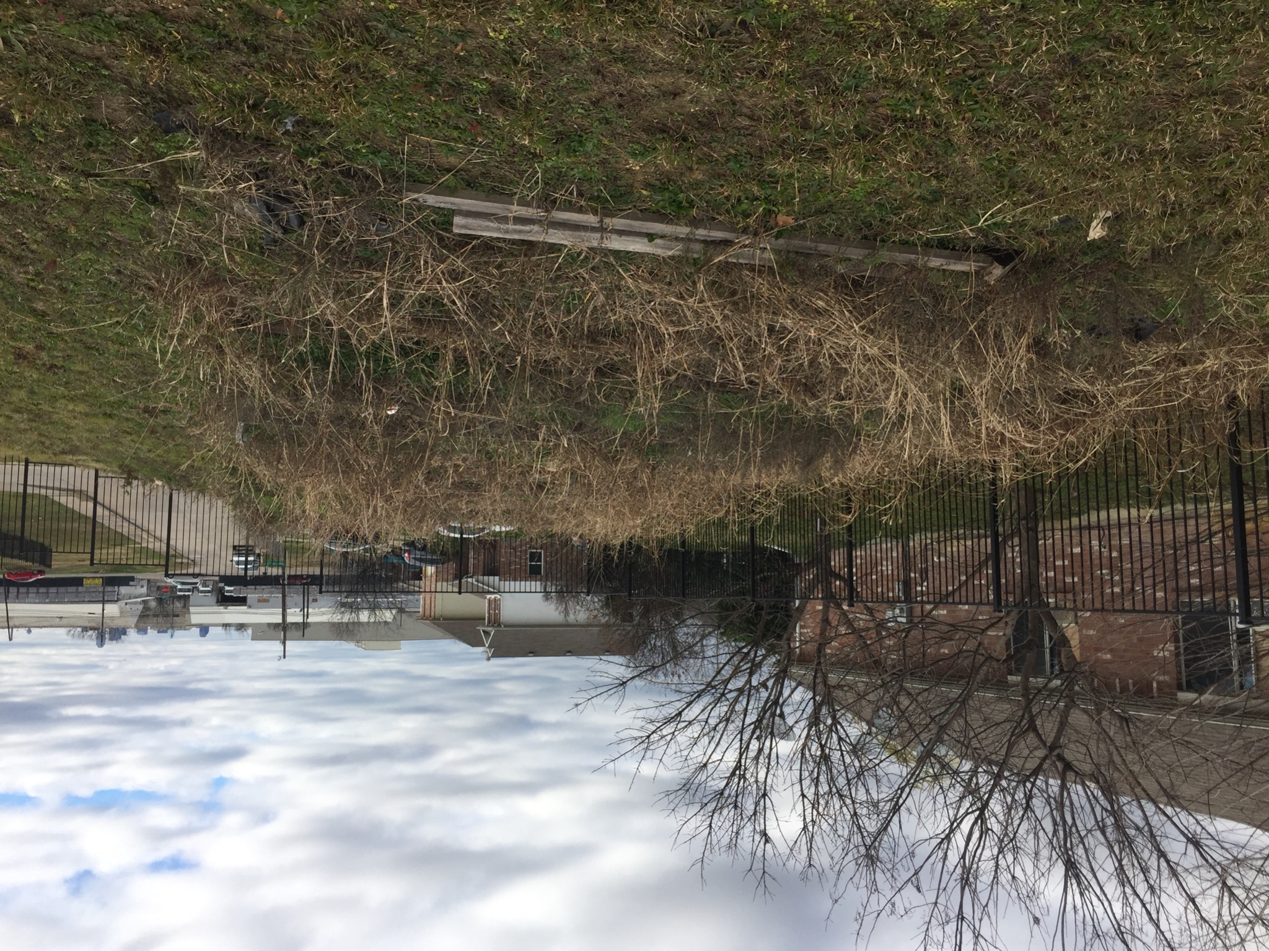
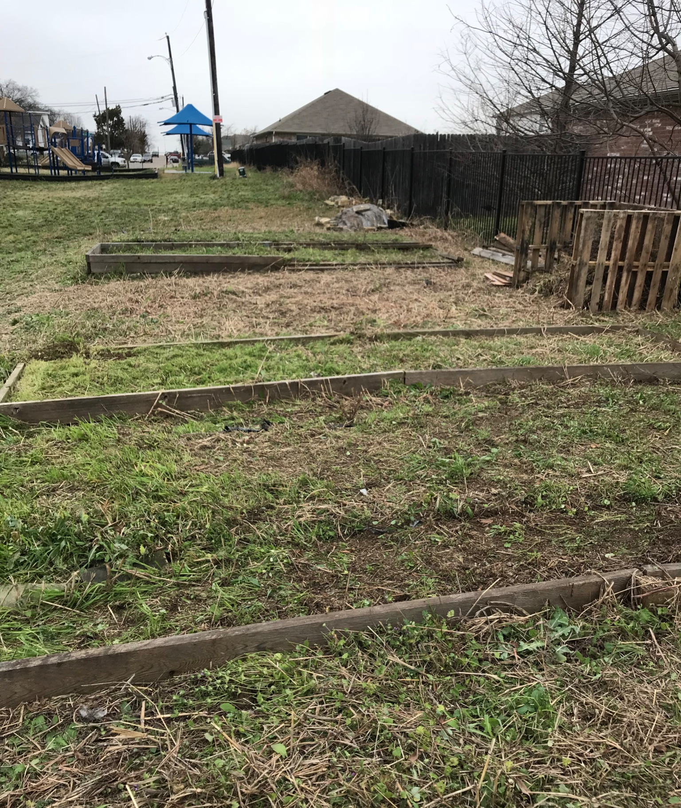
Eagle Ford Community Garden “Before” Pictures - 2019

Slide 9
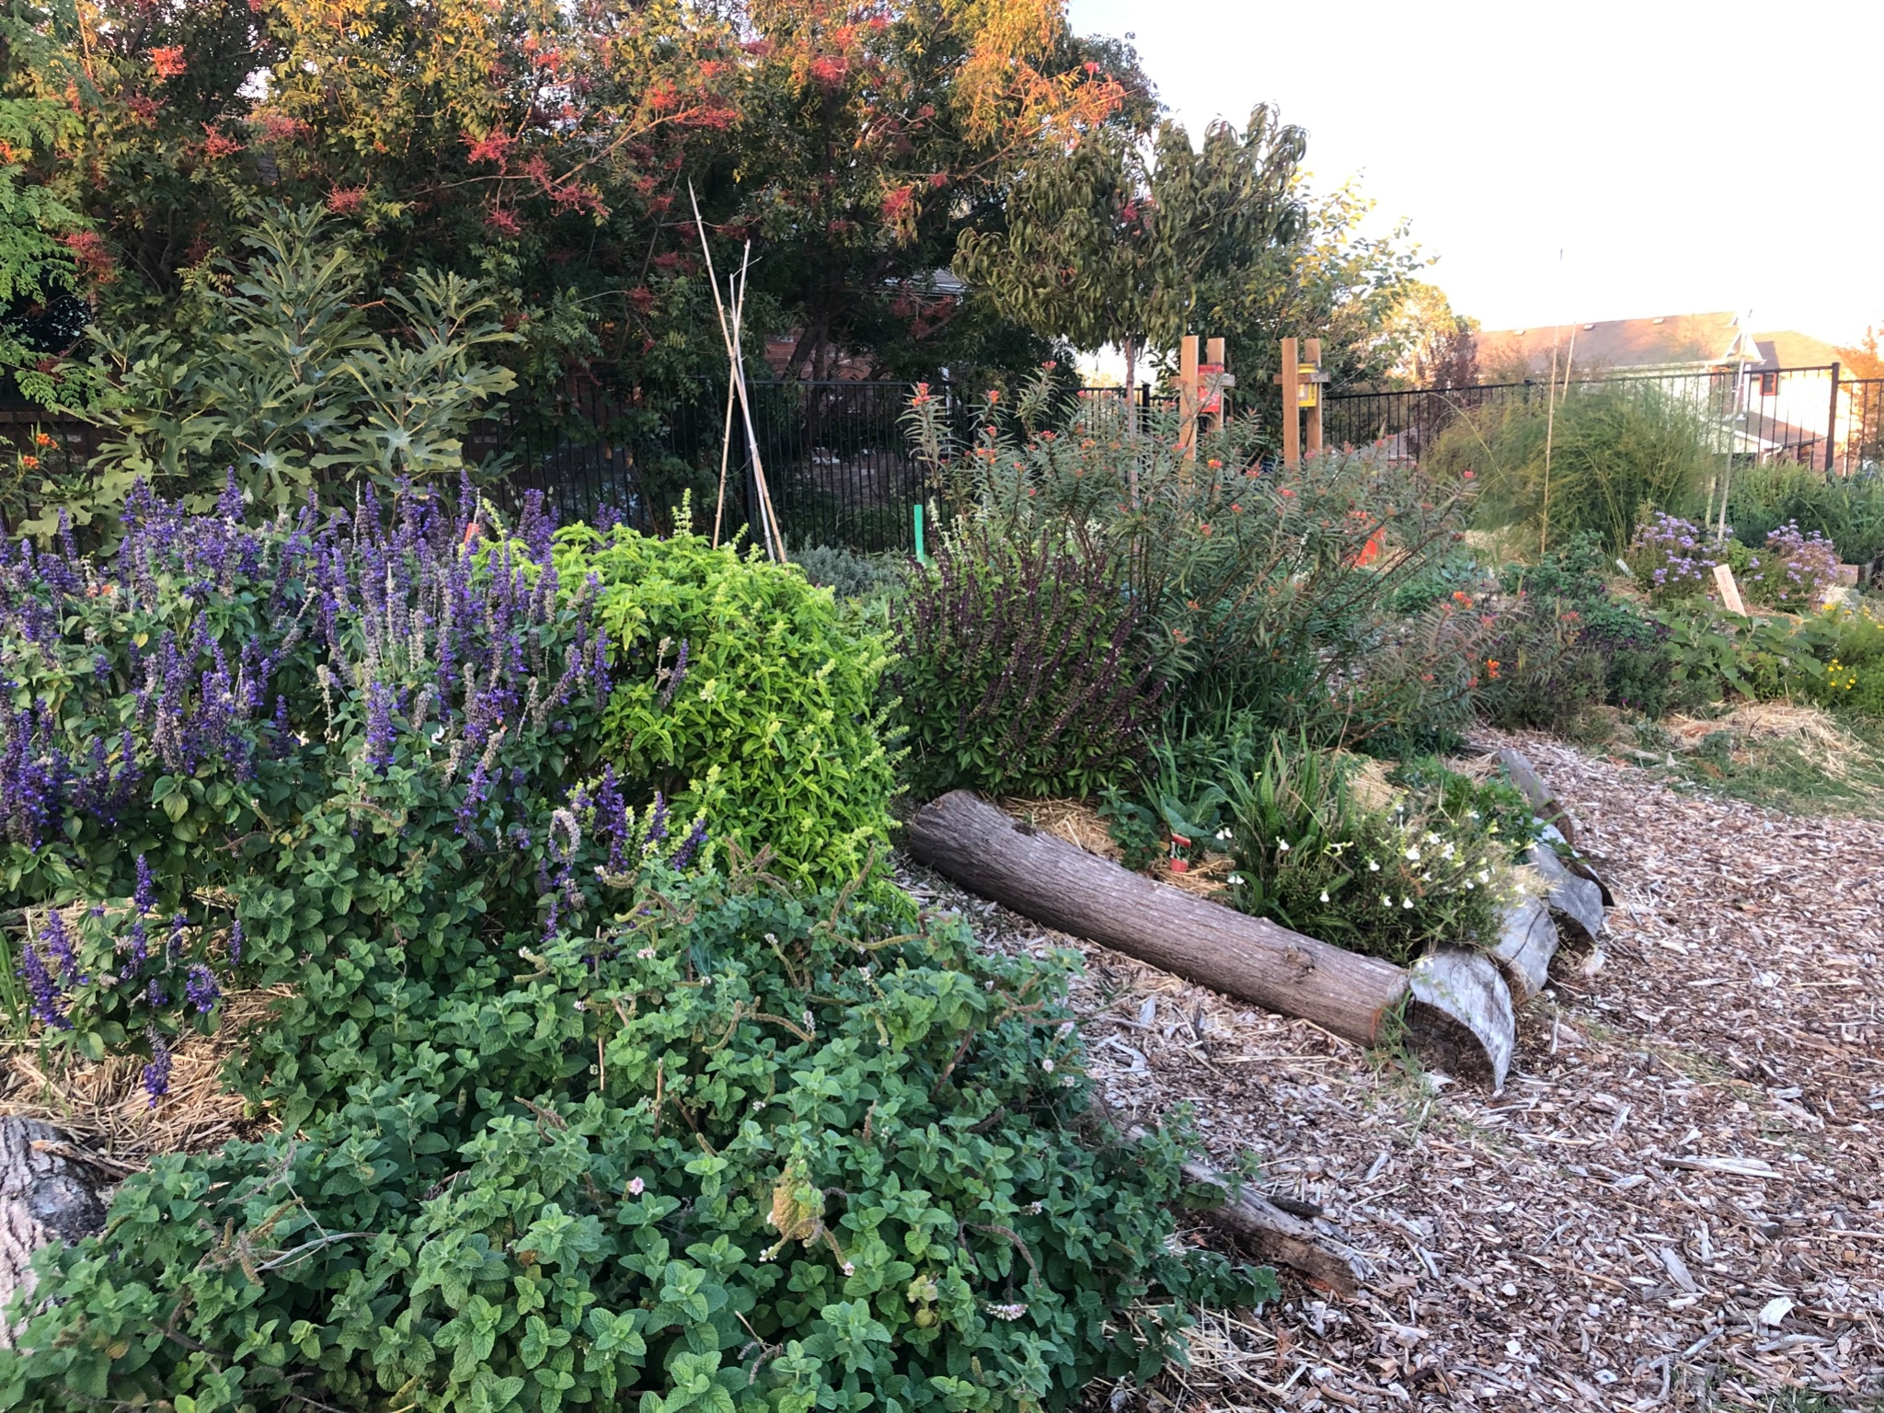
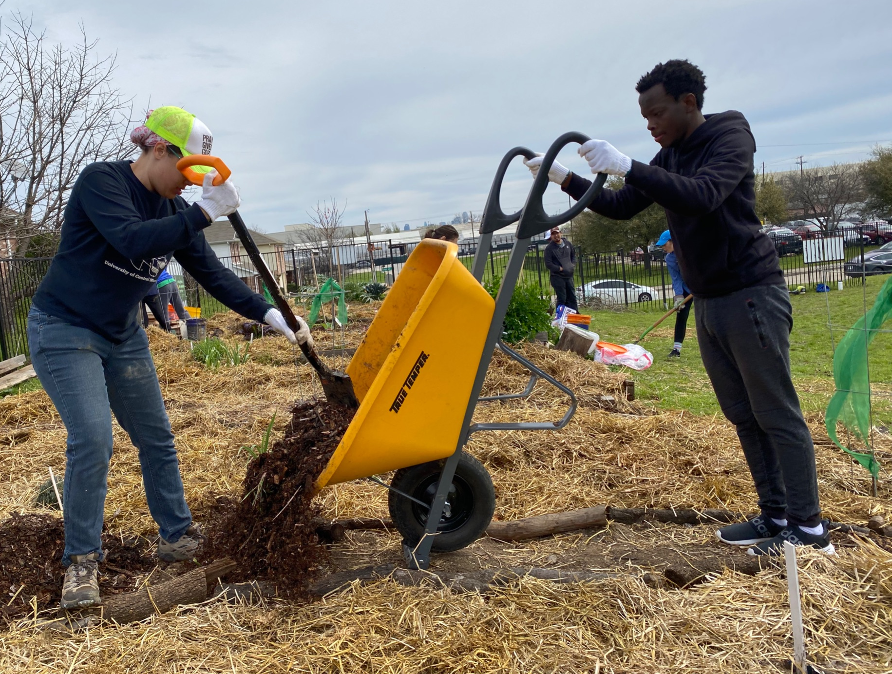
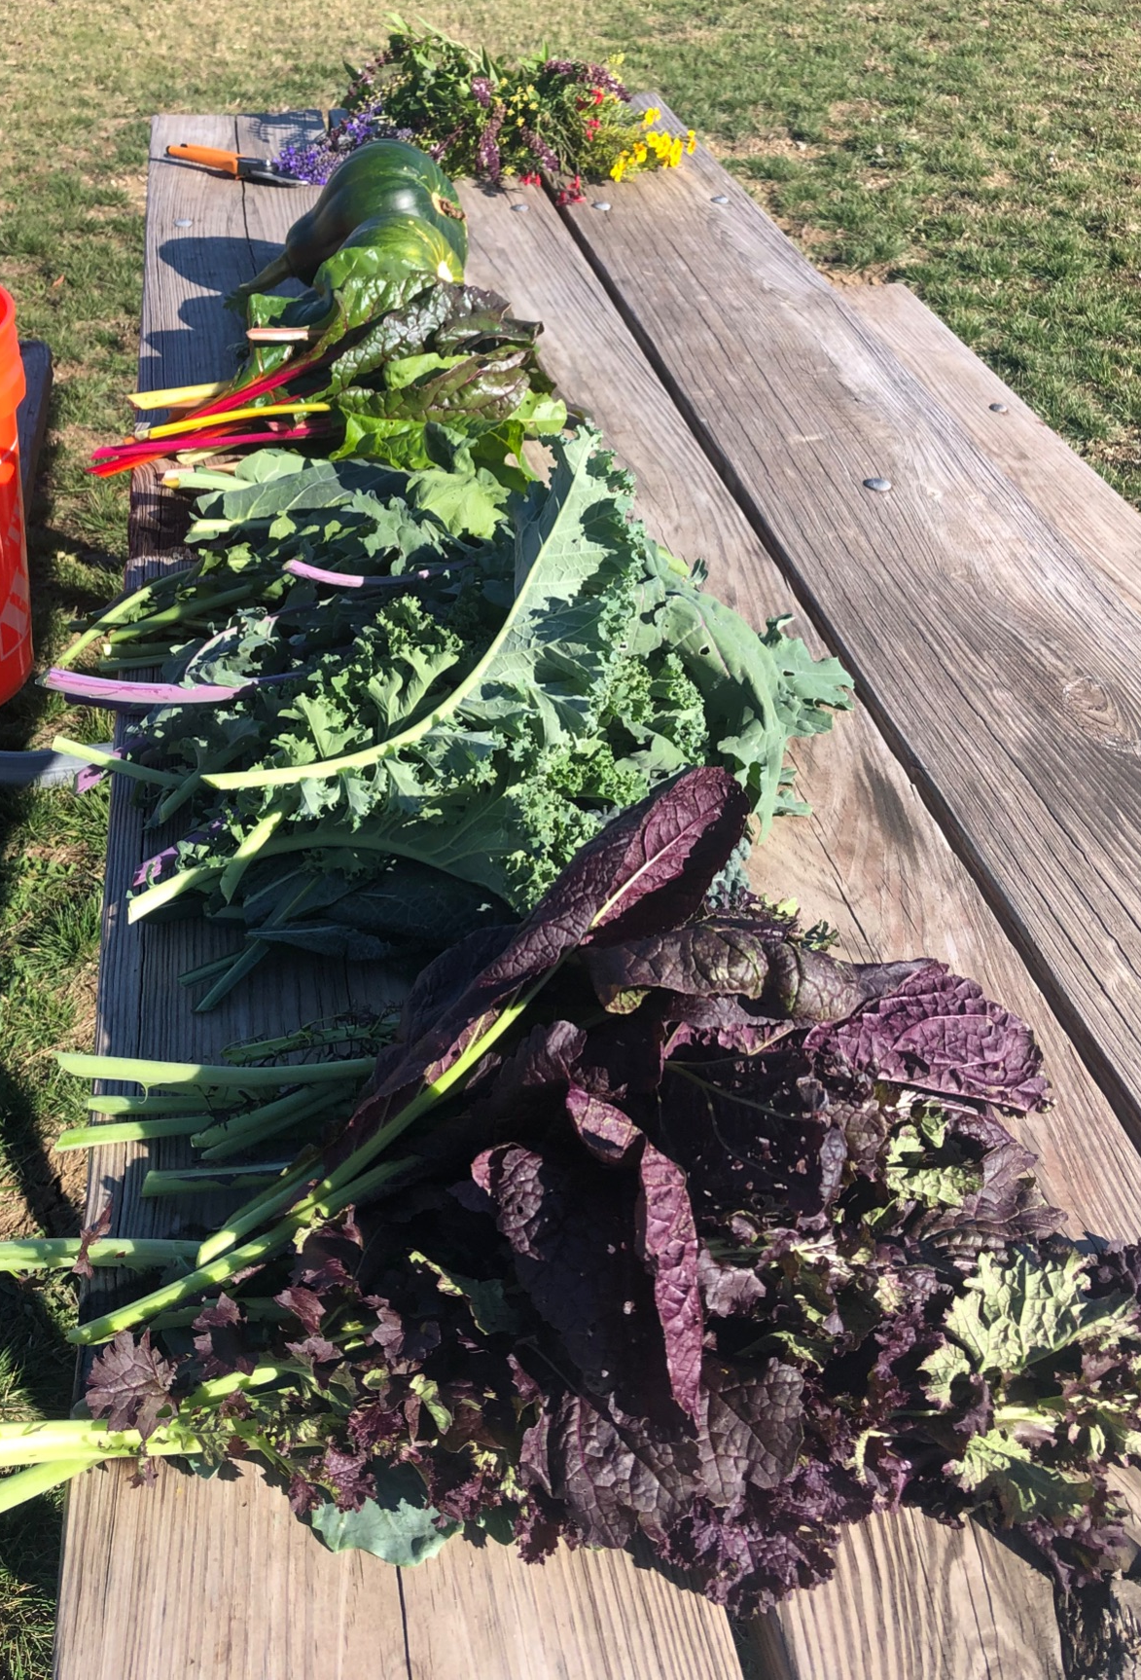
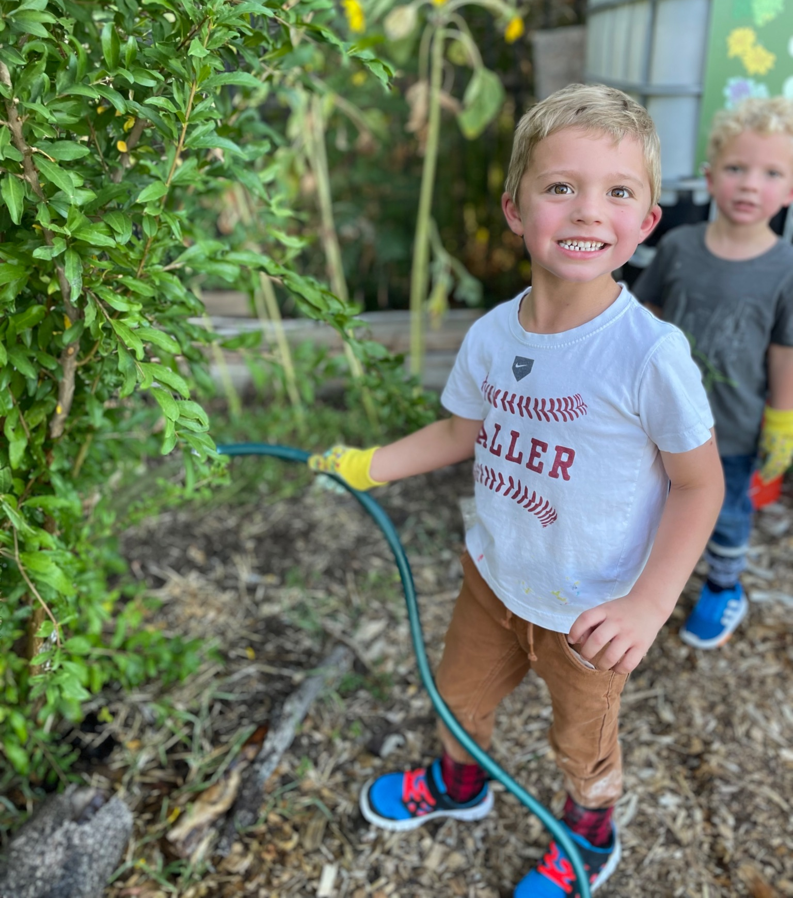
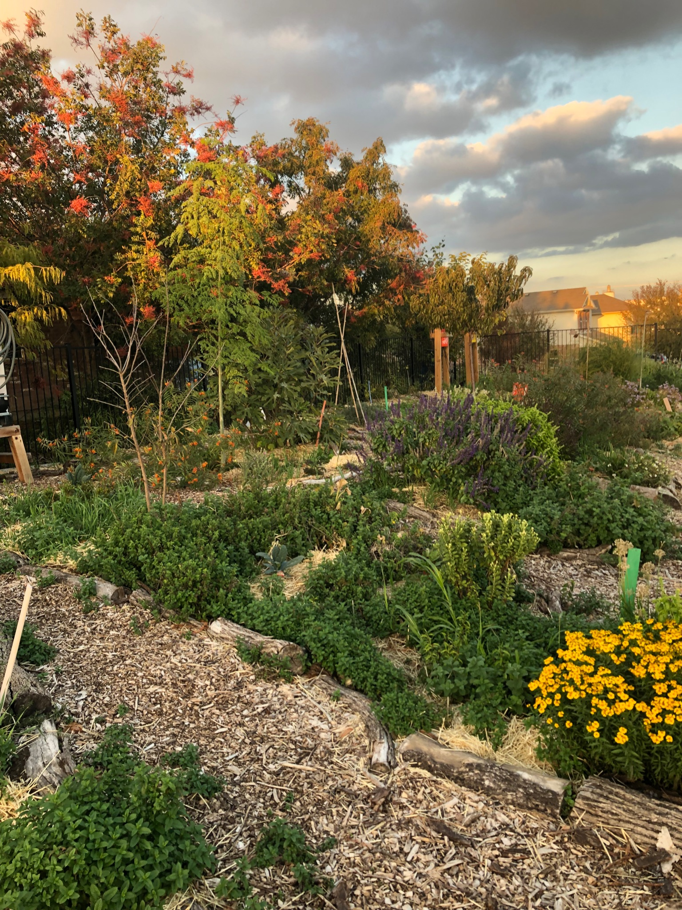
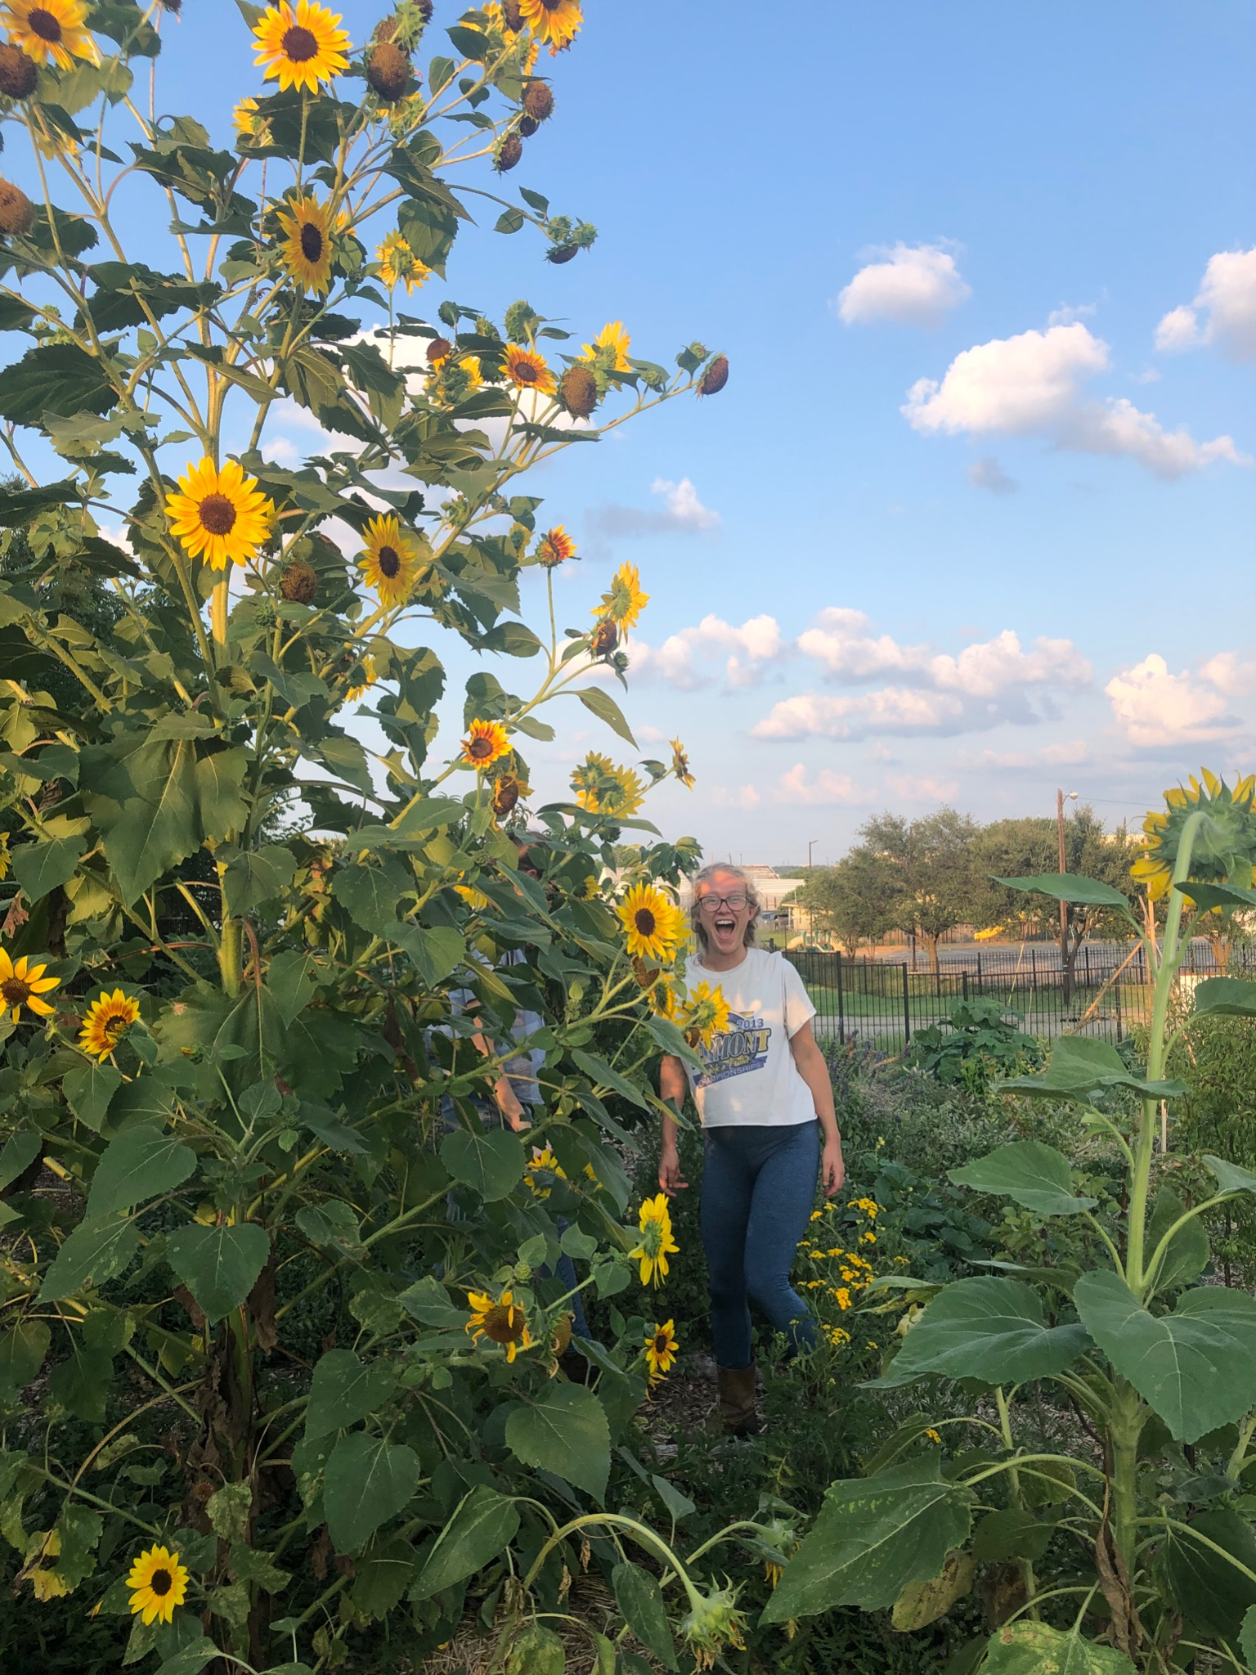
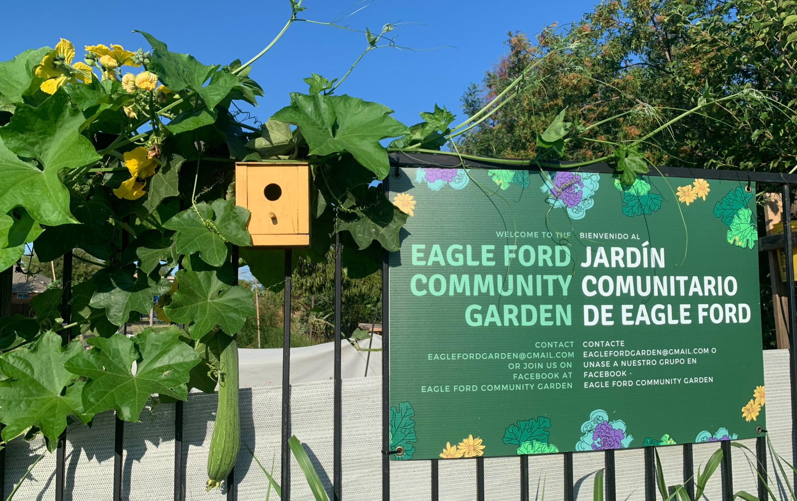
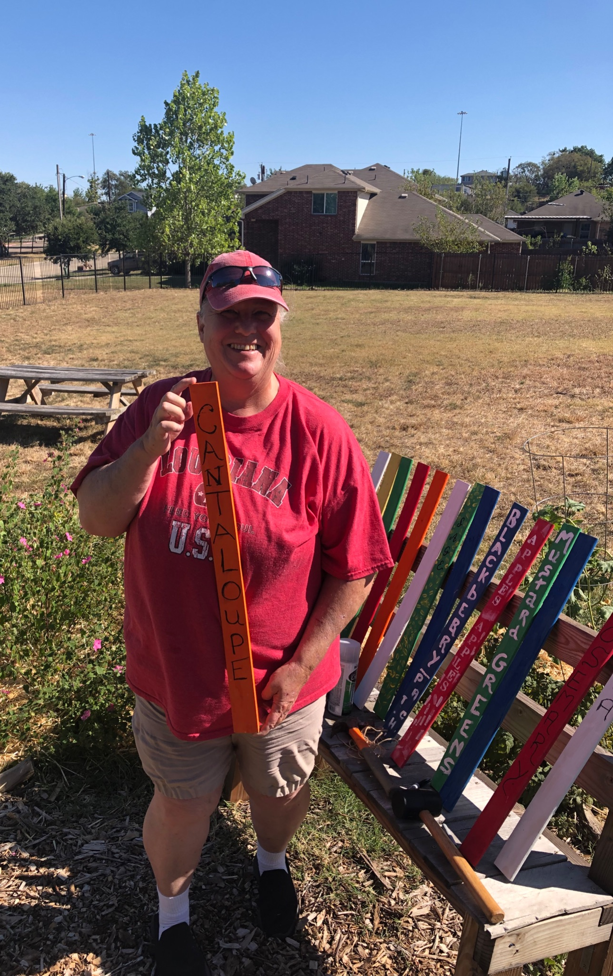
Today Pictures

Slide 10
How Can You Get Started?
Are there people in your congregation who feel called to serving our community through agriculture who could help lead?
Could you partner with an existing garden or urban agriculture program in your community?
Do you have an area of land that could be converted into a few raised beds, a micro-orchard, or one day an urban farm?
What are other ways you feel called to serve your community? Are there ways to use urban agriculture to do that (i.e. providing jobs for refugees, a welcoming space for the homeless, etc.)?
Feel free to use me as a resource as you brainstorm!

Slide 11
Urban Agriculture Resources & Partnerships
Giving Grove: helps start and support micro-orchards to help feed the hungry
Seed the Dream Grant: a local grant that funds small urban agriculture projects
Beulah Acres: a permaculture farm & community garden at a local church that hosts excellent classes
Grow North Texas: a local non-profit that has lots of grant, education, community resources
Master Gardeners: there are a few local chapters in DFW of master gardeners who can be great education resources for you as you go

Slide 12
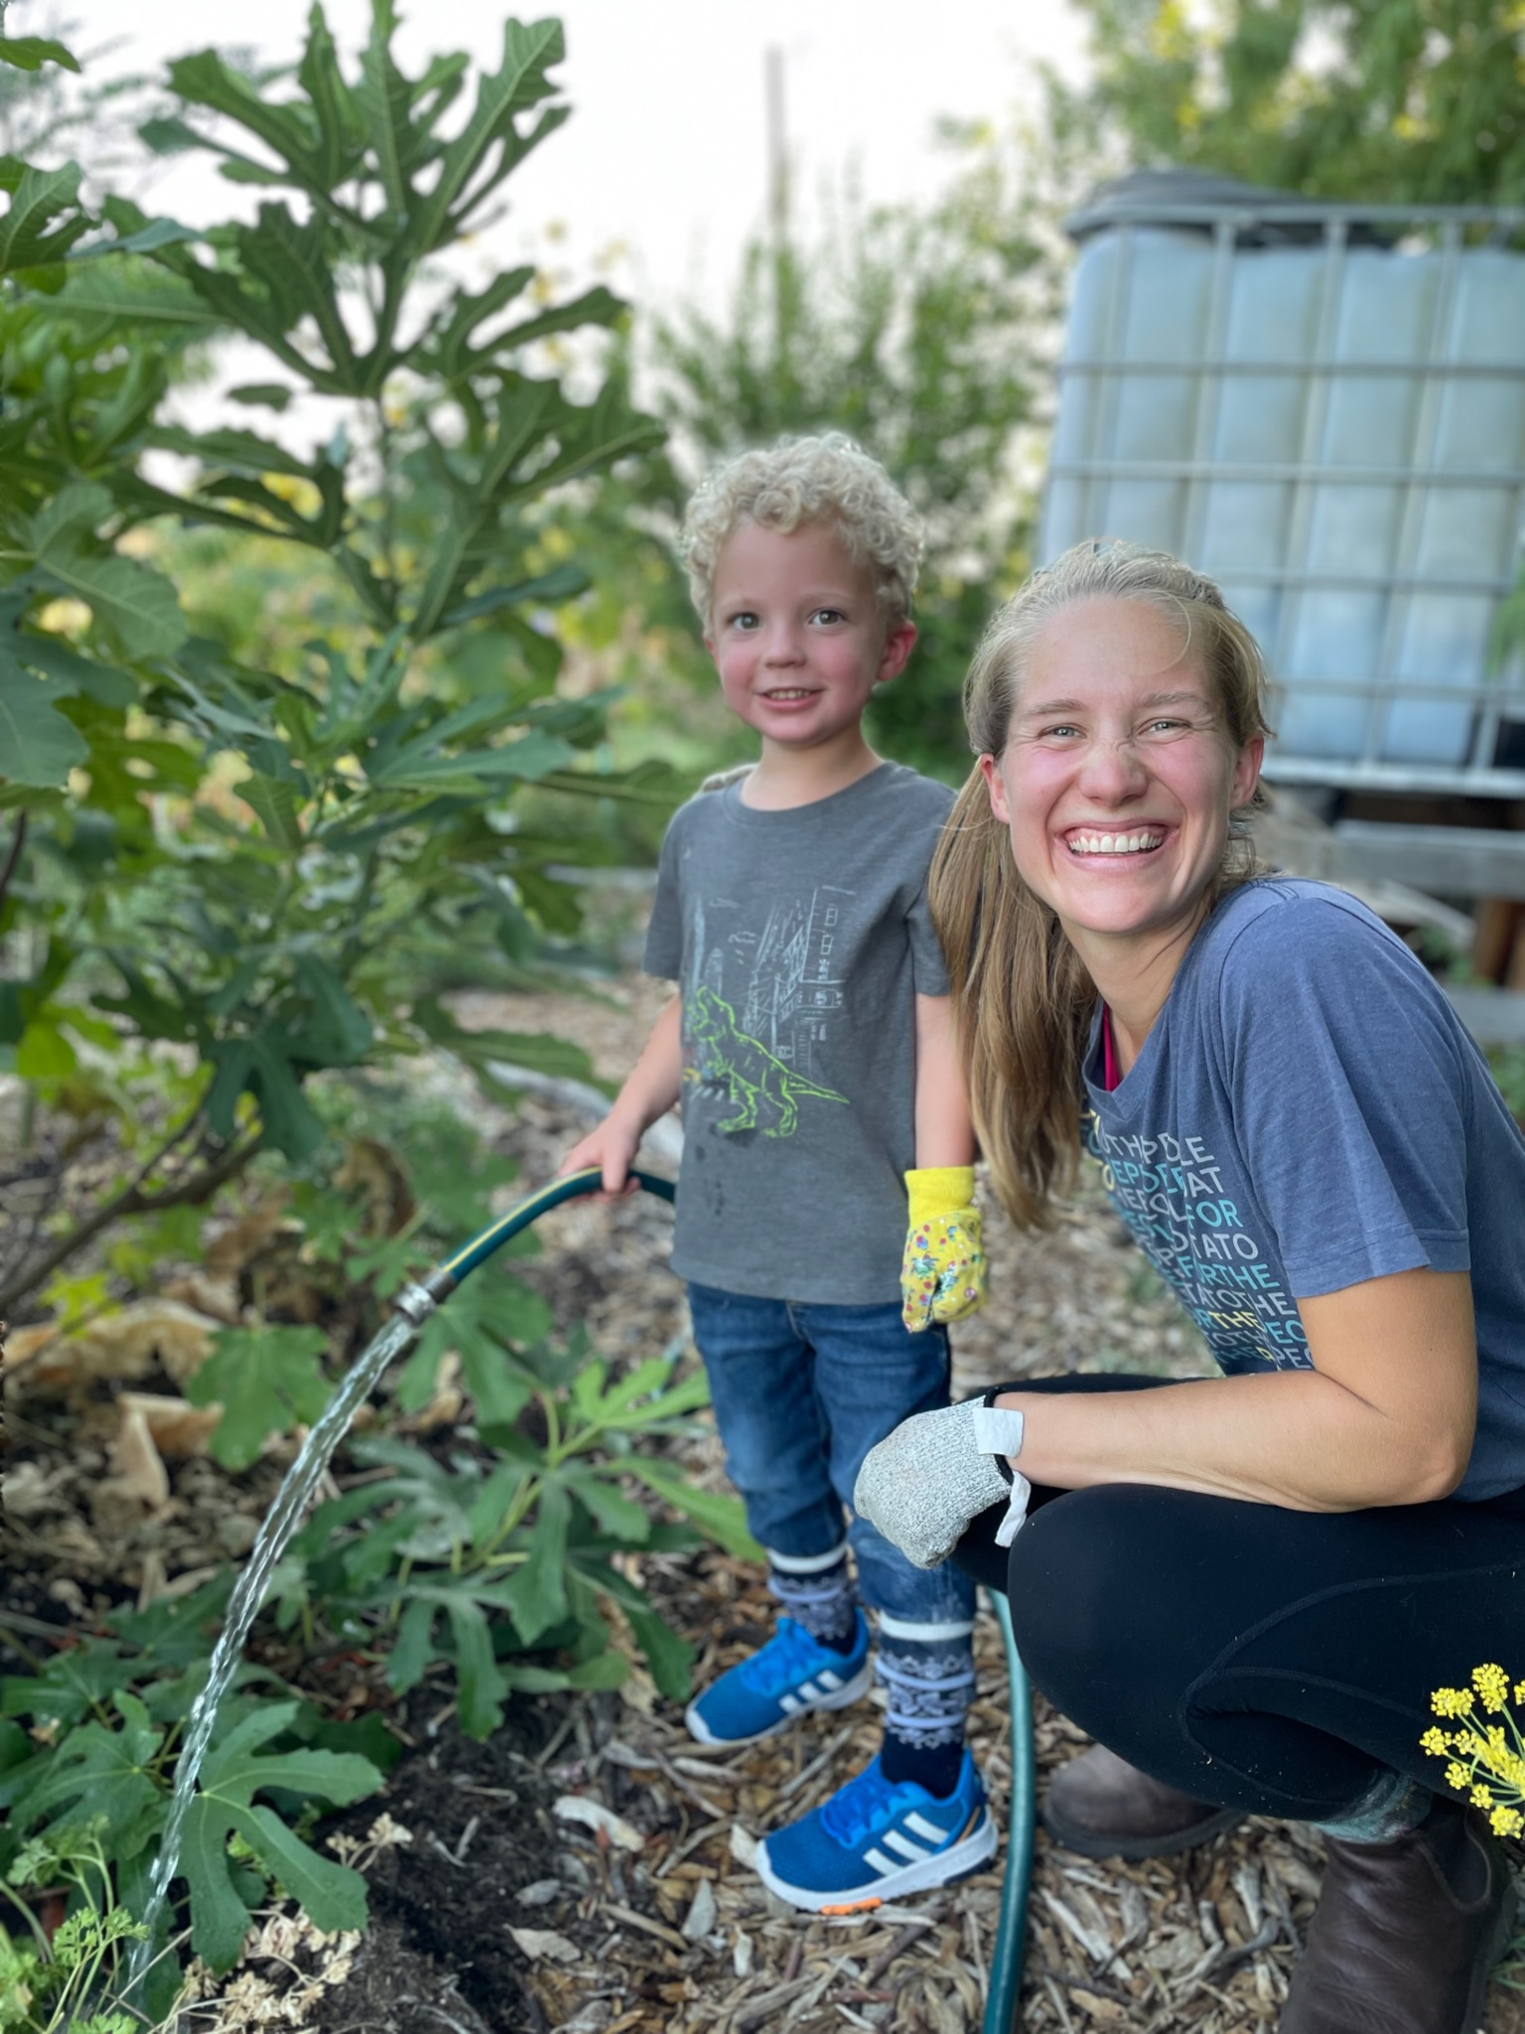
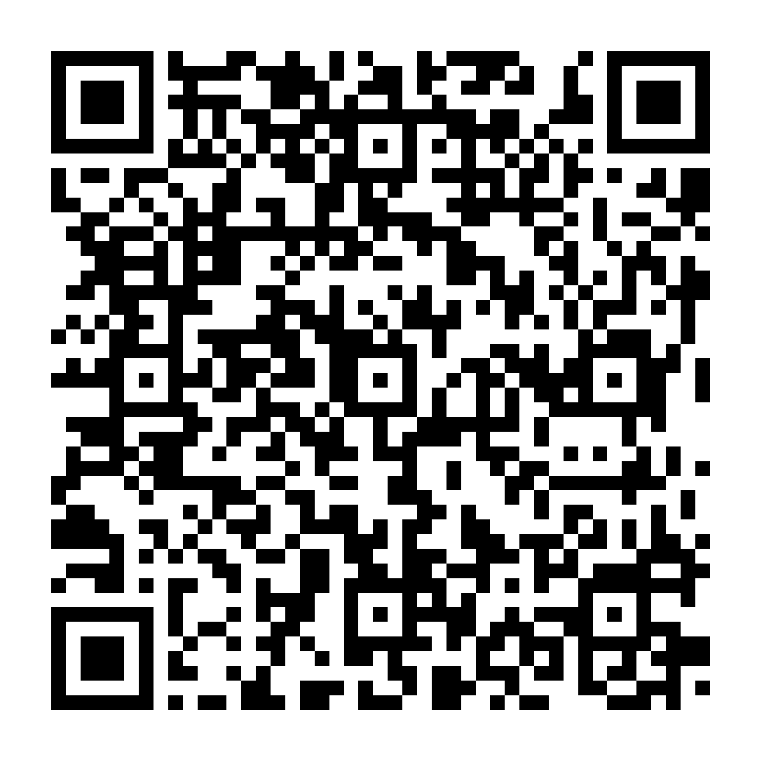
Contact
Claire Howell, Disciple City Church
Email: creationcare@disciplecitychurch.org
Phone: 802-999-8136
Sign up for our next
Garden Work Day! —>

