Slide 1


www.dallascert.com
Office of Emergency Management

Slide 2
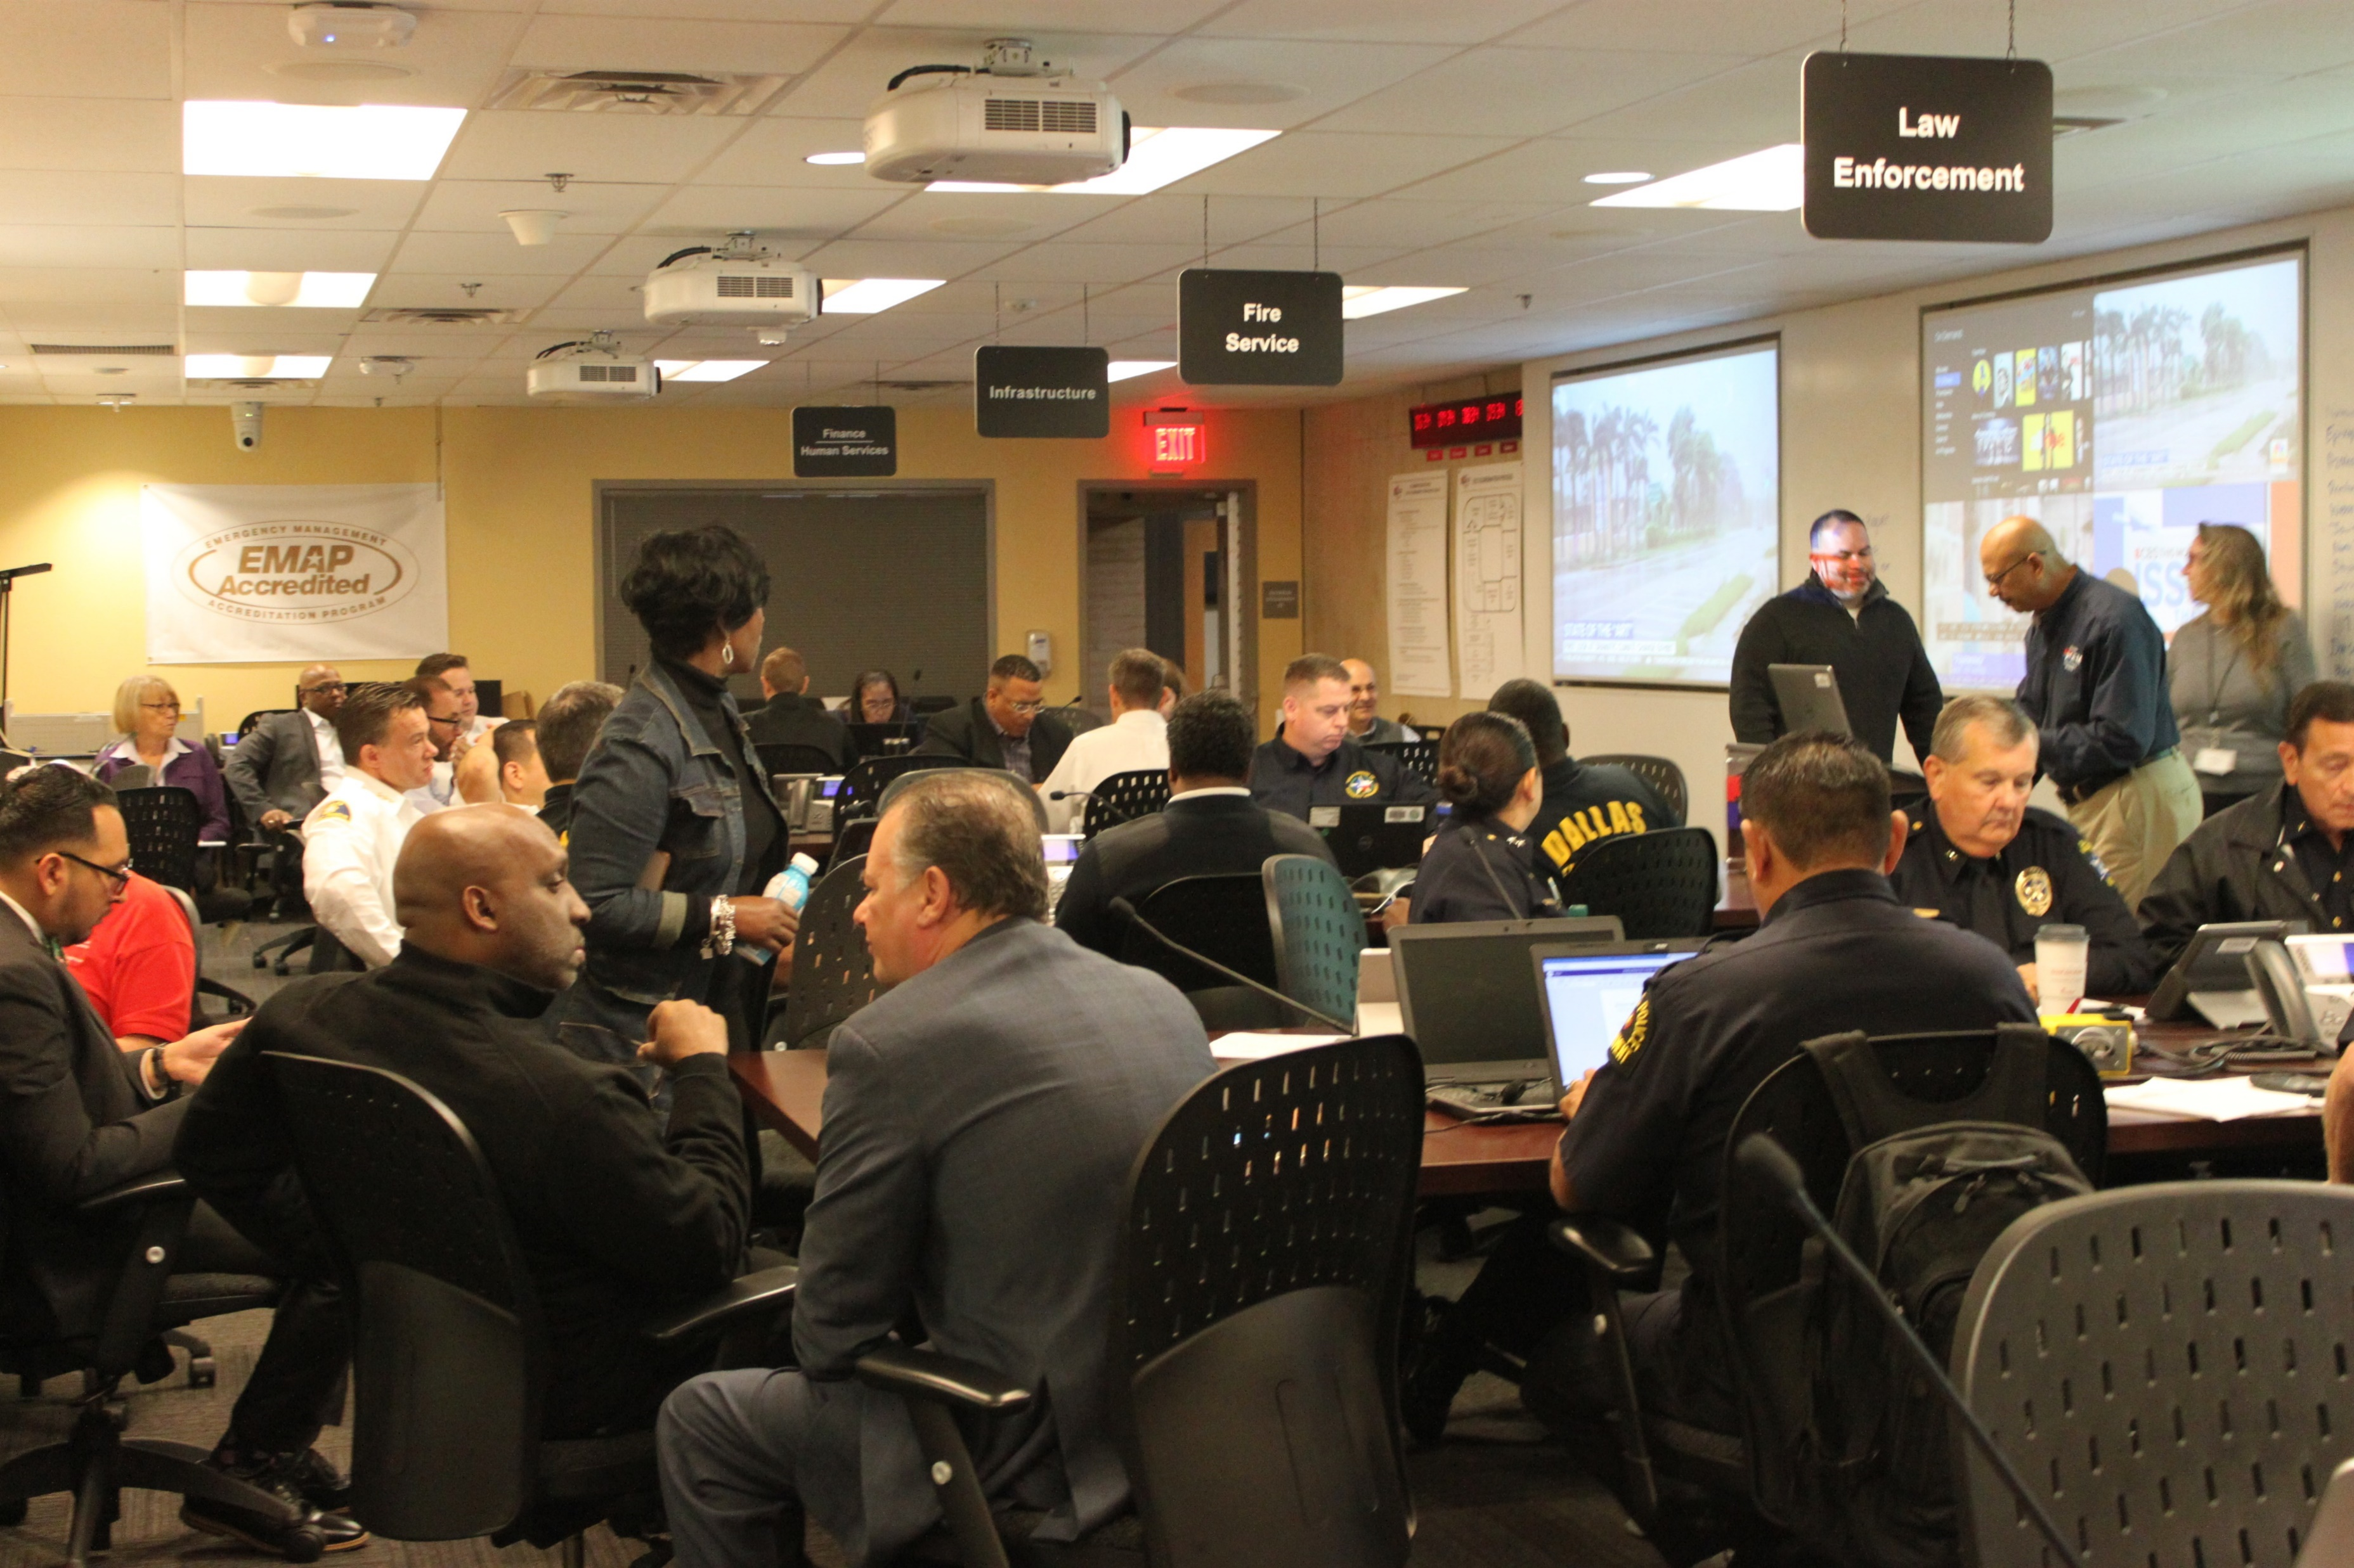
Emergency Operations Center (EOC)
The EOC serves as the coordination point for large, complex incidents and special events
Staffed by representatives that make up Emergency Support Functions (ESF), liaisons from private sector and NGOs, and County, State, and Federal partners
EOC Standing Objectives
Situational Status/Analysis
Prioritization of Incidents
Acquire/Allocate Critical Resources
Crisis Information Management
Develop/Advise/Support Policy-Level Decisions
Coordination with County, State, Federal, Private, and NGO partners
EOC Readiness Levels
Level | Triggers | Activation Authority
4 - Normal Conditions | No known threats/hazards to city | N/A
3 – Increased Readiness | Severe weather threat Planned event/protest | Incident Commander Mayor City Manager/Deputy City Manager Emergency Management Coordinator Police or Fire Chief OEM Duty Officer
2 – Partial Activation | Impact from disaster Large scale planned events Incident requiring significant amount of city resources
1 – Full Activation | Terrorism or mass violence Widespread or complex impacts from a disaster Major sheltering events Any incident requiring significant internal and external resources
1 of 24

Slide 3
Office of Emergency Management (OEM)
Blue Sky Days: Prepare in collaboration with stakeholders to enhance the capability of the city and its residents to respond and recover from disasters.
OEM manages these functional areas:
  Emergency Operations Center
  Emergency planning
  Training and exercise
  Public info & warning systems
  Emergency logistics
  Command One
  Community preparedness
  Grant management
  Disaster finance
Black Sky Days: Support the on-scene response by coordinating resources and connecting partners so that response objectives are met, and recovery begins as quickly as possible.
Organizational Chart
Disaster Finance Coordinator
Grants Coordinator
Director
Operations
Grants Assistant
Senior Office Assistant
Grants/Finance/Budget
Assistant Emergency Management Coordinator
Senior Planner
Community Preparedness Program Manager
Training and Exercise Coordinator
Regional Catastrophic Planner
Logistics Specialist
Planning Specialist
Public Information Officer
AED/Command One Coordinator
2 of 24

Slide 4
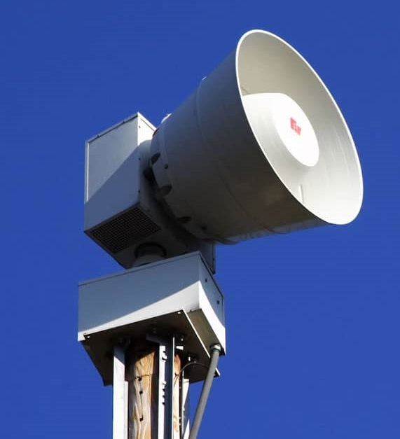
Alerts and Warnings
OEM utilizes two primary methods of notifications for emergency incidents:
Outdoor Warning System: 180 pole mounted sirens that are
activated under these criteria:
  NWS issues a Tornado Warning in or around the City of Dallas
  NWS issues a Severe Thunderstorm warning with sustained
  winds over 70 mph
  Trained spotters have reported a tornado within City of Dallas
  Hail of 1.5” in diameter or greater
  Other emergencies as deemed by OEM
Integrated Public Alert and Warning System (IPAWS):
  Wireless Emergency Alerts (WEA): alerts cell phones directly within a defined geographic area
  Emergency Alert System (EAS): issued to broadcasters to interrupt programming or scroll on screen
3 of 24

Slide 5

Dallas CERT Objectives
Increase disaster preparedness and training for citizens in the City of Dallas

Slide 6
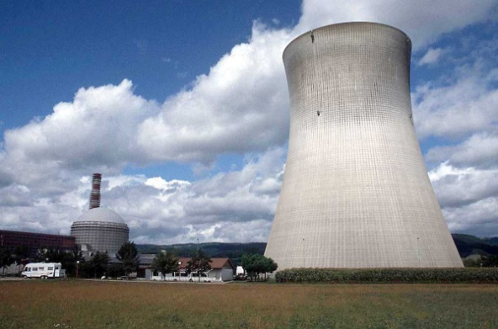
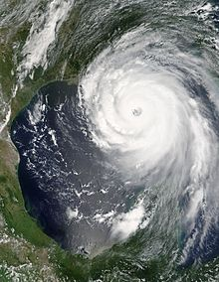
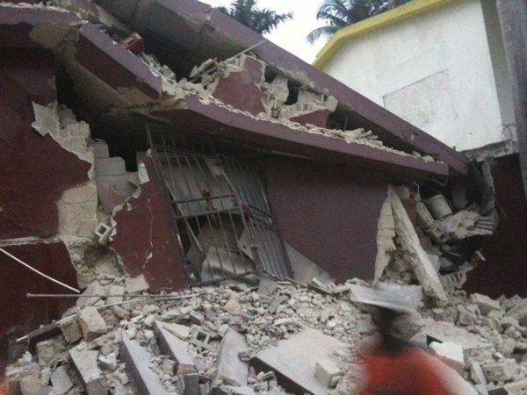
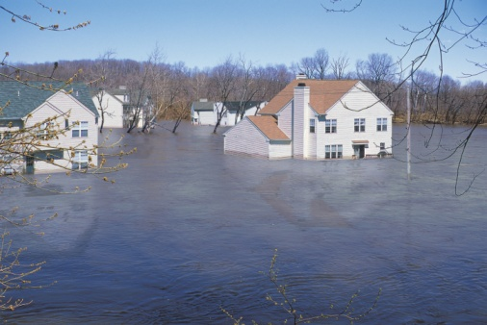
Dallas CERT Objectives
Prepare for “all hazards” to include severe weather, natural disasters, hazardous materials incidents, or other significant events

Slide 7
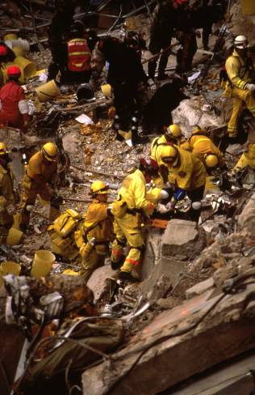
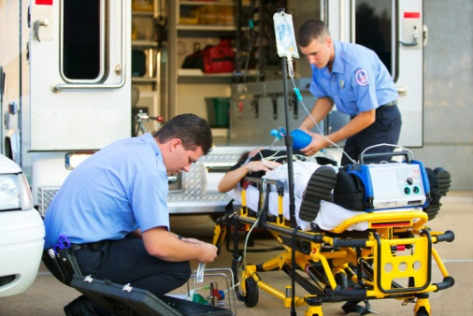
Dallas CERT Objectives
Respond to immediate needs in the neighborhood following a major incident or disaster when professional responders are delayed or to assist our public safety departments

Slide 8
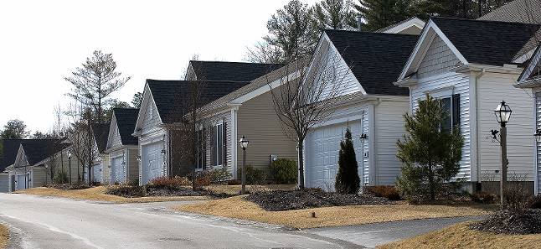

CERT Training Teaches Participants to:
Identify the types of hazards most likely to affect the home or workplace
Describe the function of CERT and their roles in immediate response

Slide 9
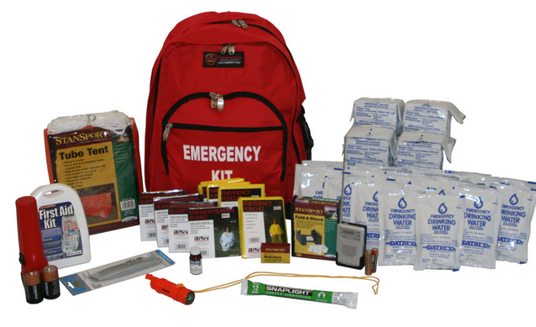
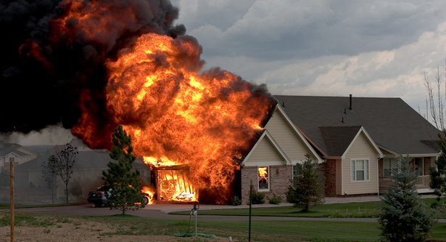
CERT Training Teaches Participants to:
Take steps to prepare themselves, families and communities for a disaster
Identify and reduce potential fire or other hazards in their communities and homes

Slide 10
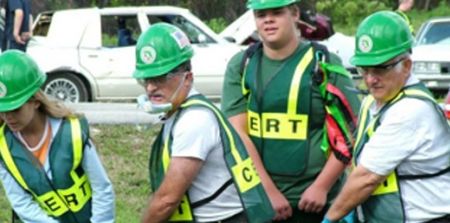
How Long is Training?
Appx. 20 hours - Students attend nine units
Students are able to make up missed sessions
  (at future CERT class offerings)
Lecture is supported by a variety of media methods
9 of 24

Slide 11
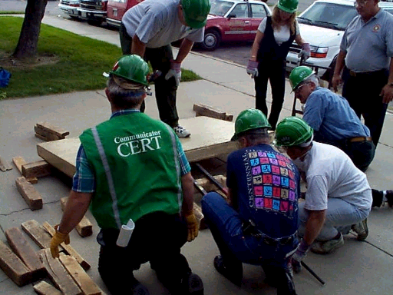
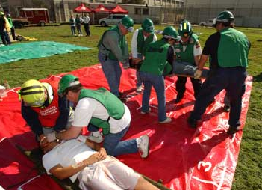
How Long is Training?
At the end of the course, you participate in a final exercise covering all the disciplines learned in class using the Fire Academy Training Facility.
10 of 24

Slide 12
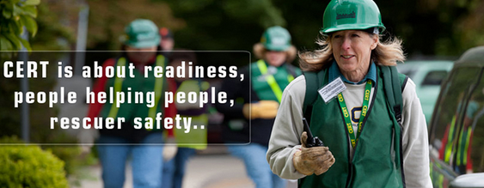
More Information on Training
Many previously CERT members are utilized as volunteer victims
After completion of the course, further study or refresher training can be done by utilizing the FEMA home study courses available on the FEMA website
11 of 24

Slide 13
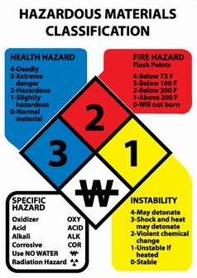
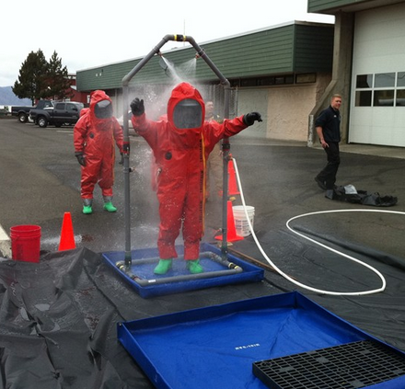
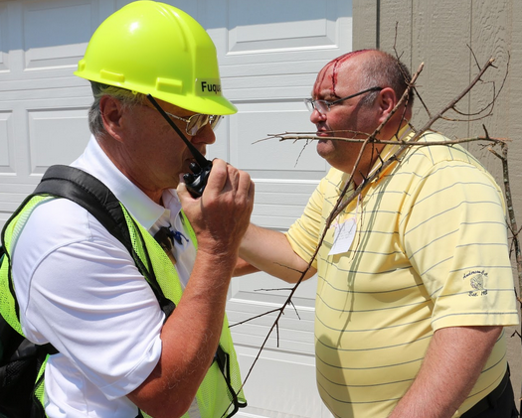

More Information on Training
We also facilitate and offer Continuing Education training to those graduates interested in furthering their education and training in a specific area
12 of 24

Slide 14
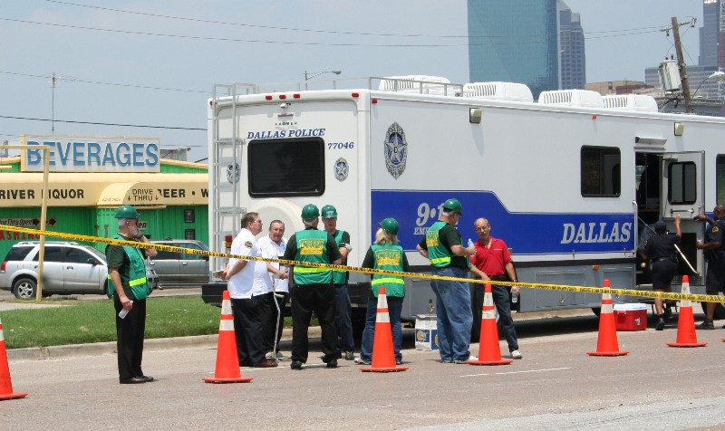



CERT Continuing Education Training
Shelter Management
Donations Management
Fire Safety
Haz-Mat
Advanced First Aid
Ham Radio Operators License
Exterior SAR
Refresher Courses
CPR/AED

Slide 15
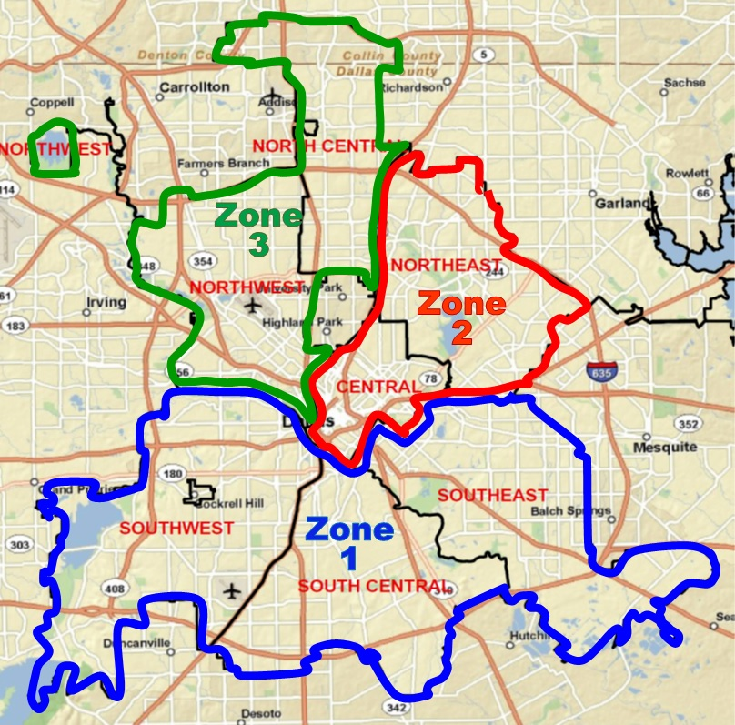

Team Composition
Teams are organized by Dallas Patrol Divisions

Slide 16



Team Composition
Neighborhood and Homeowner Associations
Police and Fire Auxiliary Academies (VIP, COPS, Citizens Fire Academy)
City Employees
Schools, Places of Worship, Businesses, Civic Groups, Hospitals, and Homes For The Elderly (future plans)
Neighborhood Watch
Volunteers
In
Patrol

Slide 17
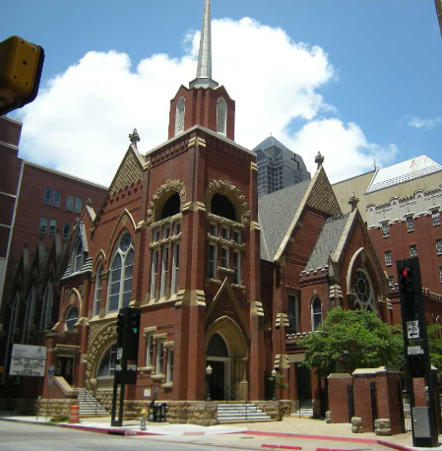
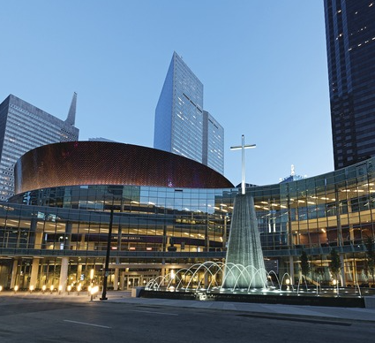
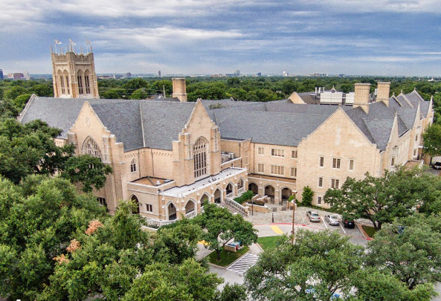
Team Composition: Houses of Worship
Prepared for severe weather, natural disasters, hazardous materials incidents, or other significant events
Trained in shelter management
Respond to immediate needs in the neighborhood following a major incident

Slide 18

What Can CERT Do To Help?
Upon being notified by authorities of the impending danger of severe weather, CERT members are able to begin:
17 of 24

Slide 19
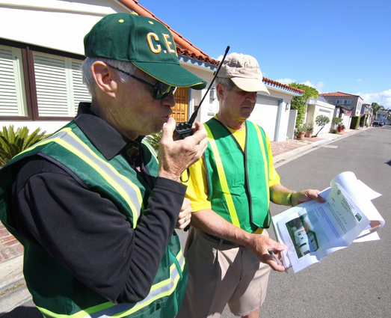



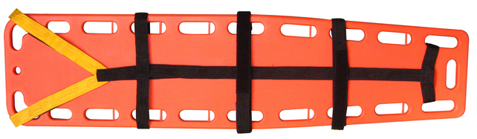
What Can CERT Do To Help?
Taking inventory of their neighborhood
Identifying neighbors that have special needs or have to make special preparations
Coordinating equipment that will be useful during and after the emergency or disaster
18 of 24

Slide 20
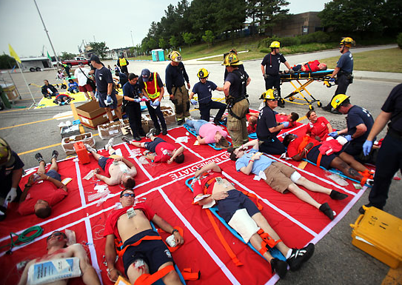
CERT to the Rescue!
After the hazard has occurred:
  Assess and assist neighbors or co-workers with special needs
  Locate injured neighbors or co-workers, render first aid and where necessary move them to a safe area for further treatment
19 of 24

Slide 21
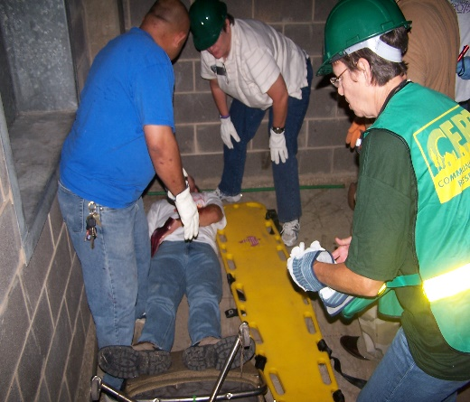
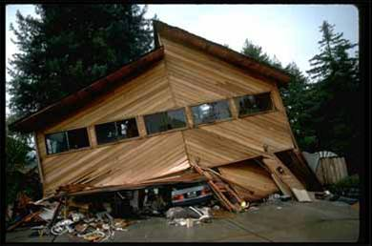
CERT to the Rescue!
  Extricate neighbors or co-workers entrapped in collapsed structures
  Identify and isolate areas of potential danger
20 of 24

Slide 22

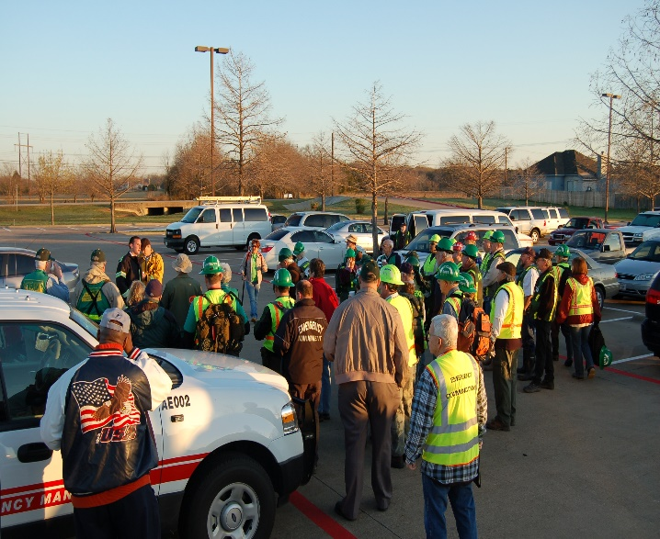
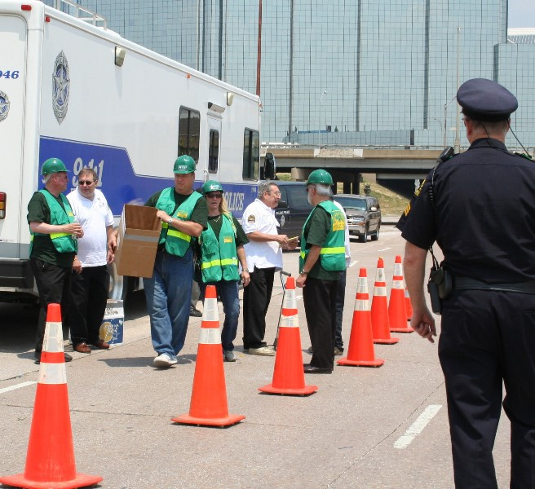
CERT Activations
Southwest Gas Explosion Incident – July 2007
Mesquite Flood/USAR Incident – March 2008
Hurricanes Gustav and Ike – August/September 2008
Rowlett Tornadoes – December 2015
Hurricane Harvey – August 2017

Slide 23
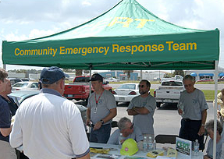
Other CERT Activities
Staff first aid booths at special events
Assist with disaster and emergency drills in their neighborhoods and workplaces
Distribute preparedness materials
Volunteer at various community and City of Dallas events such as CERT Conference
Continuing Education and Refresher Courses
22 of 24

Slide 24
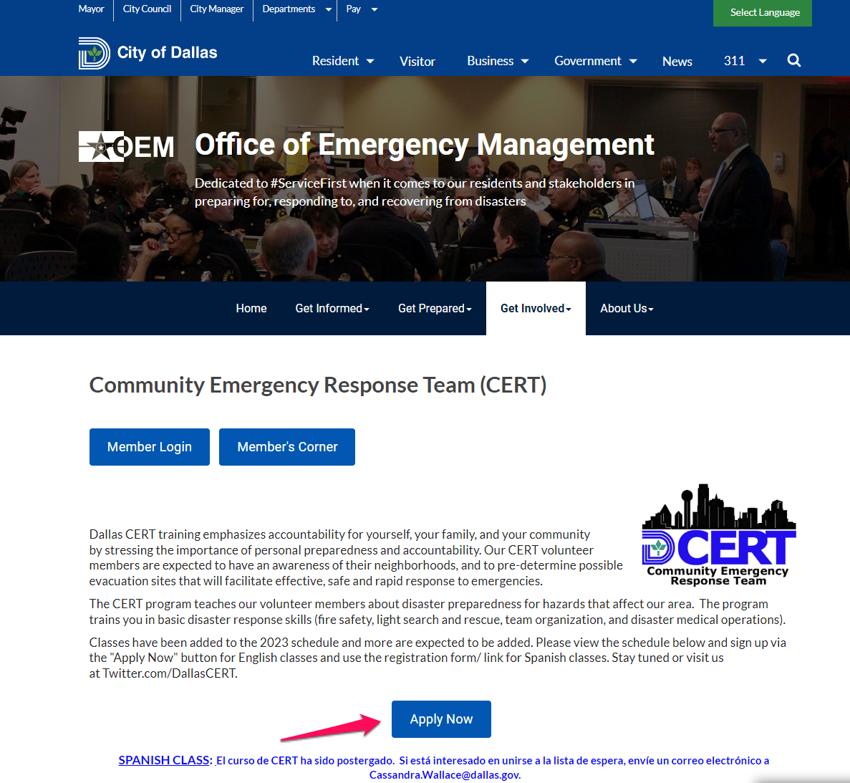
Enrolling In CERT
Notes:
Student Introductions
Name Previous related training
Reason for attending
Expectation from this class

Slide 25
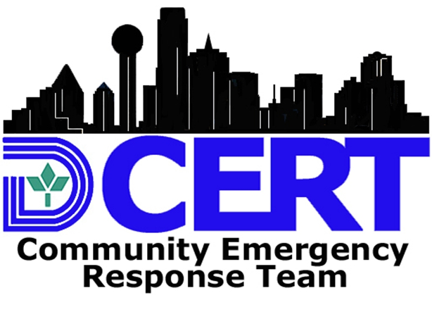
Questions?
Program Manager
Cassandra D. Wallace
1500 Marilla, L2AN
Dallas, TX 75201
cassandra.wallace@dallas.gov
214-671-8969
CERT Instructor
Chris Herzog
1500 Marilla, L2AN
Dallas, TX 75201
Christopher.herzog@dallas.gov
214-300-5021
24 of 24

