Slide 1

Expanding Coverage in Texas UMW Conference 2021
Cindy Ji, she/her
Health Policy Associate
cji@childrensdefense.org
Laura Guerra-Cardus, she/her
Deputy Director
lguerracar@childrensdefense.org

Slide 2
Take 10 minutes to reflect & write:
What is your history with health insurance? Have you been uninsured in the past?
What do you do when you get sick or need medical care? What are your concerns about facing a serious injury or new diagnosis?
How might others in your community answer this question?
How would expanding coverage impact your community?

Slide 3




Slide 4
Texas has the highest uninsured rate nationwide.
18.4%
of Texans were uninsured
US Census Bureau, ACS 1-year estimates, 2019
29.0%
of adults in Texas under the age of 65 are uninsured
July 2020, Families USA
Notes:
659,000 Texans lost their job-based health insurance from February to May (COVID-19 related job losses).

Slide 5
What have TX leaders done so far this year for healthcare?
The partial ”1115 waiver” extension provides needed federal funding to help keep hospitals doors open.
But: it marks the end of DSRIP* funding, 40% of which went to services for uninsured patients.
Without a coverage solution, uninsured Texans are left worse off than before.
The waiver does nothing to address healthcare coverage.
Our leaders’ work is not over!

Slide 6
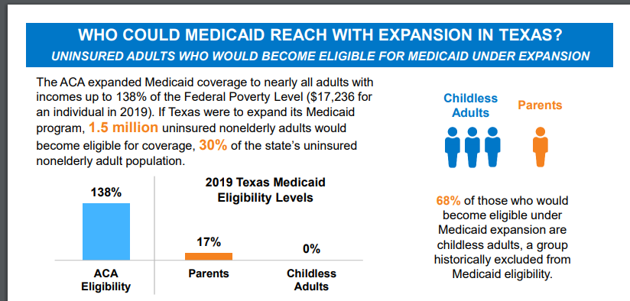

Notes:
This is a different session than past sessions: bipartisan support, COVID-19 (job loss), revenue shortfall (though not as bad as we thought), support from Metro 8, AARP, TMA, THA

Slide 7
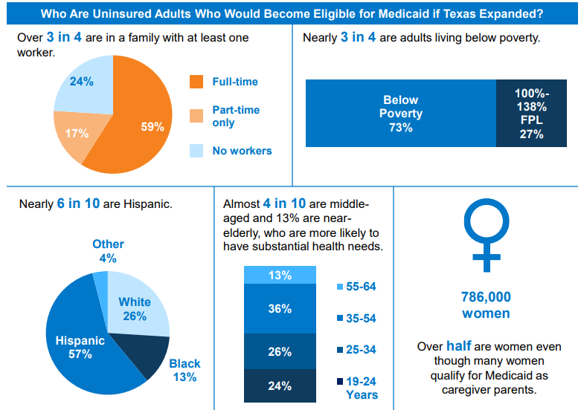

Slide 8
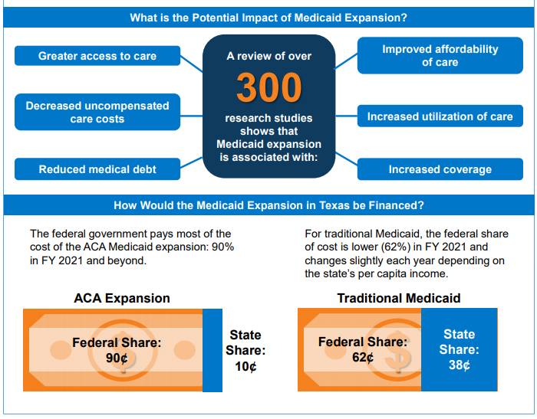

Slide 9
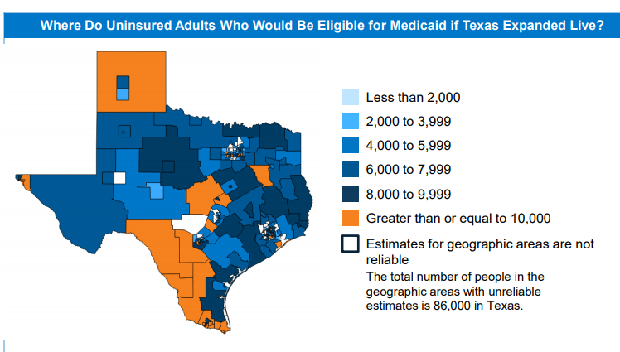

Slide 10
What is the state budget impact of expanding Medicaid?
Cost for an estimated 1 million newly enrolled Texans: $6.3 billion.
Total non-federal cost: $650 million
New Rev + State Savings= $704M (more than offset costs)
Annual Cost Savings for Existing Medicaid Groups: $106 million/yr
Annual Cost Savings for Health Programs Funded With General Revenue: $488 million/yr
Inpatient care of incarcerated prisoners: $251 million/yr
Community Mental Health Services: $200 million/yr
Substance Abuse Treatment Services: $12 million/yr
HIV Medication Assistance Program: $16.5 million/yr
Kidney Health Care Program: $8.4 million/yr
Additional Revenue: $110 million/yr
Total Positive Impact: $704 million/yr
Pitts, Pitts, and Fritz report for Episcopal Health Foundation, 2020

Slide 11
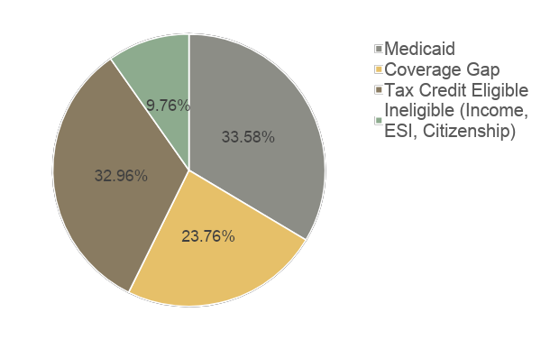

What happened to Texans who lost their health insurance last year?
Eligibility for public programs following job loss, January 2021

Slide 12
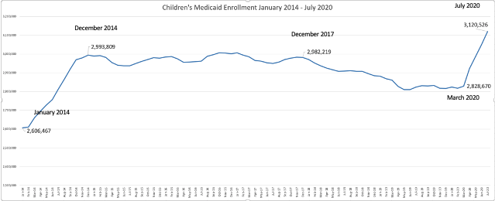
Texas also has the highest child uninsured rate.
Many TX children who are eligible for Medicaid are not enrolled.
Every Texan, Oct. 2020
Notes:
2014: ACA
2017: public charge and attack on ACA
2020: COVID-19

Slide 13
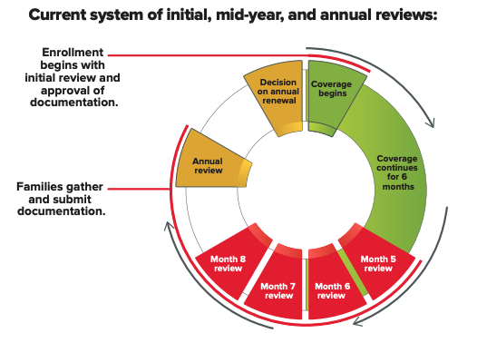
Children on Medicaid face barriers to maintaining enrollment.
Notes:
Bad data: relies on databases often with outdated information & among families who return paperwork, the vast majority are still eligible
Families only have 10 days to respond and are disenrolled if they don’t supply proper documentation in that time frame – and they’re not automatically renewed in CHIP if data in the system indicates they might be
Churning on and off has health consequences for kids

Slide 14
Healthcare Policy Priorities
Medicaid expansion for ~2.2 million uninsured adults
12 months continuous eligibility for children’s Medicaid
Extend Maternity Medicaid to 12 months after birth
Oppose budget cuts to health care
Revitalize and reinvest in outreach and enrollment support
Notes:
CTN, CDF-TX, SOIT, CHCC differences Remove HHSC barriers to remote enrollment, improve TWC referrals to TDI and HHSC
Fund local assistance statewide
Robust outreach and education to reassure parents of more than 1 in 4 Texas kids who have a non-citizen parent that they can access Medicaid and CHIP: lost over 237K kids since 12/2017

Slide 15
Healthcare Policy Priorities, cont.
Promote telehealth and telemedicine, including beyond pandemic
Close the ambulance loophole in Texas’ surprise medical billing protections
Strengthen coverage for people who buy health insurance on their own
Remove barriers to enrollment in state women’s health programs and ensure adequate funding
Clear, consistent statewide guidance on COVID-19 testing access
Oversight of workplace exposure and accountability for intervention in outbreaks in all 254 counties
Ensure adequate PPE for home health workers, personal attendants serving elderly and disabled
Notes:
Lower unsubsidized premiums using “reinsurance” to cover more middle and upper income Texans (via 1332 waiver)
Put in strong pre-existing conditions protections in state law, in case courts overturn the ACA
Close loopholes used by some non-traditional health plans to avoid giving consumers clear, up-front information on what the plan covers and doesn’t cover.
Defend against efforts to expand plans that lack protections for pre-existing conditions, offer only limited-benefits, and can expose consumers to catastrophic costs in the event of illness or injury.

Slide 16
What can we do to make these policies a reality?
Notes:
Talk briefly about history of SOIT, and how we came to realize that we needed to build people power.
Activity to answer in the chat: In your own words, what is people power?

Slide 17

Notes:
Summarize chat discussion on people power.
People power is the difference between walking in to a legislative visit with your talking points, and walking in with a petition with hundreds of signatures.
People power is demonstrating that you’re engaging your community on this issue, that you are constituents, and that you’re watching to see if your representative will make the right decision.

Slide 18
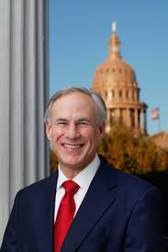
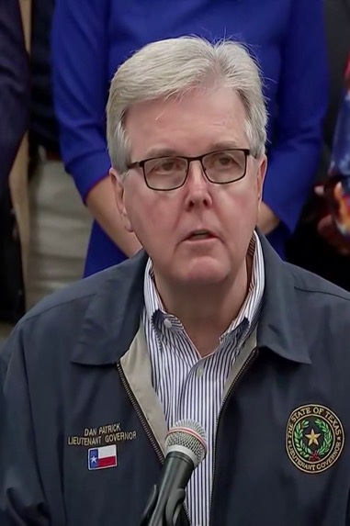
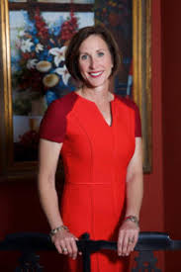

Who are our targets?
Gov. Greg Abbott
Lt. Gov. Dan Patrick
Sen. Lois Kolkhorst
Your State Senator!
Chair of Senate Health and Human Services Committee
Who represents you?
wrm.capitol.texas.gov

Slide 19



What can you do to make your targets feel the power of your community?

Slide 20
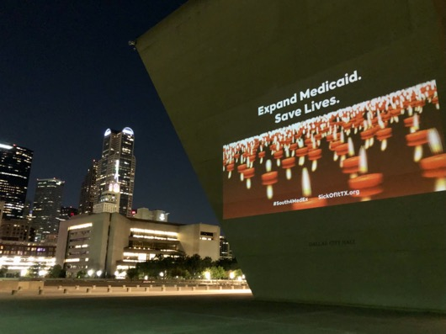
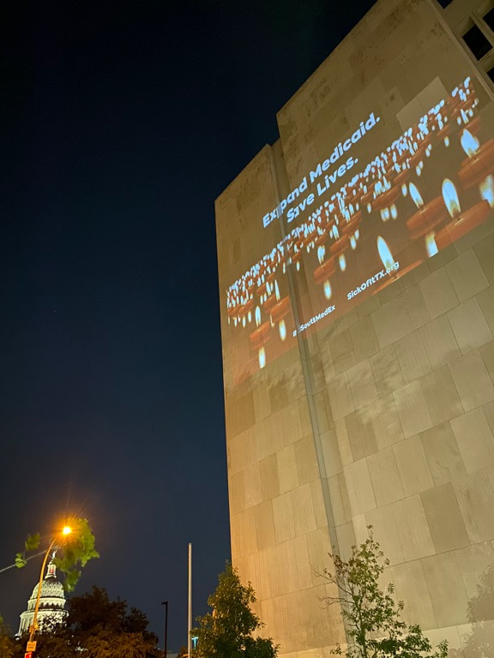


What can you do to make your targets feel the power of your community?
Notes:
Creative example during COVID-19

Slide 21
What can you do to make your targets feel the power of your community?
Write to your state representatives: https://sickofittx.com/medex-letter-lege2021/
Call your state senator or Tweet at Gov. Abbott, Lt. Gov. Dan Patrick, and Sen. Kolkhorst: https://ctt.ac/T5ILV
Share your health coverage story: sickofittx.org/tell-your-story Plus: Use our tool to survey members of your community. https://forms.gle/uTRUgxswyo9FXTWJ9
Notes:
Other tactics: petitions, letters-to-the-editor, legislative visits

Slide 22
Power building activity:
Introduce yourselves!
Who is your target?
Who in your area has influence over the people who can make coverage expansion a reality?
Who else do you need to persuade?
What resources are available to you? (e.g. time, volunteers, allies, connections, partner organizations, people with personal stories)
What action do you want those in your community to take? (e.g. letter-writing campaign, call campaign, publishing a letter-to-the-editor about living in the coverage gap in a local media outlet)
What are the components of your strategy to get people to take action?
For the next 30 minutes, plan a mini-campaign to build power in your community for expanded coverage in Texas.

Slide 23

Connect with us!
cji@childrensdefense.org
Receive updates on the latest healthcare research, activities, and policy: covertexasnow.org/subscribe
Receive updates on how to take action on healthcare policy: sickofittx.com/join

