Slide 1
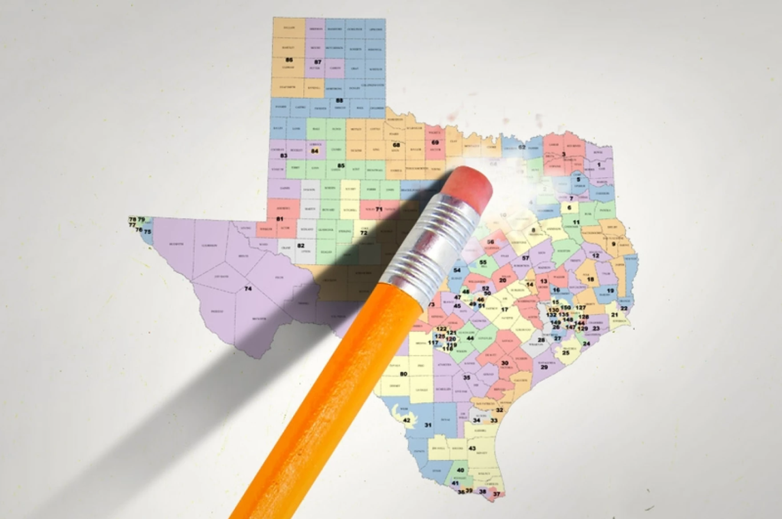
REDISTRICTING IN TEXAS
Presentation for the United Methodist Women’s Legislative Event
January 24, 2021
Bonnie Bruce, Director of Governmental Affairs for Texas Society of Anesthesiologists

Slide 2
WHO DRAWS WHAT DISTRICTS, WHEN AND UNDER WHAT AUTHORITY?

Slide 3
WHO DRAWS WHAT?
State Government
Local Government
Congressional Districts
State Legislative Districts
State Board of Education
State Judiciary
County Commissioner Districts
City Council Districts
School District Trustee Districts
Local Precinct lines
Order of Operations

Slide 4
REDISTRICTING AUTHORITY
 | Congress | State Legislature | State Board of Education | State Judiciary
 | The Texas Legislature Does not have to be during Regular Session although Gov. would have to put on the call for a Special Session | After a decennial census: Texas Legislature during a Regular Session, and the Texas Legislative Redistricting Board (LRB) if they fail | Texas Legislature Does not have to be during Regular Session | After a decennial census : Texas Legislature during a Regular session, and the Texas Judicial Council (TJC) if they fail, and the Texas Legislative Redistricting Board (LRB) if they fail
U.S. Constitution | Each Legislature determines manner of apportionment in a manner directed by law Citizens include all individuals born or naturalized Apportionment shall happen every ten years and includes all citizens, except “Indians not taxed.” All citizens may not have their rights abridged, except for participation in rebellion, or other crime. | Citizens include all born or naturalized All citizens may not have their rights abridged, except for participation in rebellion, or other crime. |  | Citizens include all born or naturalized All citizens may not have their rights abridged, except for participation in rebellion, or other crime.
Texas Constitution | The apportionment of the Congressional district can only be decided by the Texas Legislature | Legislative districts are draw at the first Regular Session after a decennial census If the Legislature fails the LRB draws Legislative seats County line rule | The Legislature shall provide by law for a SBOE whose members shall be appointed or elected in such manner and by such authority and shall serve for such terms as the Legislature shall prescribe not to exceed six years. | The Legislature may draw judicial districts during any regular session The TJC may meet after a Regular Session after a decennial census where the Legislature failed to adopt a new statewide judicial map If the TJC fails, the LRB will draw districts

Slide 5
WHAT IS THE LEGISLATIVE REDISTRICTING BOARD?
Texas Legislative Redistricting Board
Lieutenant Governor
Attorney General
Comptroller
Commissioner GLO
Speaker of the House
Does not exist until Sine Die, but nothing prevents them from working together prior to their actual start date. In past, members of the LRB would appoint staff to follow hearing and meet with stakeholders and potentially draw or work with Legislative Council to draw maps.
The LRB only has authority over Texas Legislative districts (and in unusual circumstances, judicial districts).
The LRB has only 90 days to complete its work some of which will be during the Governor’s veto period. And will most certainly be during litigation.

Slide 6
REDISTRICTING TIME LINES IN THE PAST
May | June | July | August | September | October
2011
Governor Perry
Redistricting Board
5 Rep 0 Dem
House
101 Rep 49 Dem
Senate
19 Rep 12 Dem
30
May 31 – Jun 29
17
Republican Legislature passes Congressional maps
Republican Legislature passes House and Senate maps
Republican Governor Signs Maps
2001
Governor Perry
Redistricting Board
5 Rep 0 Dem
House
72 Rep 78 Dem
Senate
16 Rep 15 Dem
28
6
10
16
24
25
Legislative Redistricting Board Hearings
Divided Legislature fails to pass maps
1991
Governor Richards
Redistricting Board
0 Rep 5 Dem
House
60 Rep 90 Dem
Senate
9 Rep 22 Dem
27
16
Democratic Legislature passes maps
Democratic Governor Signs Maps
1981
Governor Clements
Redistricting Board
0 Rep 5 Dem
House
37 Rep 113 Dem
Senate
7 Rep 24 Dem
21
30
30
3
24
25
25
26
27
28
Democratic Legislature passes maps
Republican Governor Vetoes Maps
Legislative Redistricting Board Hearings ***
*** The LRB of the 68th Legislature also met in Jan. 1982 to resolve a non-contiguous issue with a district adopted by the LRB in Oct. 1981

Slide 7
NORMAL TIMELINE OF A SINGLE REDISTRICTING PROCESS
January 2021 | February 2021 | March 2021 | April 2021 | May 2021 | June 2021 | July 2021 | August 2021 | September 2021 | October 2021 | November 2021 | December 2021
Lawsuits over Constitutional & VRA violations
US Census Bureau
Texas Legislature
(30 Day Special Session)
Texas Legislature
(140 Day Regular Session)
Gov. Abbott
Texas Legislative Redistricting Board
(90 days upon final adjournment of Legislature)
Filing for Precinct chairs
Filing for Primary Candidates
Local Govt. draw districts
Candidates running for office

Slide 8
POSSIBLE COVID-IMPACTED SCHEDULE FOR 2021
January 2021 | February 2021 | March 2021 | April 2021 | May 2021 | June 2021 | July 2021 | August 2021 | September 2021 | October 2021 | November 2021 | December 2021
Texas Legislature
(140 Day Regular Session)
Lawsuits over Constitutional & VRA violations
Gov. Abbott
US Census Bureau
Texas Legislative Redistricting Board
(90 days upon final adjournment of Legislature)
Texas Legislature
(30 Day Special Session)
Local Govt. draw districts
Filing for Precinct chairs
Filing for Primary Candidates
Candidates running for office

Slide 9
REDISTRICTING PRINCIPLES
Legal guidelines for how to draw a map

Slide 10
VOTING RIGHTS ACT
Citation
Fed. VRA of 1965 – Sec. 2 | Allow members of a racial or language minority group to challenge a redistricting plan that limits or diminishes their opportunity to participate in the electoral process and to elect representatives of their choice. The burden of proof is on the plaintiff, if a jurisdiction is found guilty of discrimination, they can be required to preclear their future maps regardless of pre-Shelby status or the nullification of Shelby itself. There is a post-Shelby “claw-back” into pre-clearance in Section 5 based on discrimination. This requires citizenship data to determine affect on citizen voting outcomes.
Fed. VRA of 1965 – Sec. 4 | This section allowed jurisdictions under Section 5 to request “bailout.”
It is now moot after Shelby. Fed. VRA of 1965 – Sec. 5 | Required 9 states (Alabama, Alaska, Arizona, Georgia, Louisiana, Mississippi, South Carolina, Texas, and Virginia), counties in 5 states (California, Florida, New York, North Carolina, and South Dakota) and two townships Michigan to have any new apportionment of district lines to be re-cleared by the Department of Justice or in a court of law with the burden of proof on the district that they did not discriminate. On June 25, 2013 the SCOTUS held that it is unconstitutional to use the coverage formula in Section 4(b) of the VRA to determine which jurisdictions are subject to preclearance. Congress has yet to adopt a new coverage formula so no districts are currently required to undergo Section 5 preclears unless they are coverage by a separate court order under Section 3(c).

Slide 11

LEGAL REQUIREMENTS & PERMISSIBLE GOALS
DO Maintain Equal Population
Congressional – Equal as practicable
Legislative - White v Regester (9.9% deviation from idea)
DO Respect Traditional Redistricting Principles
Compactness
Contiguous
Preserving communities of interest
Preserving political subdivisions
Preserve natural or other geographical boundaries
DO Preserve the core of the previous district
DO Protect Incumbents
DO Protect Political Goals
DO Respect Texas Constitution
County Line Rule for House districts

Slide 12
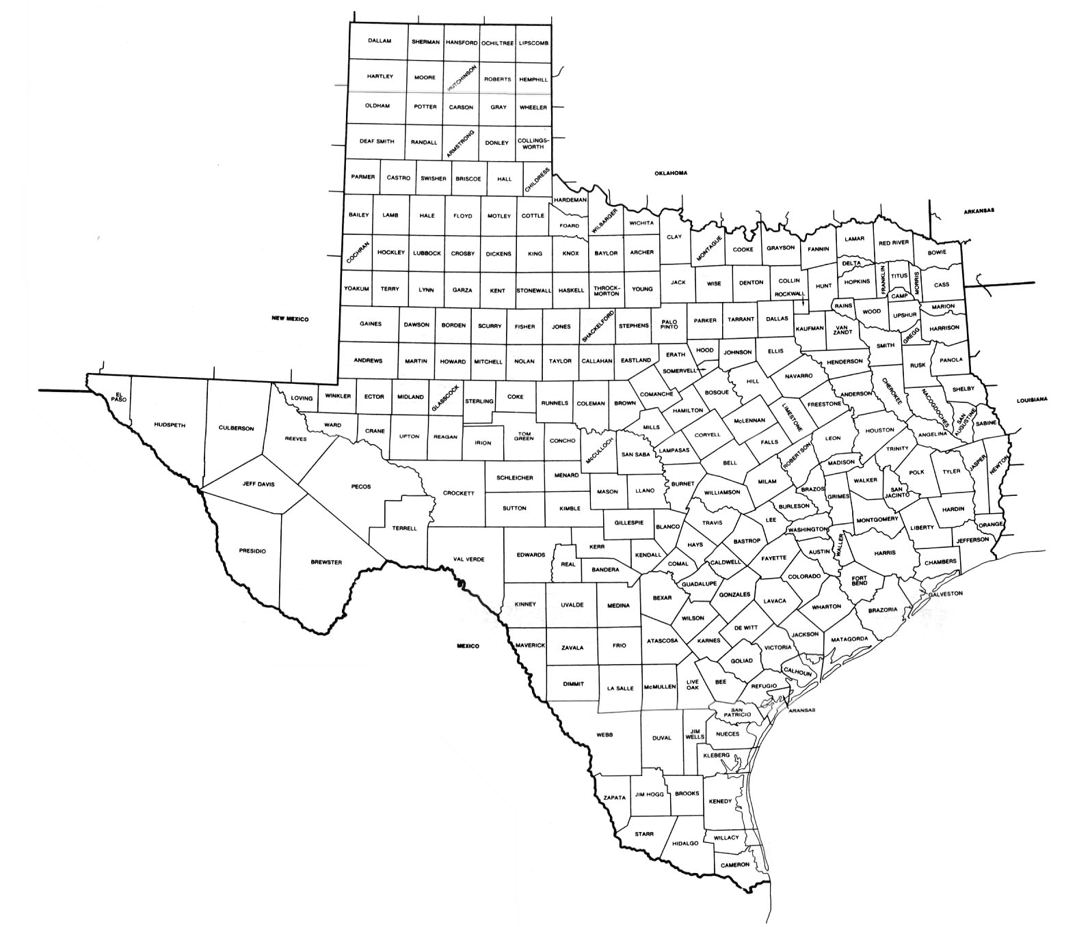
2010 Drop-in Counties for House Districts
Bexar
Dallas
Denton
El Paso
Harris
Tarrant
Travis
Williamson

Slide 13

LEGAL PROHIBITIONS
Thornberg v Gingles
Geography
Cohesive minority
Racially polarized voting
DO NOT Racially Gerrymander
Shaw v. Reno
Districts drawn just for racial purposes require strict scrutiny for compliance
DO NOT Crack Minority Population
DO NOT Pack Minority Population
DO NOT Impinge on minority voters’ rights to elect the candidate of their choice
U.S. Constitution
14th Amendment – Equal Rights
15th Amendment – Prohibits Abridgement or Denial of Vote because of race
Voting Rights Act
VRA Section 2 – Discriminatory Intent
Triggered by Suit
Burden on Plaintiffs
VRA Section 3c – Bail in
Burden on Plaintiffs
VRA Section 5 – Preclearance
Effect
Burden on Defense
Texas has been a covered jurisdiction since 1975
No Retrogression
Must draw minority majority districts
Shelby v. Holder

Slide 14
CAVEATS
The data on the following slides are based on the 2019 U.S. Census Bureau’s 2019 1-year American Community Survey
It is an extrapolation of a survey, not a count
The 1 year data is not as accurate as the 5-year rolling data, but the most recent rolling data is from 2018
The survey’s smallest unit of data is the county level

Slide 15
IDEAL POPULATION
HD Ideal
193,306
CD Ideal
754,574
SD Ideal
935,531
SBOE Ideal
1,933,059
Courts require as little deviation from the ideal as practicable for congressional districts
Courts allow a 10% deviation from the ideal for legislative districts
Largest district
Smallest district

Slide 16
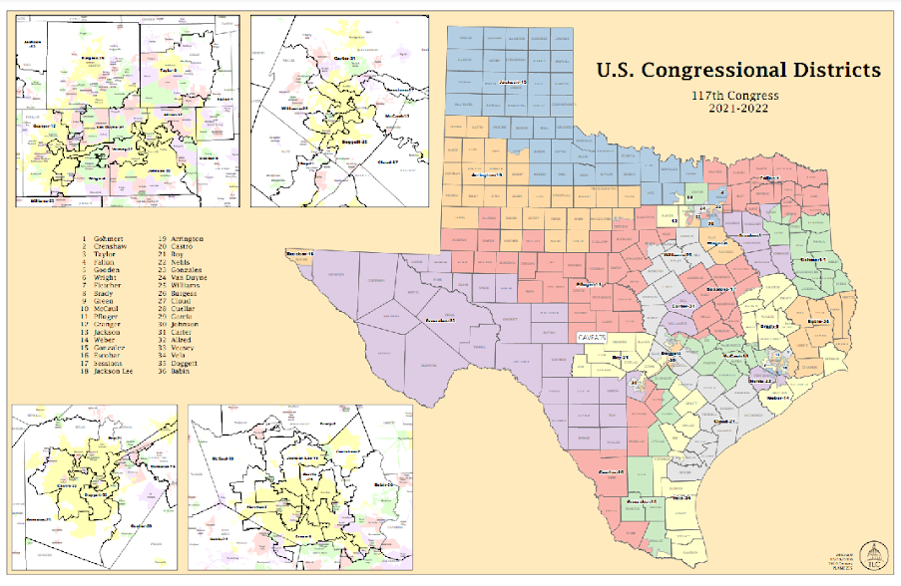
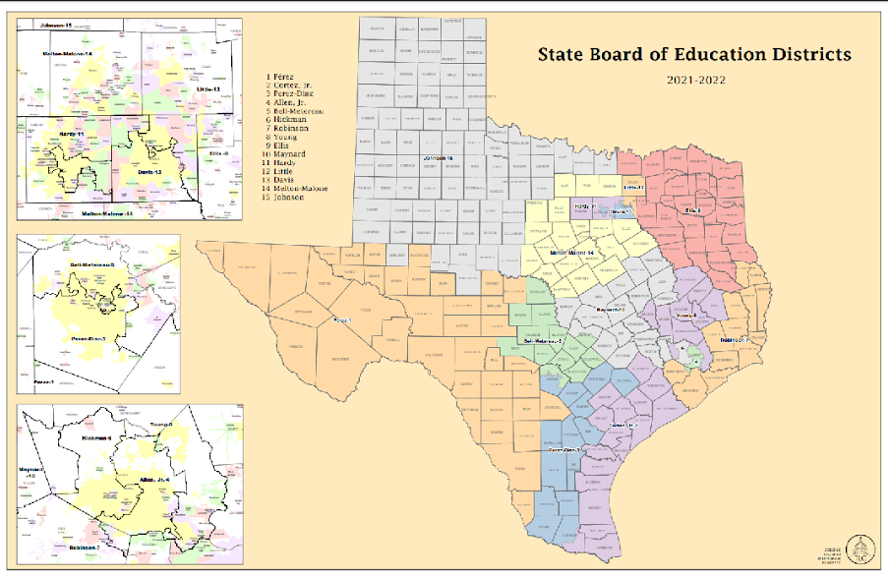
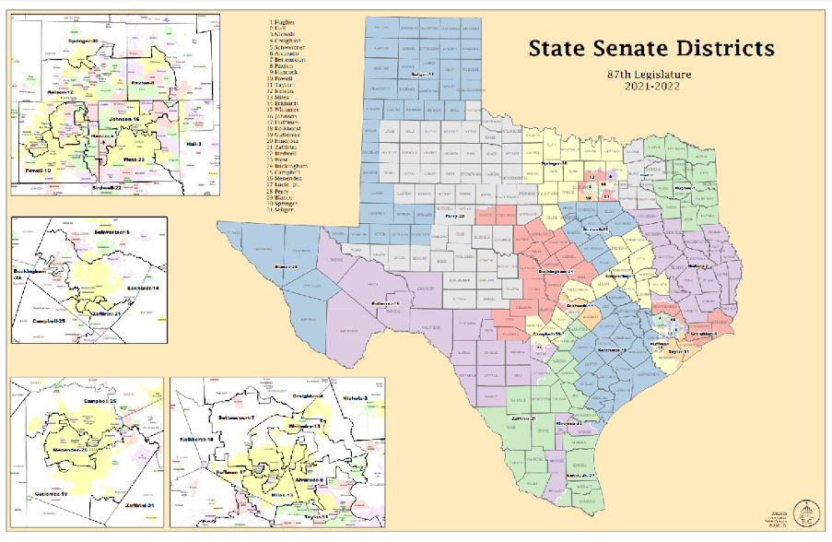
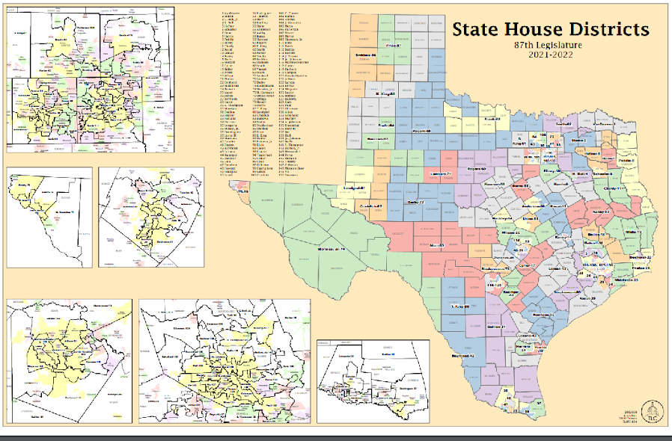
Congress
2011 Ideal Pop
698,488
2021 Ideal est.
754,574
SBOE
2011 Ideal Pop
1,676,371
2021 Ideal est.
1,933,059
Senate
2011 Ideal Pop
811,147
2021 Ideal est.
935,351
House
2011 Ideal Pop
167,637
2021 Ideal est.
193,306

Slide 17
SO HOW DO I GET INVOLVED?
Lt. Gov.
Comptroller
House Floor
Jurisdictional Committee
Conference Committee
Attorney General
GOVERNOR ABBOTT
Calendars Committee
Senate Floor
General Land Commissioner
Jurisdictional Committee
Speaker

Slide 18
REDISTRICTING RESOURCES
U.S. Census Bureau News Room - https://www.census.gov/newsroom.html
Texas Legislative Council’s Redistricting Website - https://redistricting.capitol.texas.gov/
Texas Comptroller Redistricting 101 - https://comptroller.texas.gov/economy/fiscal-notes/2020/jan/redistricting.php
The Brennan Center - https://www.brennancenter.org/issues/gerrymandering-fair-representation
National Council of State Legislatures’ Redistricting Page - https://www.ncsl.org/research/redistricting.aspx

Slide 19
QUESTIONS?
Bonnie Bruce, Director of Governmental Relations
Texas Society of Anesthesiologists
bonnie@tsa.org
512-633-0487

