Slide 1
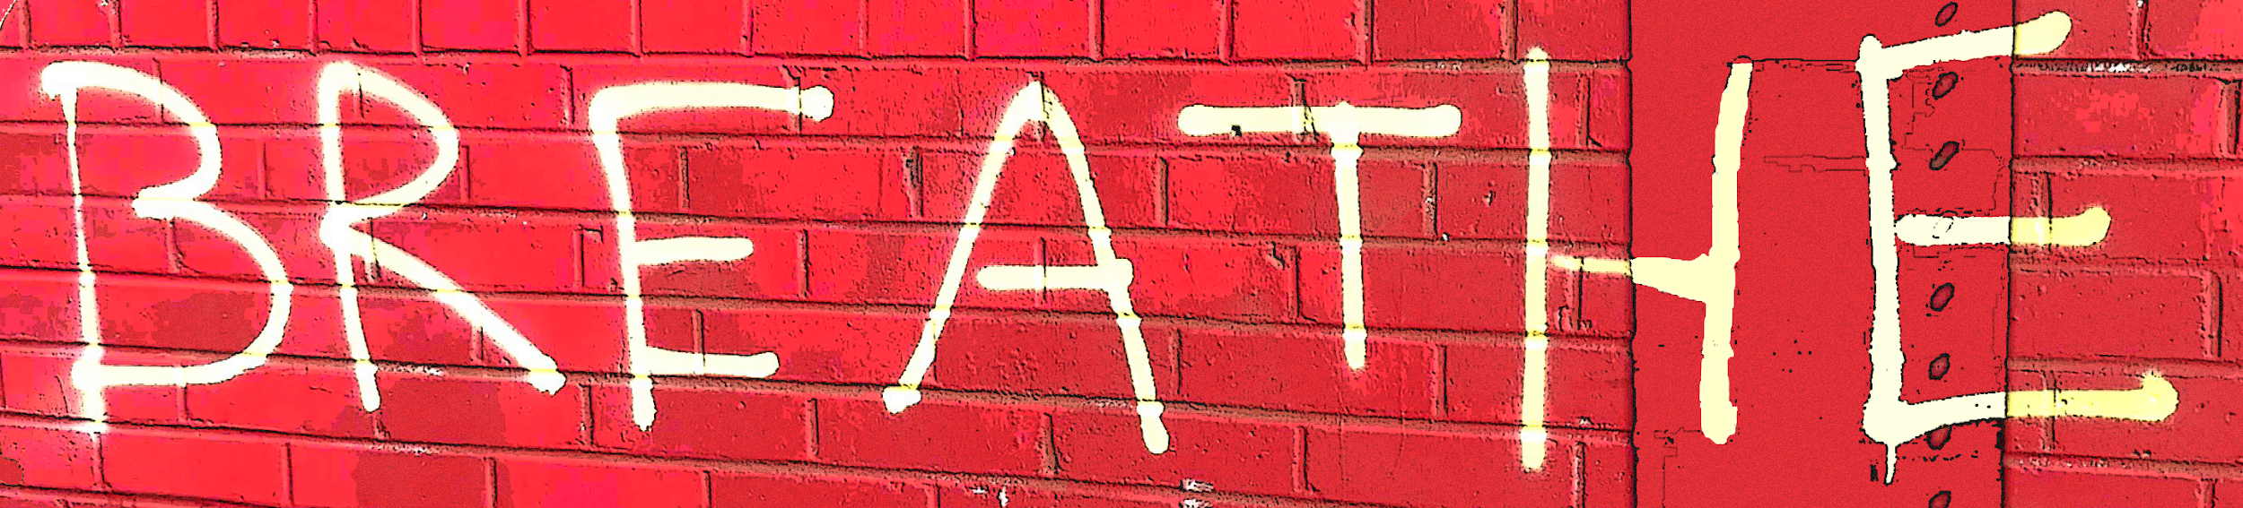



The 34th Annual Texas United Methodist Women’s Legislative Event
January 23-26, 2021
Presented by the Texas United Methodist Women’s Legislative Event Committee and Texas Impact

Slide 2
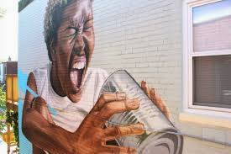
Creative Advocacy
Making Your Voice Heard From 6 Ft Away
While You’re Wearing a Mask

Slide 3
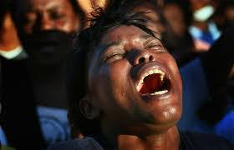
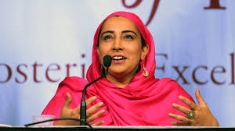
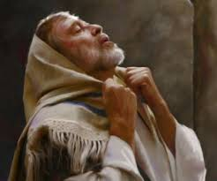
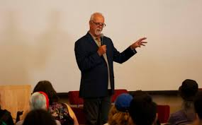

Advocacy means to “speak for”
Notes:
Using your voice to advance something you care about. Advocacy doesn’t mean trying to tear something or someone else down.

Slide 4
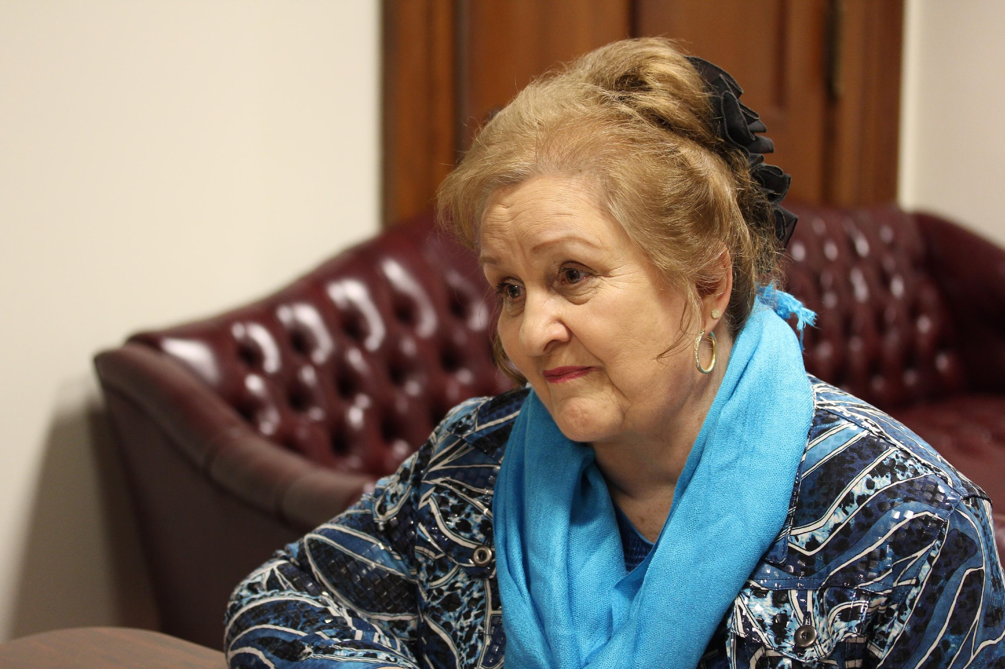
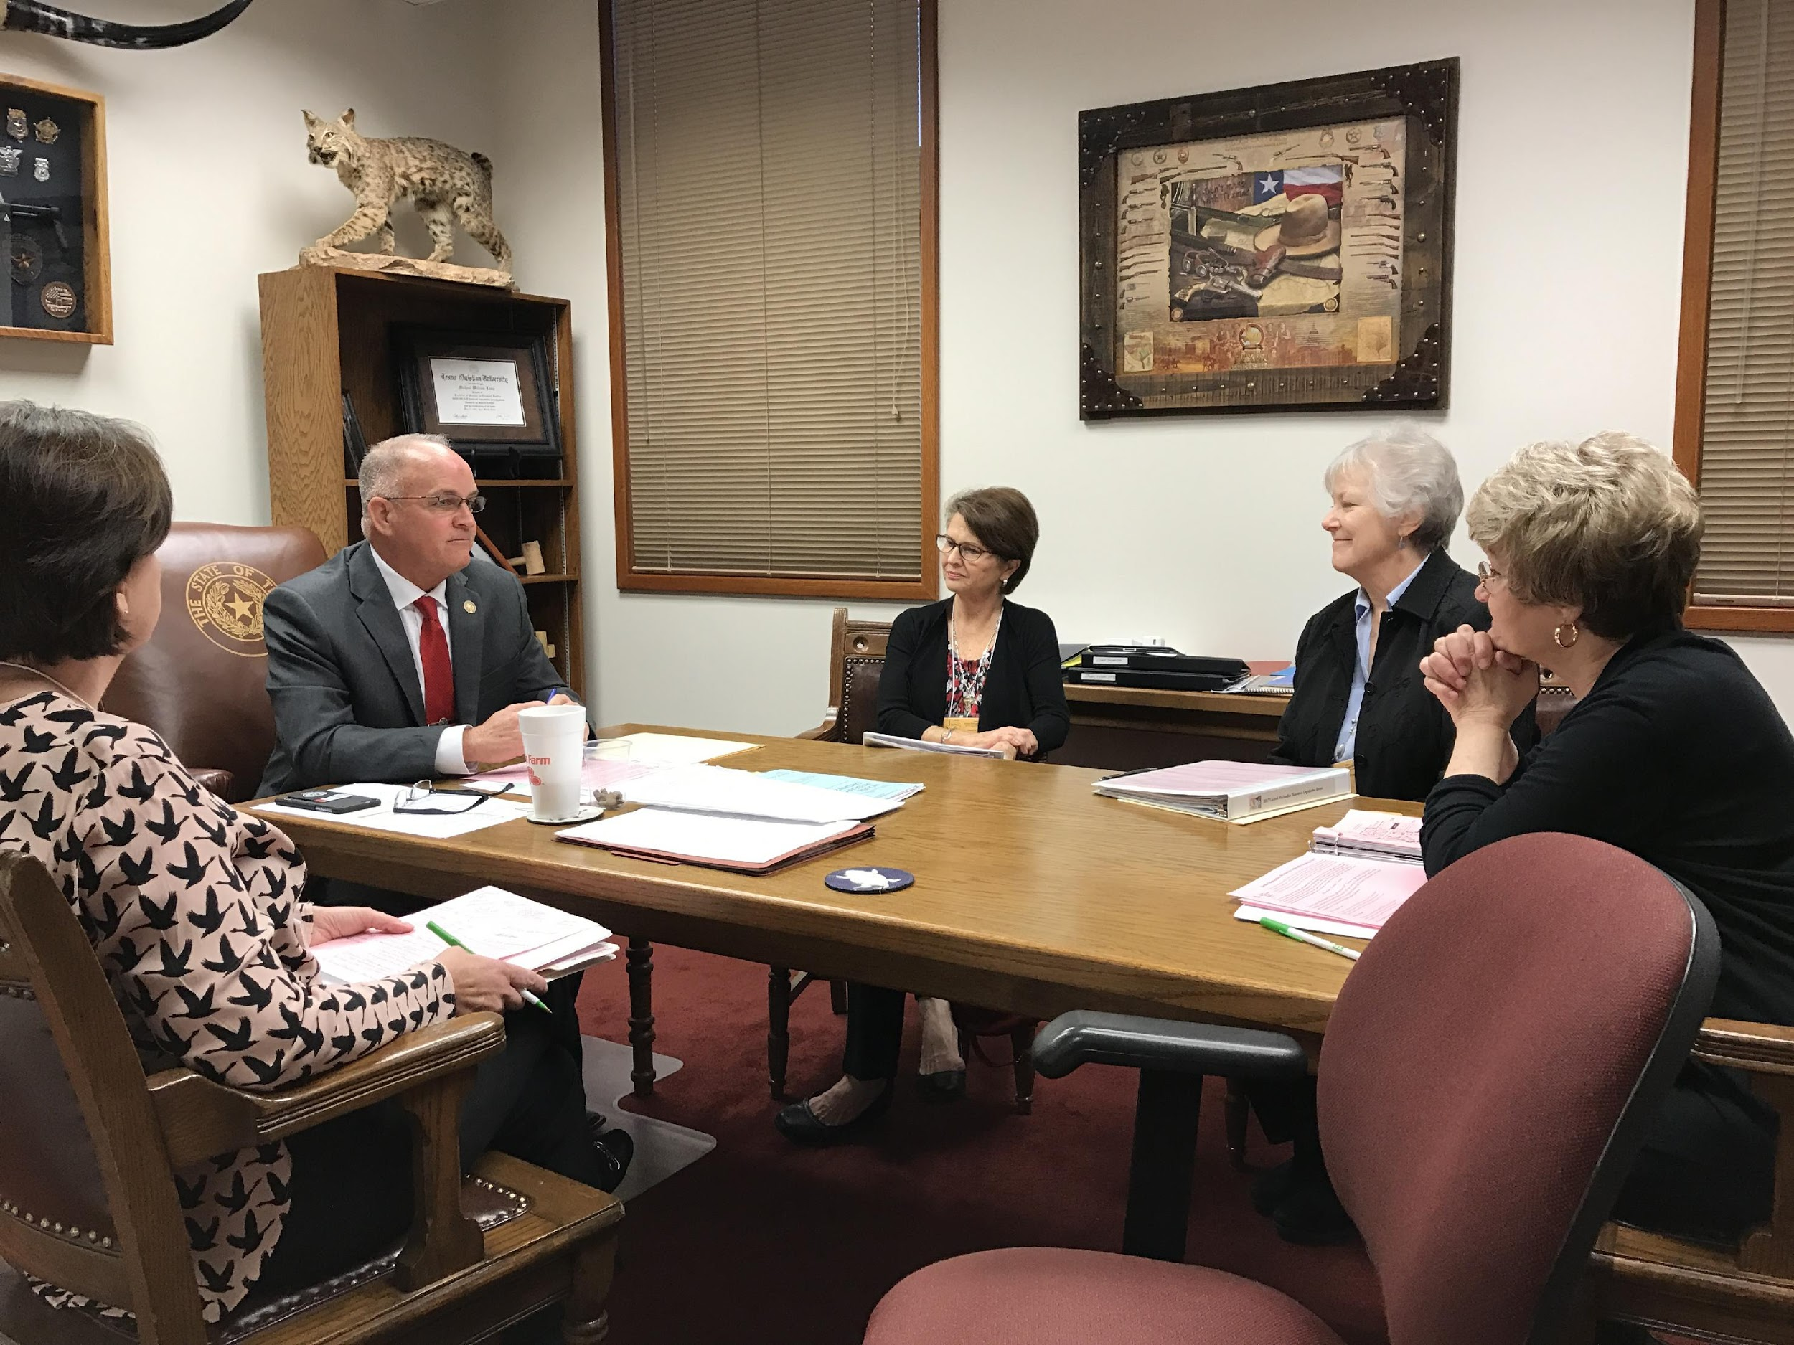
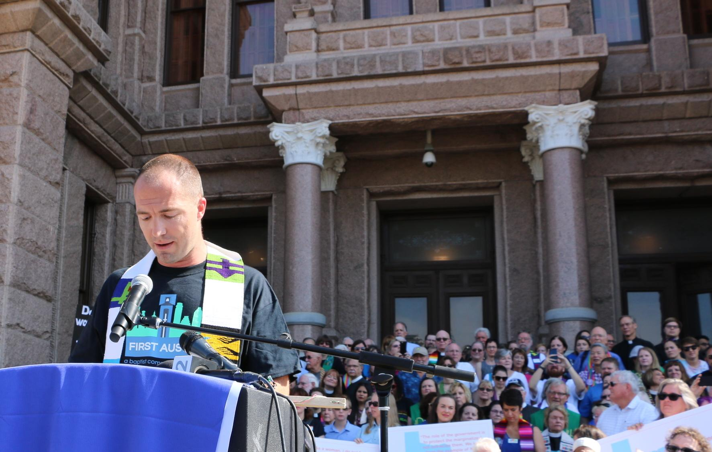
Policy Advocacy is speaking for particular kinds of policies.
Telling your story helps explain how policies impact real people.

Slide 5
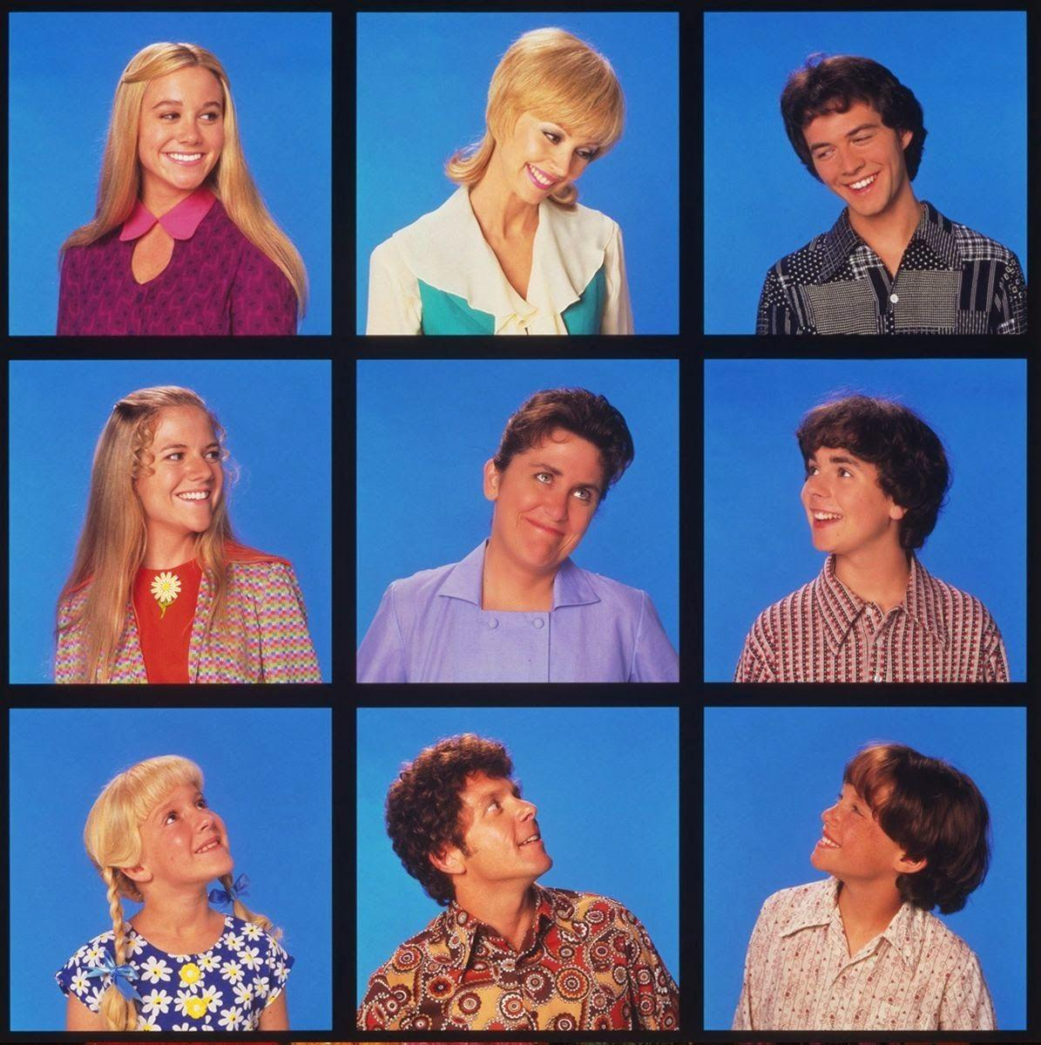
Congress
Federal
“The Hil”
The Branches and Levels of Government
Legislature
State
“The Pink Building”
School Board, City Council, County Commissioners
Local
Legislative
Executive
Judicial
Notes:
After 30 years in public policy I feel strongly: this is the crucial first step where people get it wrong.
Mail that comes to the wrong address, people who call you by the wrong name

Slide 6


Moving from Worry…
Hunger and Poverty
Public Budgets
Migration
Medicaid Expansion
Climate Change
COVID
Disaster Relief
…to Work
Notes:
With so many crises right now it can be tough to focus. We need to move “from worry to work.” That can be challenging. It’s especially tough when we can’t get together in person. Ways we are used to learning about our communities—like volunteering and doing group activities—are off-limits. And ways we are used to advocating—like going to the Capitol—are, too. What are we supposed to do?

Slide 7
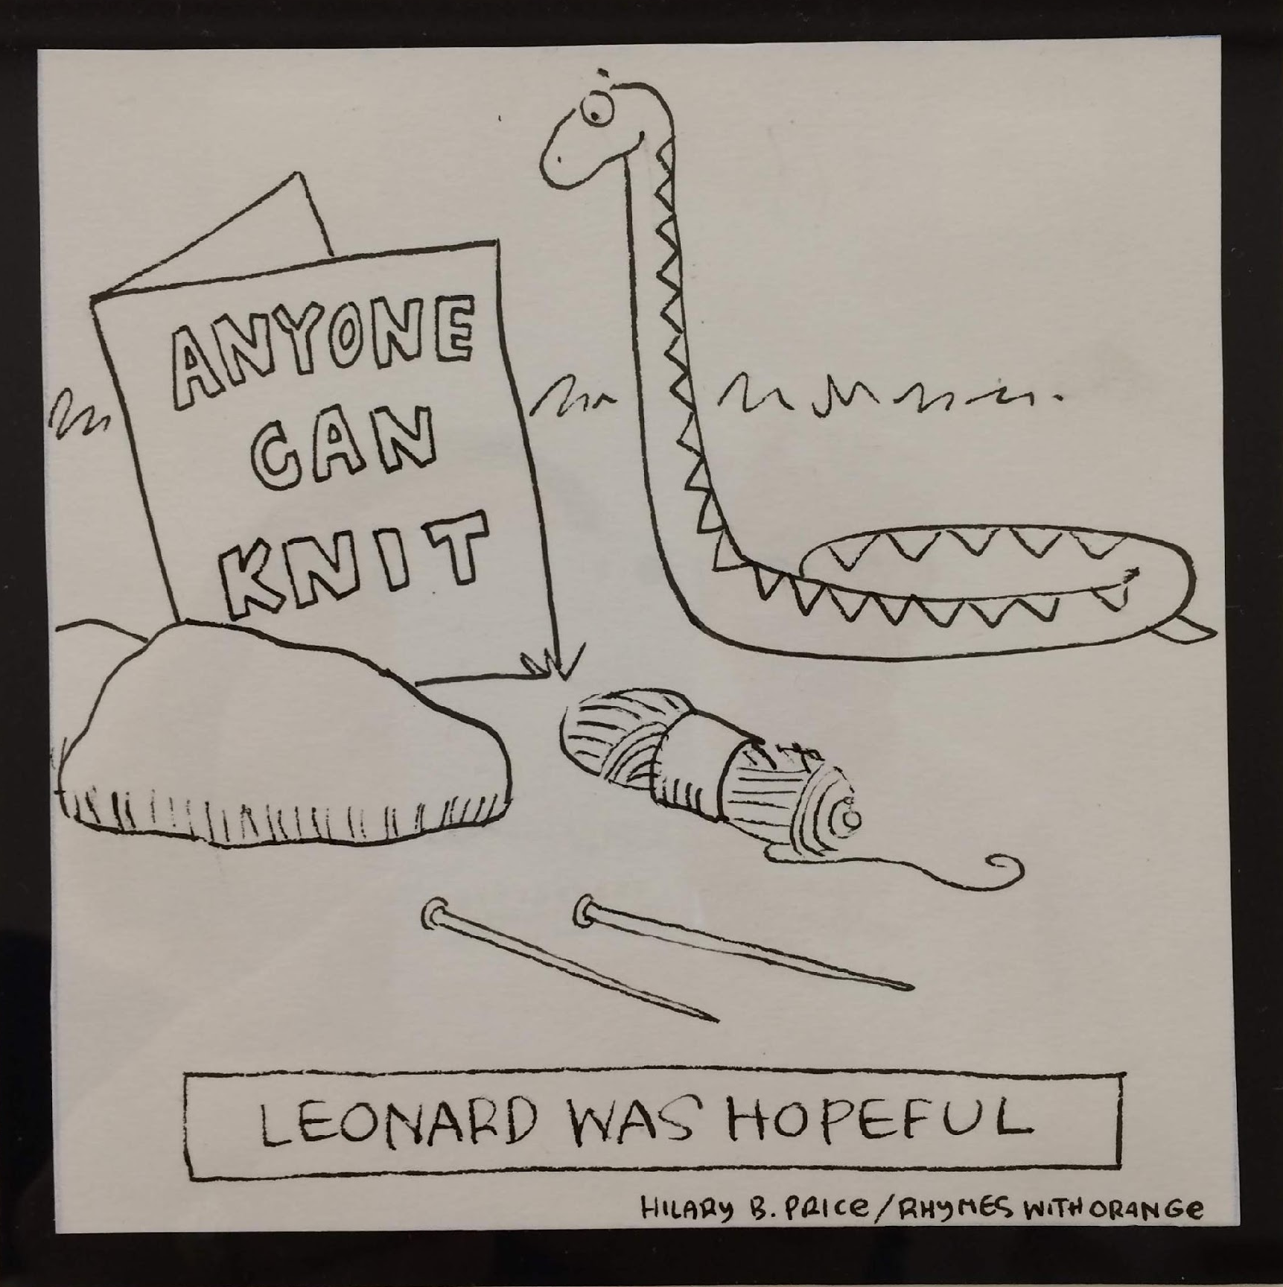
Getting Creative

Slide 8

Creative Advocacy
Capitol visits
Rallies
District visits drop-offs
Phone calls
Social media
USPS
Zoom
“Normal” Advocacy
Capitol visits
Rallies
Public meetings
District visits
Phone calls
Social media
USPS

Slide 9
Social Media
Facebook—where your friends are
Instagram—where your kids and grandkids are
Twitter—where your lawmakers are
TikTok—a black hole from which you will never return

Slide 10
Advocacy on Facebook=Sharing
Share news
Share events
Share stories and experiences
Share helpful information
x Get a lawmaker’s attention
x Change someone’s mind

Slide 11
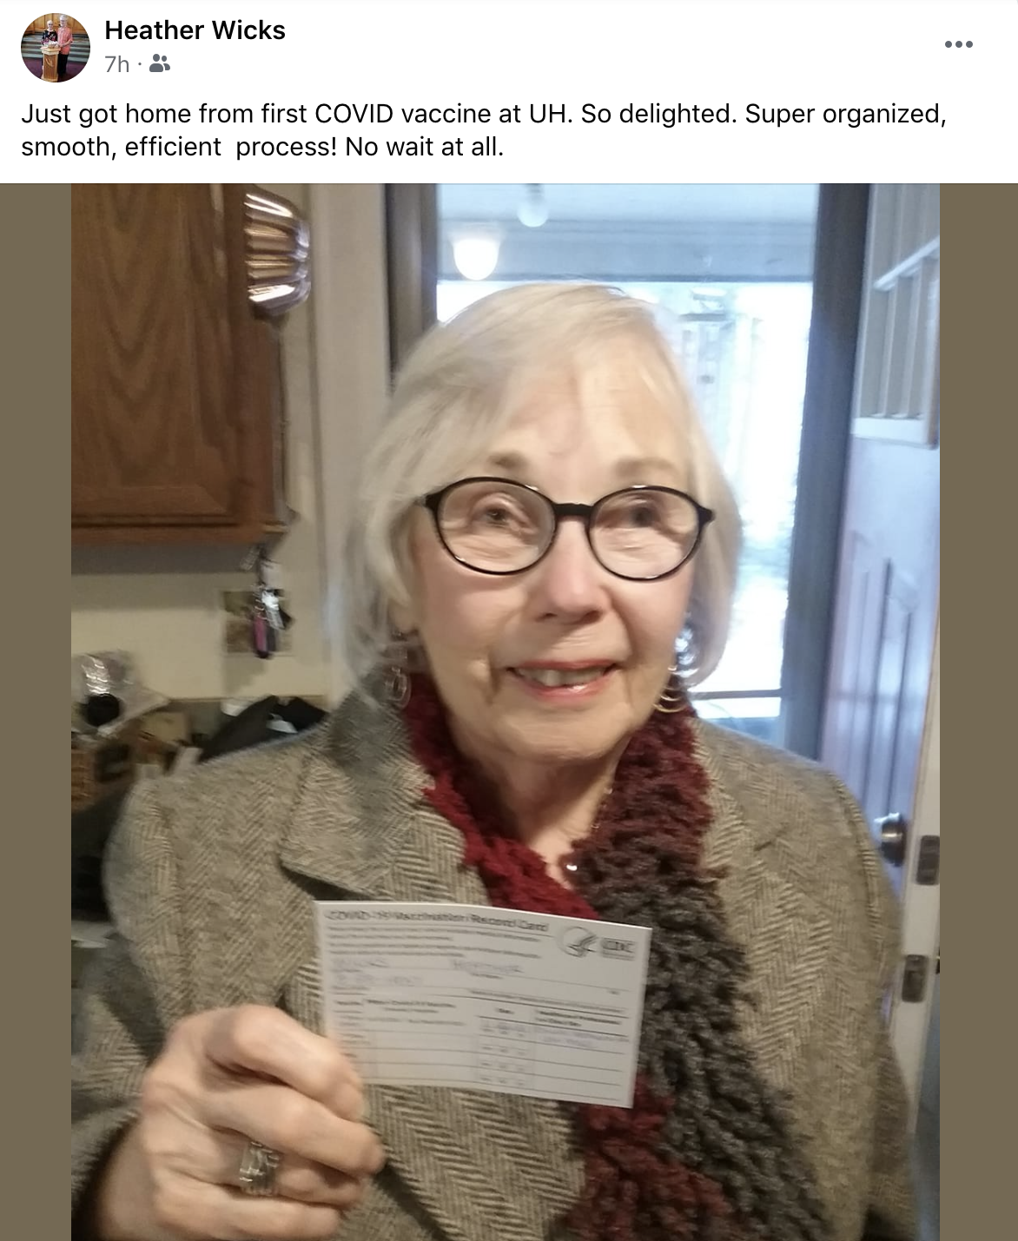
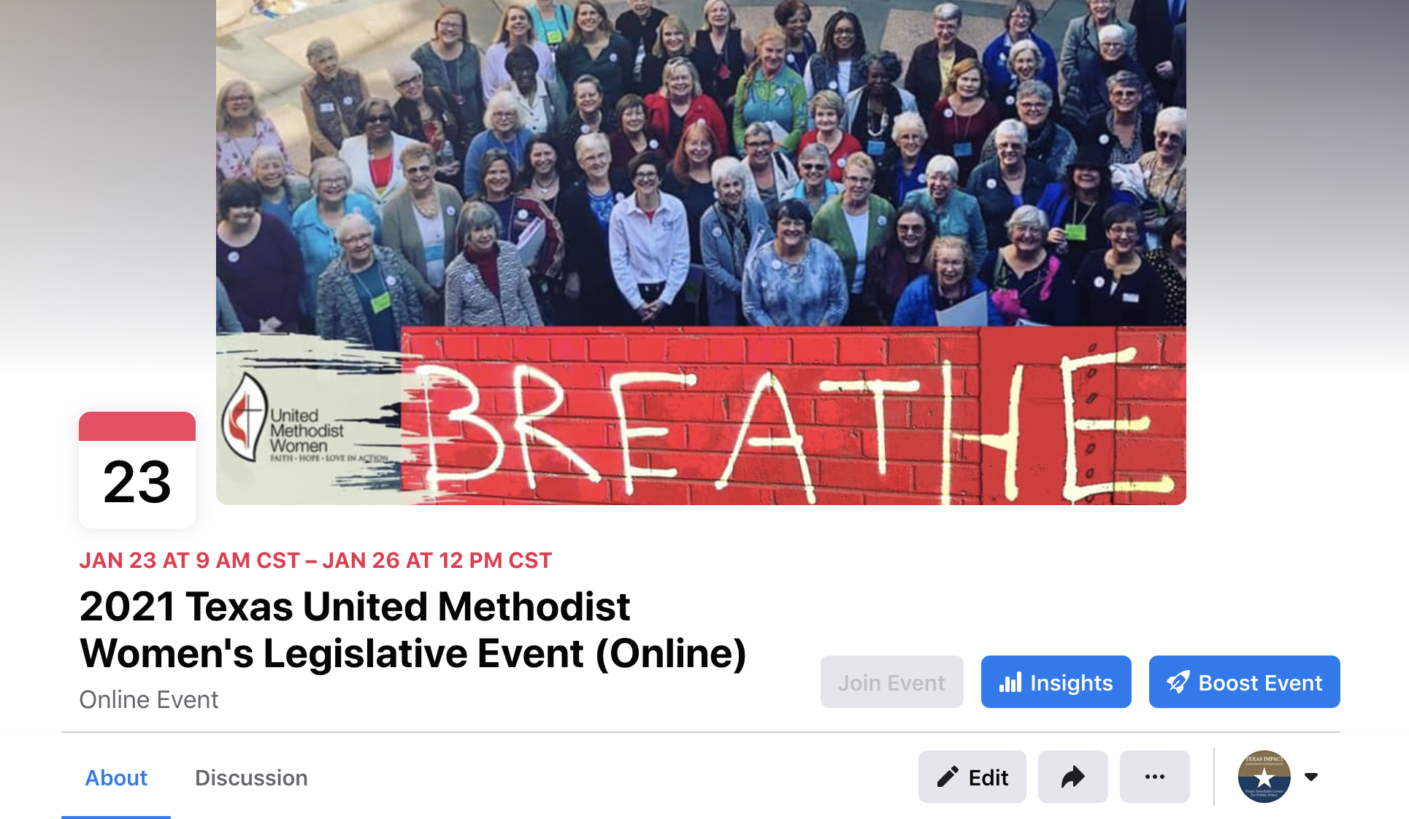
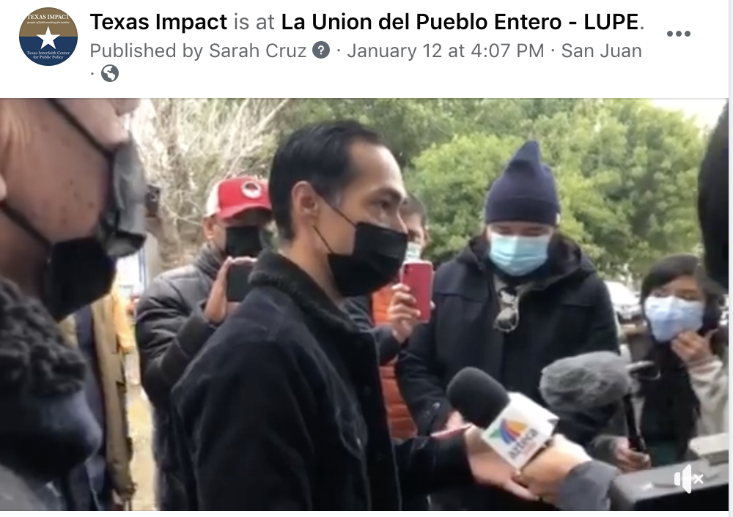

Slide 12
Advocacy on Instagram=Showing
Showing an event or activity
Showing a digital space
Showing a story
Showing an example
x Get amplified by media
x Get confirmation of your impact

Slide 13
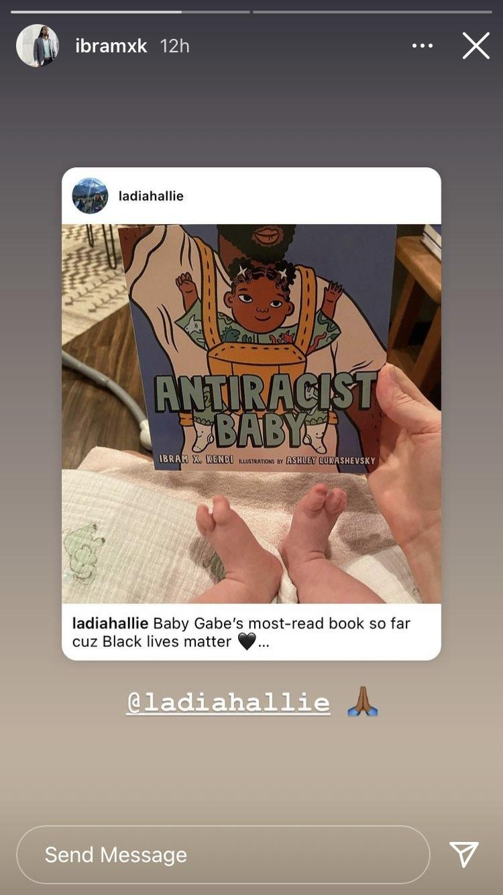
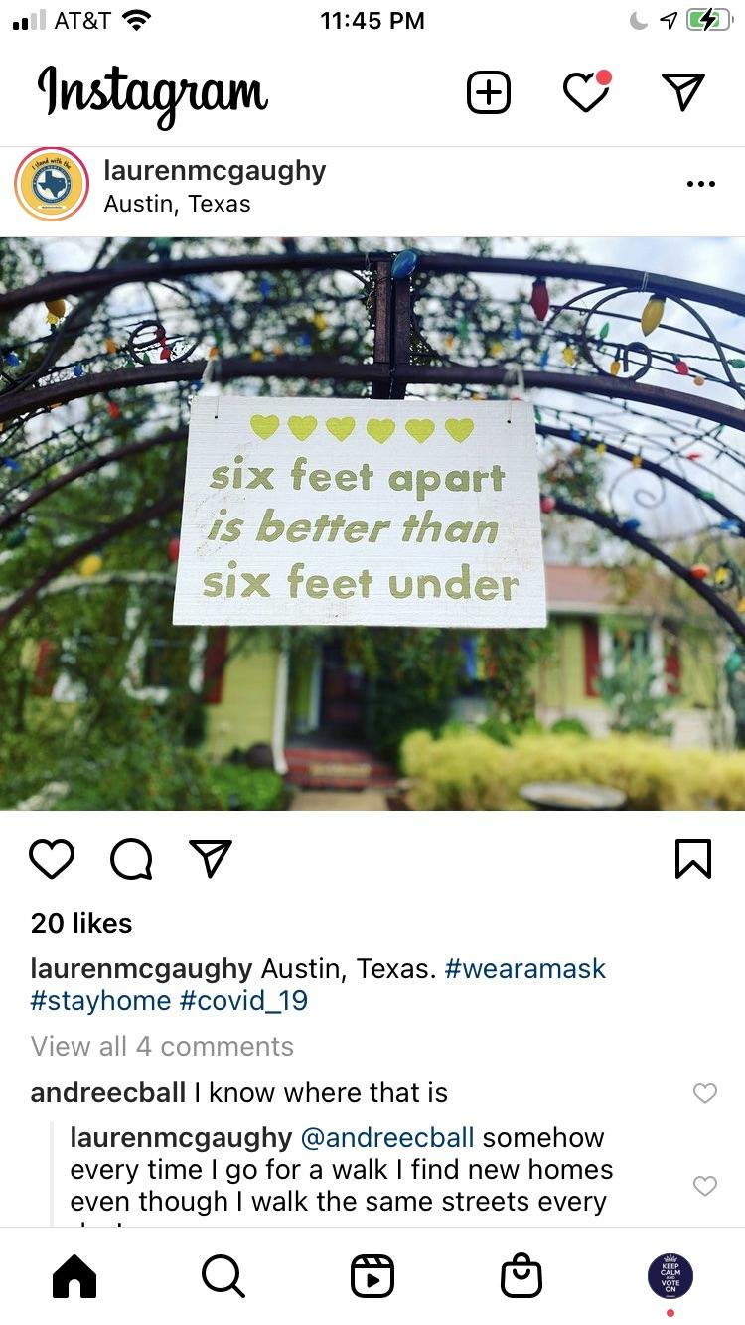
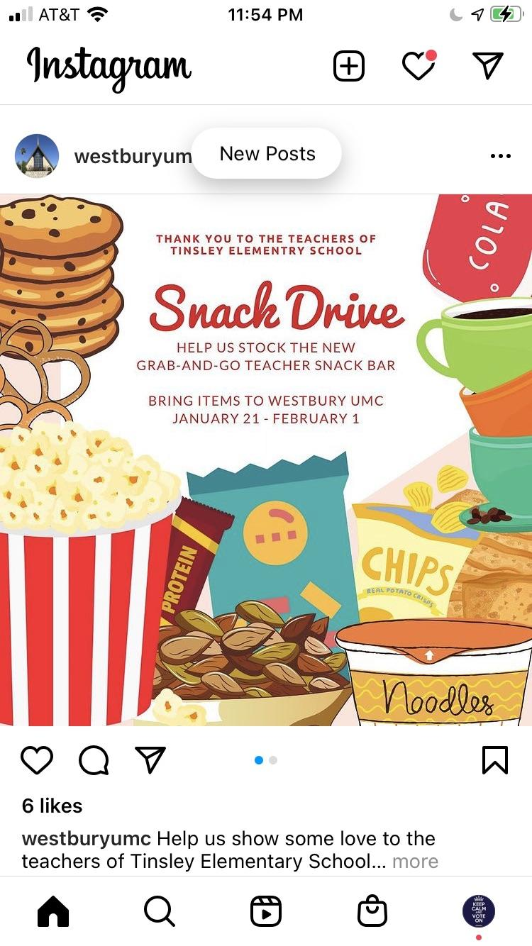

Slide 14
Advocacy on Twitter=Informing
Informing lawmakers
Informing media
Informing businesses
Informing colleagues
Informing opponents
Informing organizations
Informing influencers
x Get it wrong
x Get in fights

Slide 15
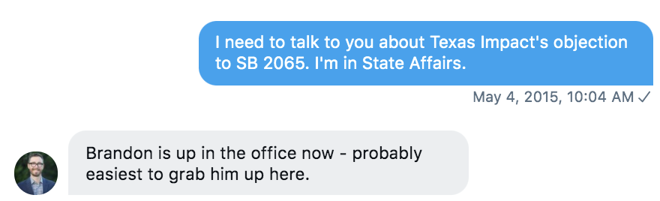
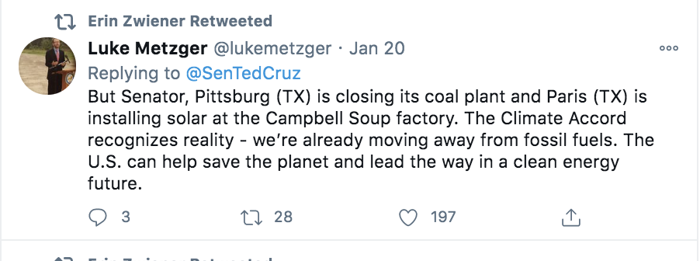
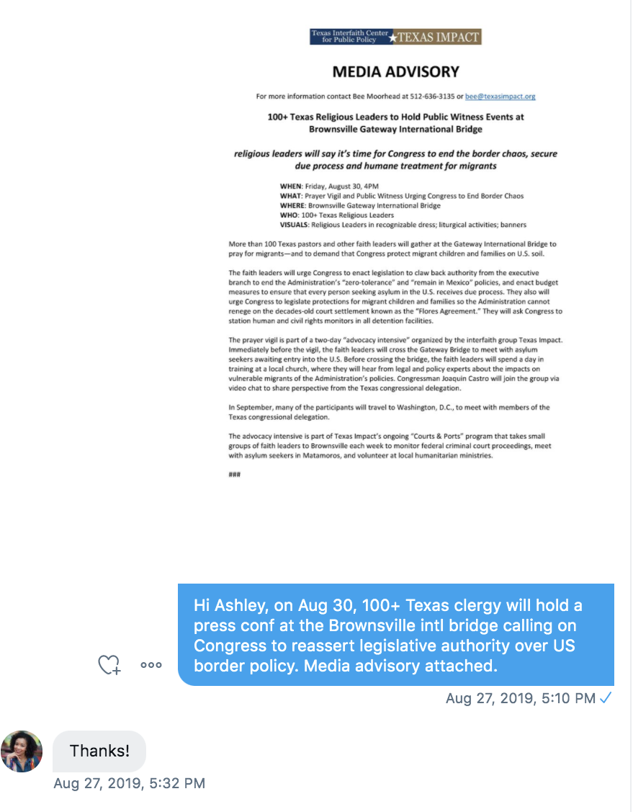
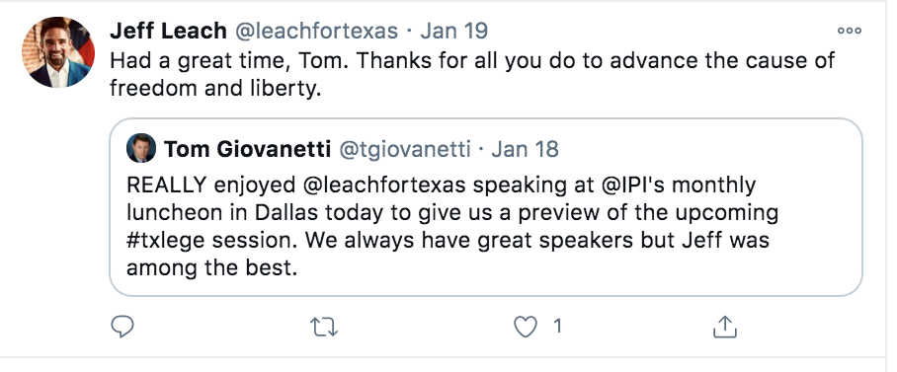

Slide 16
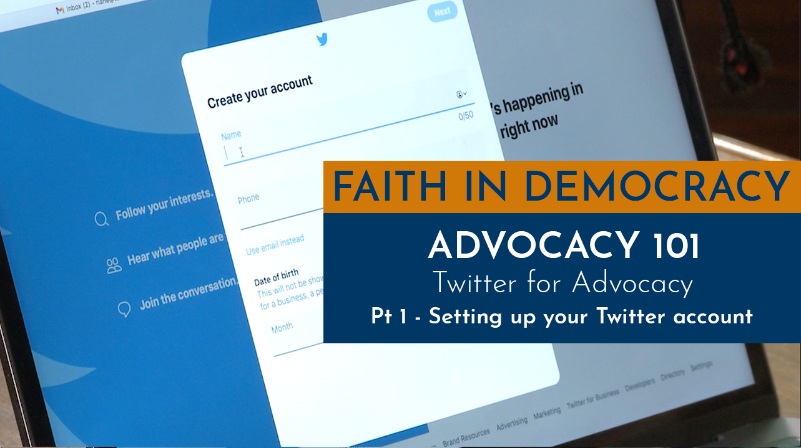
Twitter Will Not Hurt You

Slide 17
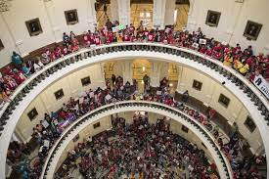
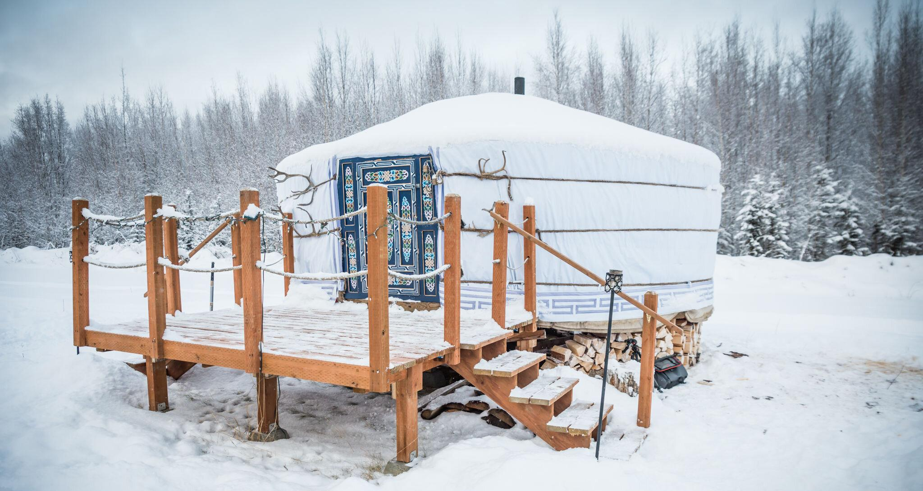
District Drop-Offs

Slide 18
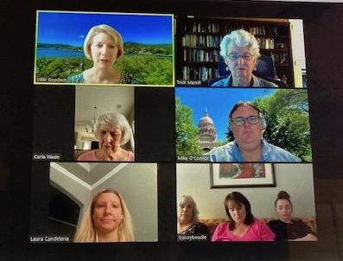
Zoom
Actual legislator

Slide 19
Thank you!
Q&A

