Slide 1

Advocacy for the Immigrant— a New Administration, an Ongoing Challenge.
Michael Seifert, ACLU of Texas, Ports and Courts Co-Founder
Deacon Cindy Johnson, Volunteer at the Matamoros Asylum Camp
Rochelle Garza, ACLU of Texas, Staff Attorney
Dr. Marsha Griffin, M.D., Community for Children

Slide 2
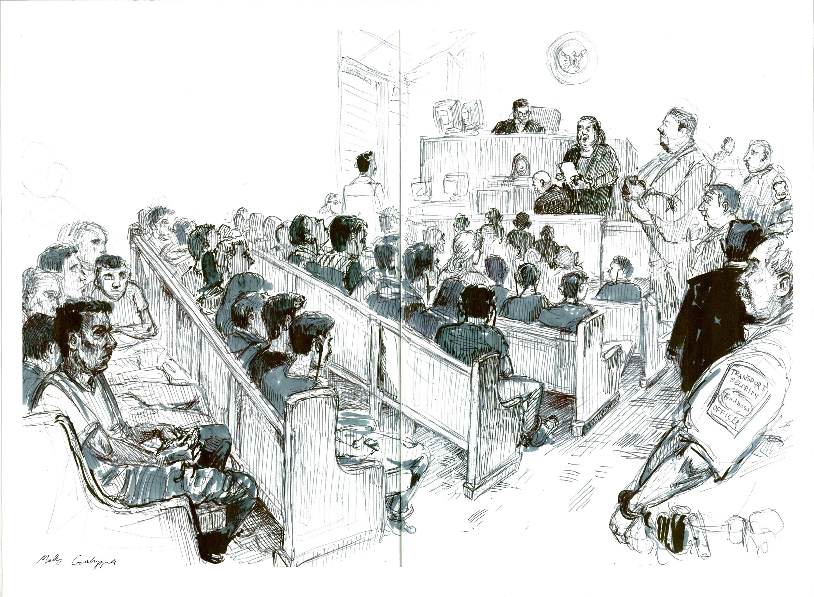
ACLU of Texas/Texas Impact Ports and Courts
Michael Seifert, ACLU of Texas,
Ports and Courts Co-Founder

Slide 3
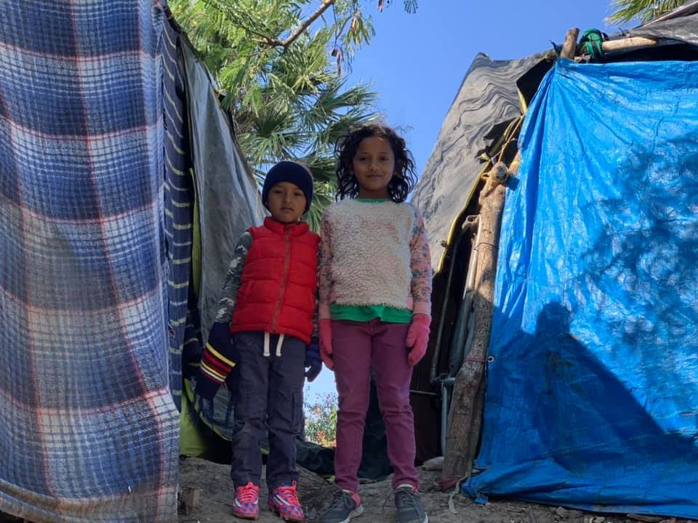
The Asylum Seekers’ Camp,
Matamoros,Mexico
Deacon Cindy Johnson, Volunteer,
Matamoros Asylum Camp

Slide 4
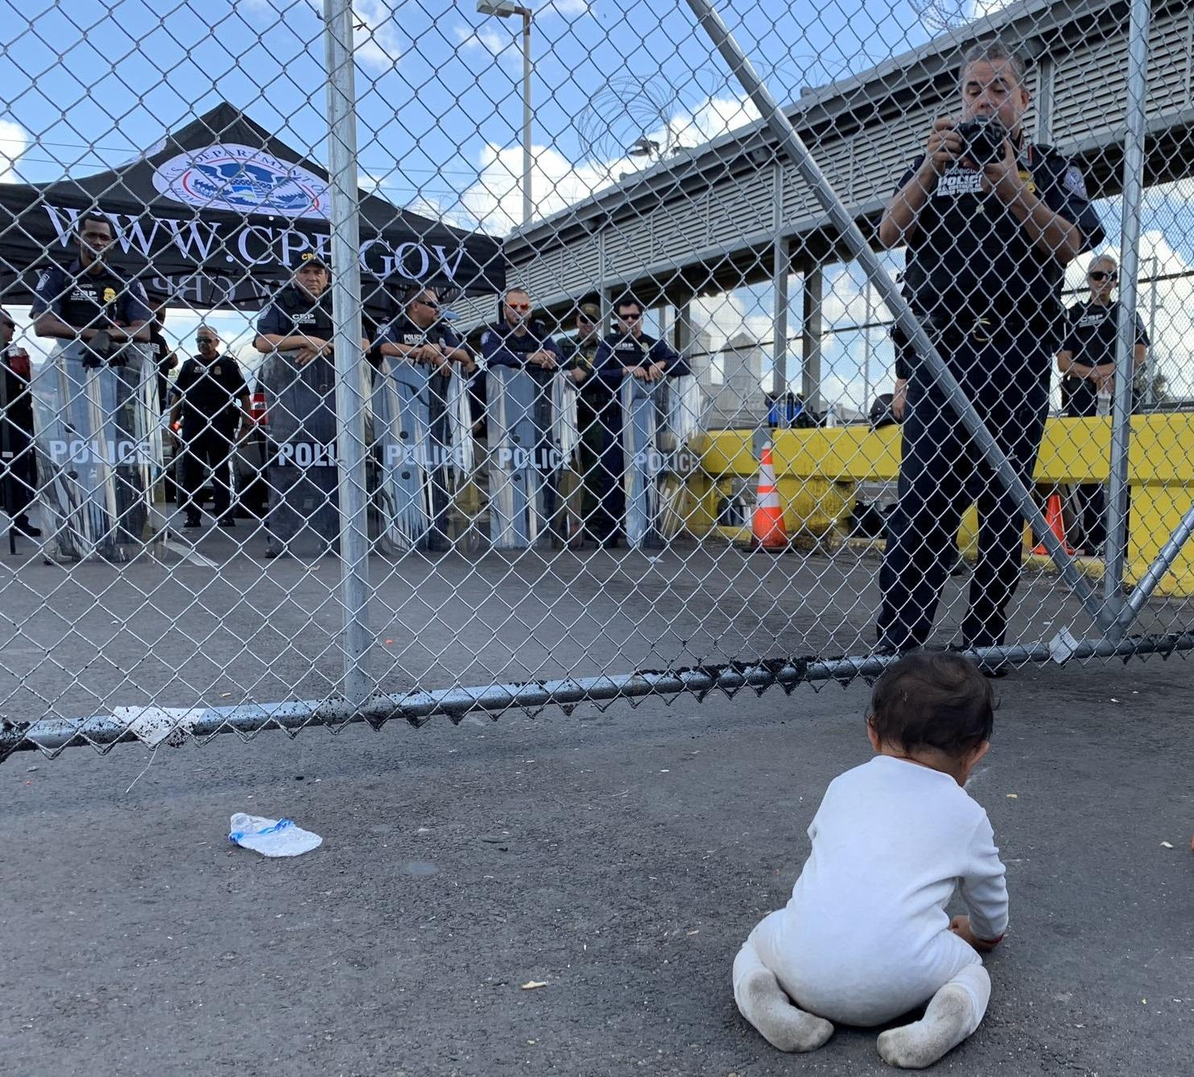
It is Not Enough to Undo Trump
Rochelle Garza,
ACLU of Texas, Staff Attorney

Slide 5
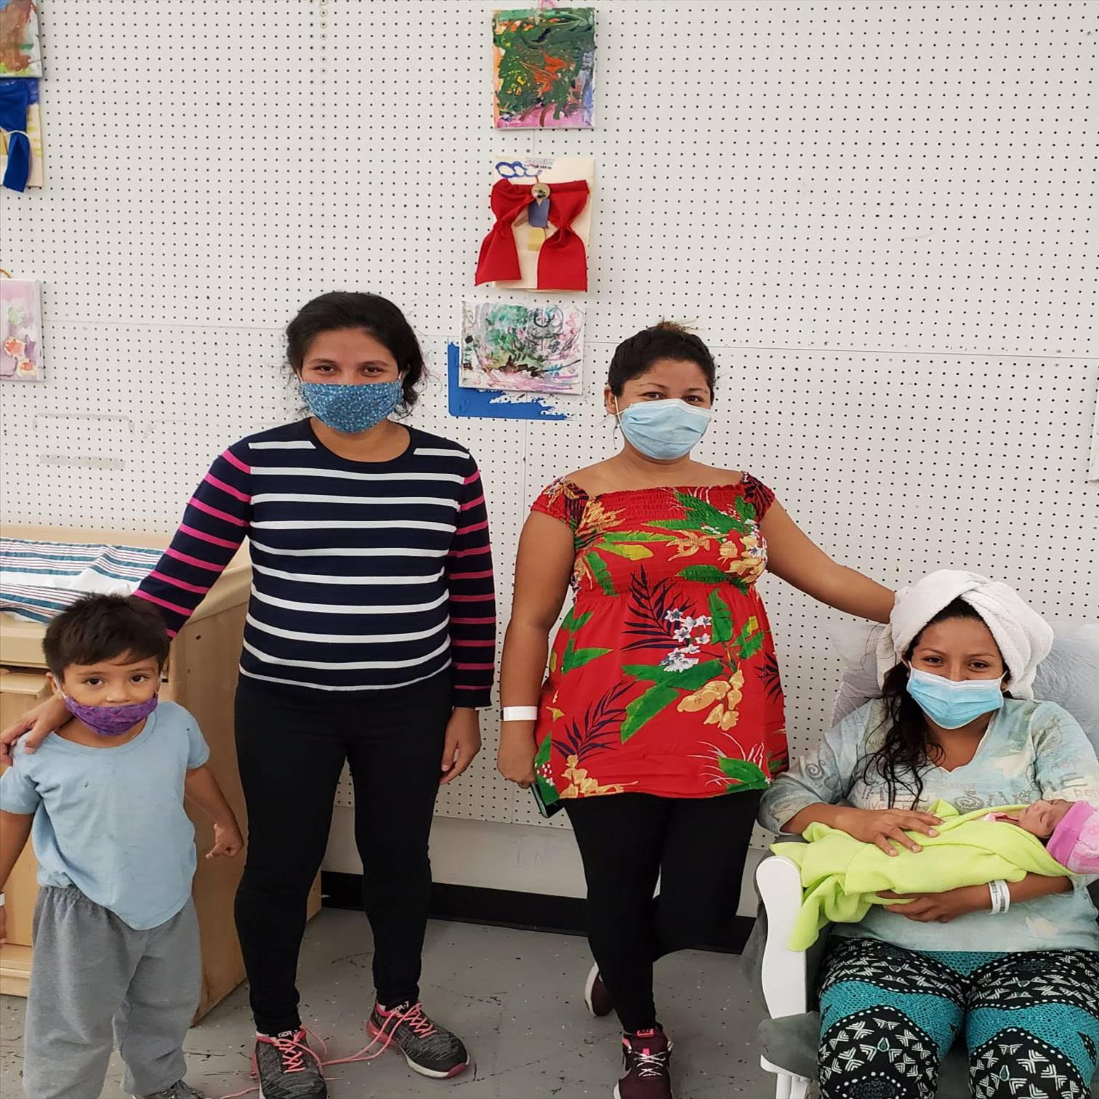
“What then should we do?”
(Luke 3: 10)
Dr. Marsha Griffin, M.D.
Community for Children

